Slide 1
Lesson Twenty:
Monitoring Rangelands

Slide 2
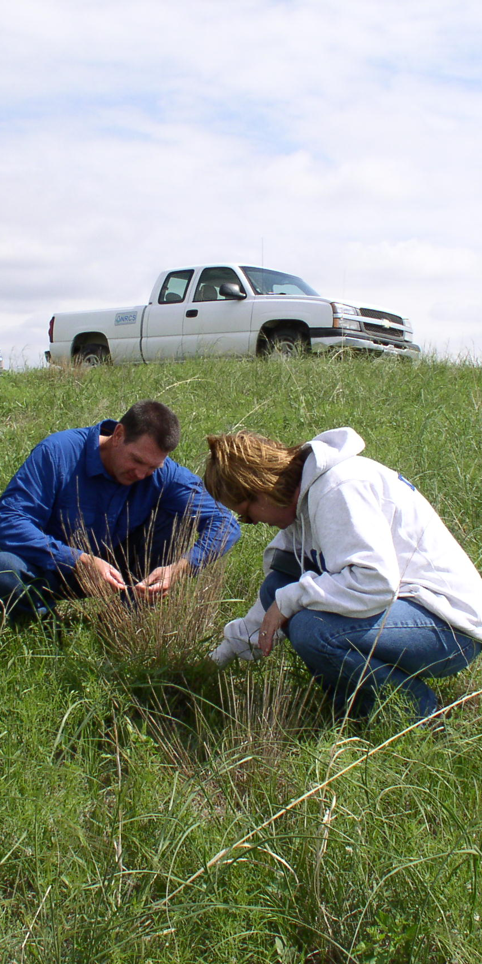
What is Monitoring?
Monitoring is the collection and analysis of repeated observations or measurements. This data is used to evaluate progress toward meeting management objectives and goals.
Monitoring is based upon samples of a population. The item being measured or observed will depend upon the goals and objectives for the ranch.
Monitoring is used to determine the trend of a resource. Trend refers to the direction of change. When monitoring rangeland, data is collected at different points in time at the same location and the results compared to detect the change in direction.
Monitoring is the basis for changing a management strategy in order to meet objectives.
Photo: Plant identification is an important part of monitoring.

Slide 3
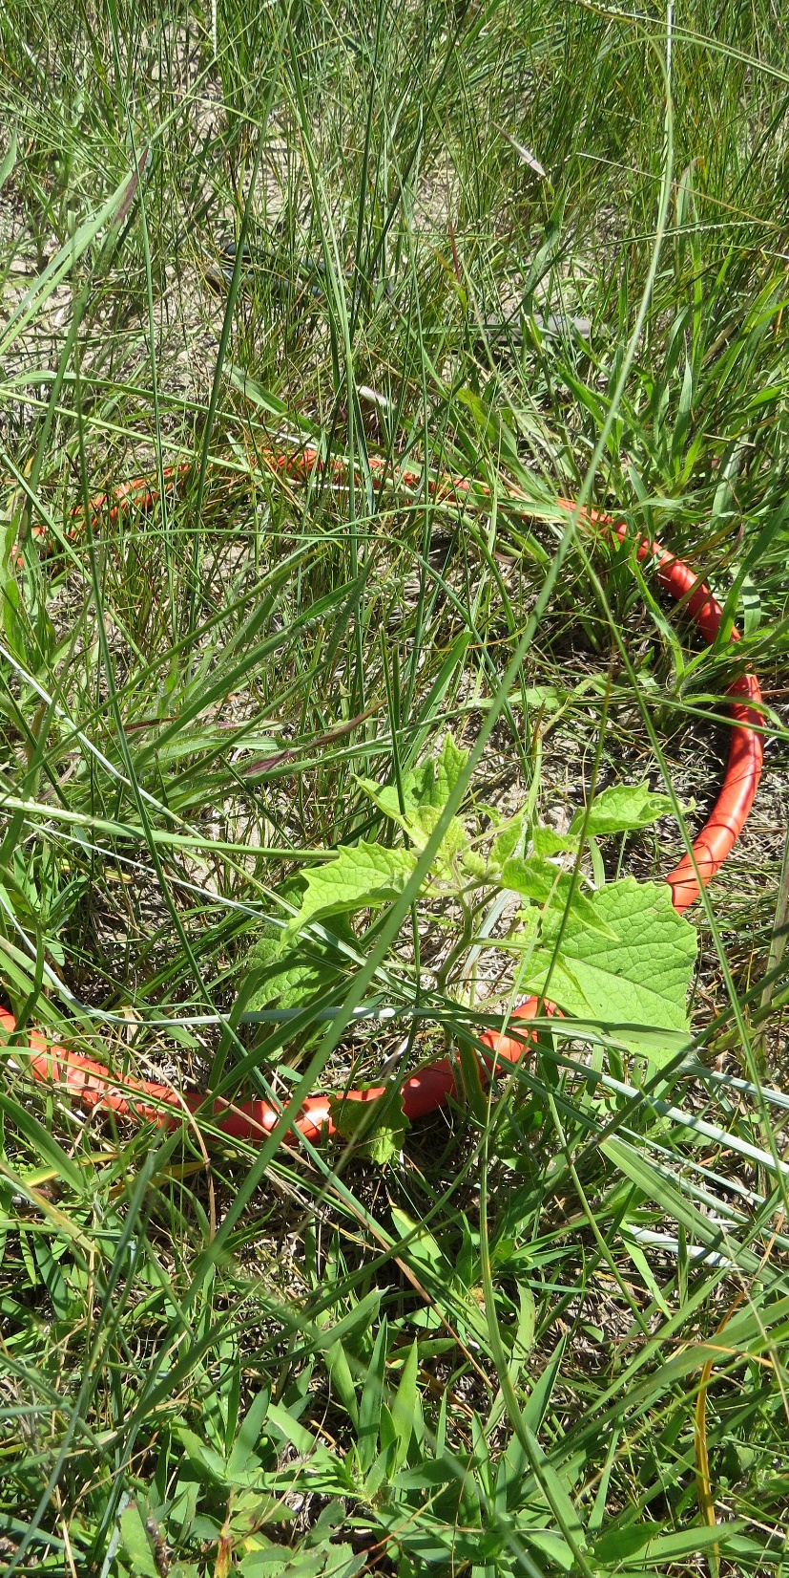
Selecting Monitoring Areas
Several monitoring areas should be selected across the grazing unit. The number and location will depend upon the size of the unit, variability of the vegetation, and the management objectives. Monitoring sites may be key areas or critical areas.
Key areas represent what is happening on the majority of the unit due to management. The soils, ecological site, plants, and topography should be similar to the majority of the land unit. Key areas should be away from water locations, fence lines, areas where animals concentrate, and/or areas that are rarely grazed. Key areas should be located within one ecological site and plant community.
Critical areas are evaluated separately from the rest of the unit. Critical areas contain special or unique areas. A prairie chicken booming ground, a degraded riparian area, or a blowout area examples of critical areas..
Key species within the key areas are often selected as indicators of change. A key species can be a desirable species that is targeted for increase in the management plan or an undesirable plant that is targeted for decrease in the plan.
A permanent marker, such as a short steel or PVC reference post, and/or GPS coordinate should be used to identify the location of the monitoring areas.
Photo: Clipping frame used for production monitoring. The location was selected because it was on the dominant ecological site and plant community for the pasture being monitored.

Slide 4
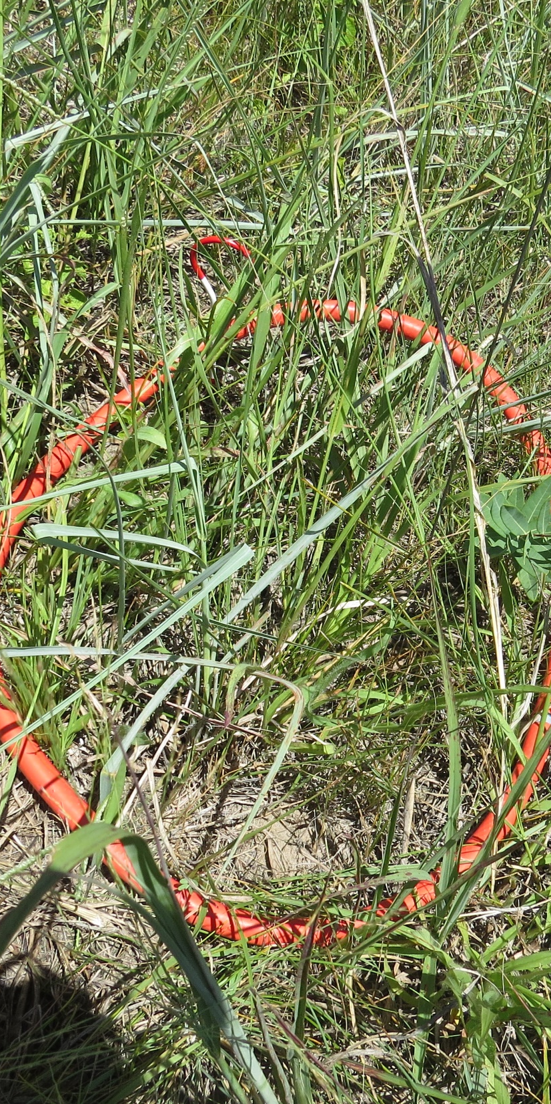
Vegetative Attributes Commonly Monitored
The most appropriate monitoring methods will depend upon the desired changes to the plant community.
The most common items monitored in rangeland systems are:
  Frequency
  Cover
  Density
  Production
  Structure
  Composition
Photo: End of season production represented by this plot is approximately 1900 pounds per acre. Production was measured by the harvest method.

Slide 5
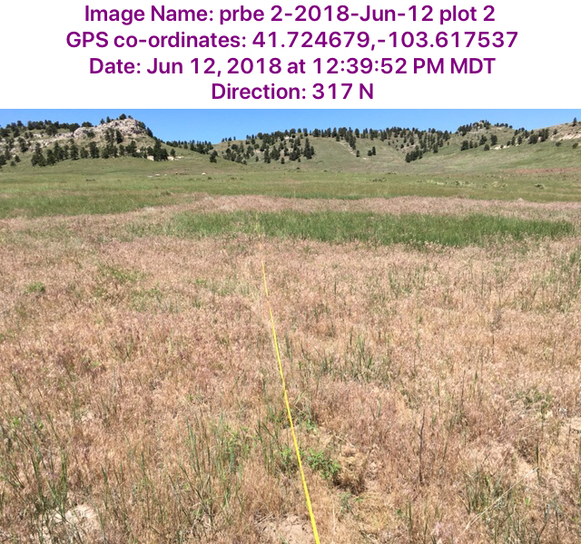
Photo Monitoring
Photo monitoring is a qualitative method to illustrate changes in the plant community Photos taken at key areas are an effective visual method for documenting change and rate of change.
Photos are taken at each key area. A landscape photo should be taken the same time of year on a regular basis (annually, every other year, every 5 years, etc.). A recognizable landmark should be in the background to ensure that the photo is taken along the same direction each year. A photo looking down at the vegetation is taken in the same location.
University of Nebraska-Lincoln has developed an app to assist with photo monitoring. GrassSnap stamps the photo with GPS location, bearing, time, date and image name. When returning to the key area, the app provides a shadow feature to assist the user in lining up the shot in the same direction as the original photo.
Photo: Photo taken using GrassSnap. One of the objectives for this ranch is reducing the amount of cheatgrass present. Annual photo monitoring will be helpful in determining if the objectives are being met.

Slide 6
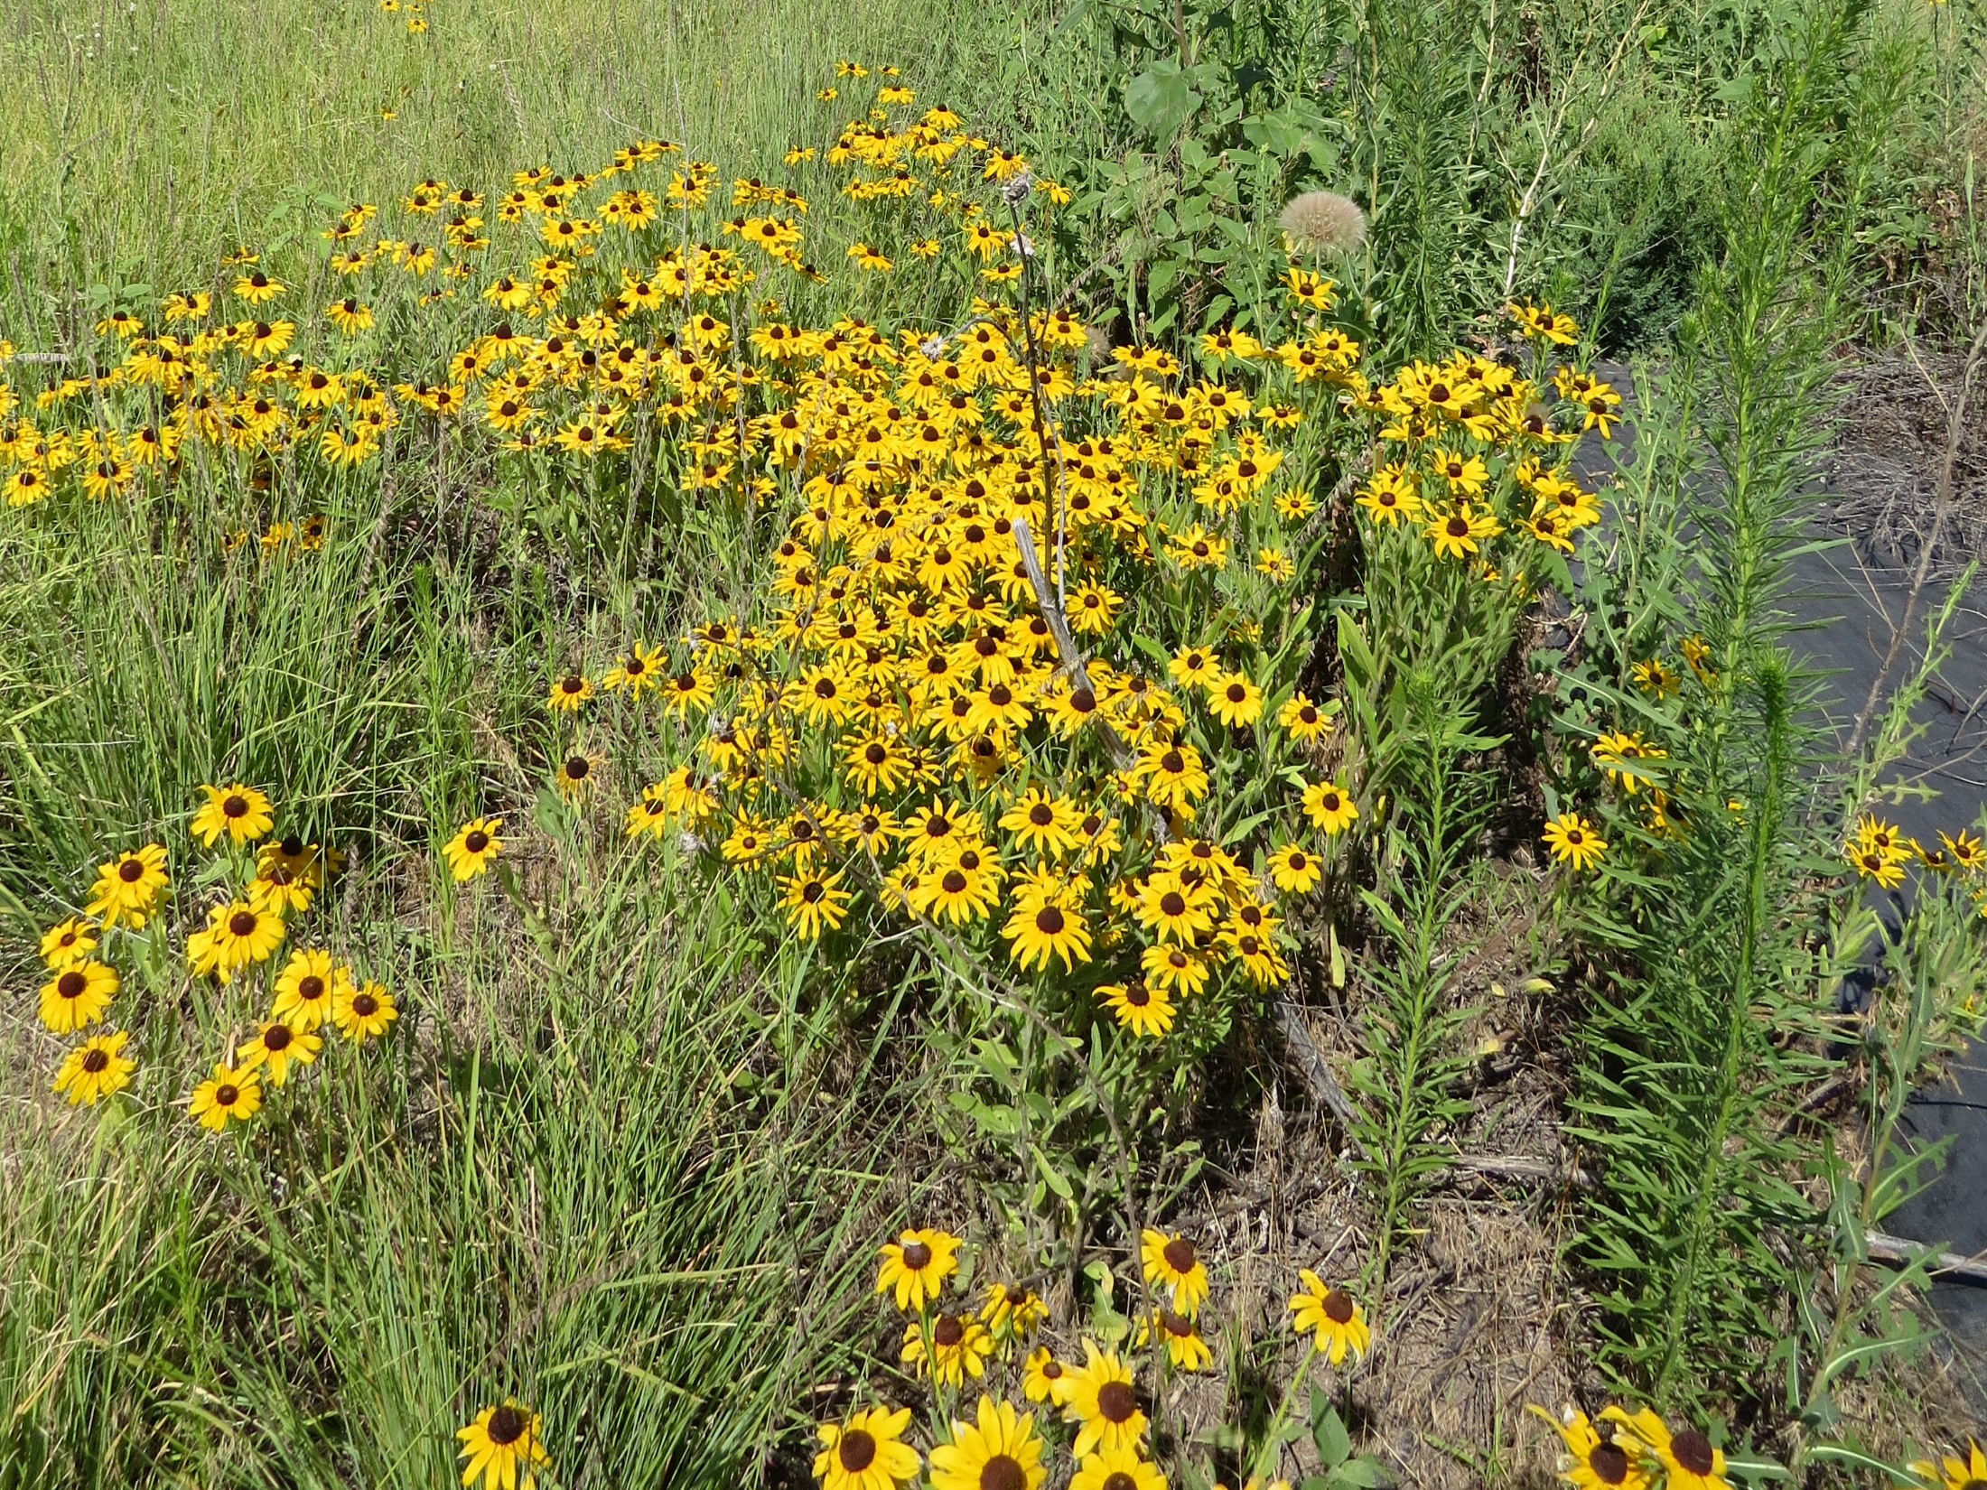
Frequency
Frequency describes the abundance and distribution of a species and is used to detect changes in the plant community over time.
The frequency method is one of the easiest and fastest monitoring methods. Frequency is the number different plant species that occur in a given number of sampling units, A number of quadrats (sampling areas or plots) are sampled. The individual species occurring in each plot is recorded. This number is compared throughout the years of sampling.
Frequency is quick, highly repeatable, and sensitive to changes in distribution. The accuracy of this method depends upon the size of the quadrat and the number of quadrats sampled.
Frequency can be used to measure changes in species richness which is the number of different plants that occur in an area. The data collection could easily be modified to include species diversity which measures the evenness of occurrence.
A plant community with 30 different species has high species richness. If most of the individual plants are of one or two species, then the diversity is low. If each species consisted of 5-6 individuals, then the diversity is high.

Slide 7
Frequency Using Nested Frequency Plots
When using the frequency method to evaluate vegetation, it is difficult to know what plot or quadrat size is the best to use. The plot size should result in the plants occurring in 20-80% of the plots. A small plot size is needed to measure frequency of very common plants and a large plot size is needed to measure uncommon plants. As the plant community changes over time, the right plot size will also change.
To overcome the right size problem, the nested frequency plot method is used. With this method, 3-4 different plot sizes are observed at the same location.
The example to the left shows a nested frequency plot layout. Plot 1 is the small square outlined in green, Plot 2 is the larger square outlined in the blue dashed line, Plot 3 is the rectangle in red and the large square is outlined in yellow. Since the plot sizes are nested, data collection for plants with large differences in frequency is quick and easy.

Slide 8
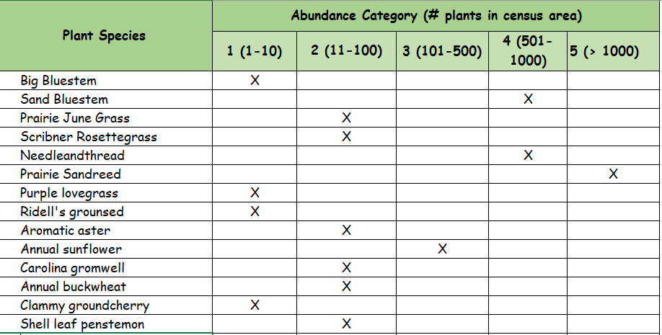
Frequency using Plant Census Method
A variation of frequency method is the plant census. In addition to presence in the quadrat, the relative abundance on a scale of one to five for each species is recorded.
Plant census measures species richness and species diversity.

Slide 9
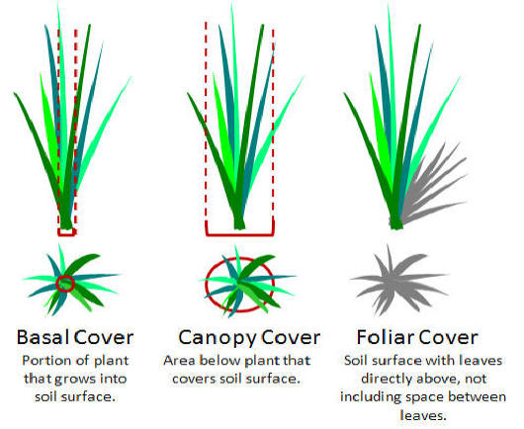
Cover
Cover is important for soil stability, hydrology and vegetation. Cover is usually expressed as the percentage of the soil surface covered by vegetation.
Vegetation (or vegetative) cover is all types of cover present on a site.
Canopy cover is the percentage of the ground covered by the outermost perimeter of the spread of plant foliage.
Basal cover is the percentage of the ground covered by plant bases
Foliar cover is the percentage of the ground covered by the aerial portion of the plants.
Litter cover is the percentage of soil covered by dead plant material that is not attached to the base of the plant. Attached dead cover is referred to as standing dead and can be canopy or foliar cover.
Bare ground is the percentage of the land that has an absence of cover or that is bare mineral soil.
In semi-arid areas, the rangeland health indicators litter cover and bare ground often have a departure from the reference condition. In these cases, litter and bare ground would be appropriate items to monitor to measure progress toward improving range trend.
Drawing from Principles of Vegetation Management & Assessment and Ecological Monitoring & Analysis – University of Idaho College of Natural Resources

Slide 10
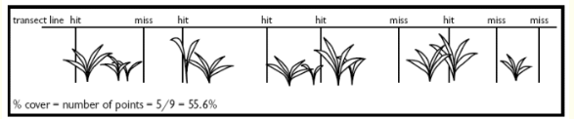
Cover: Line Point Intercept Method
The Line Point Intercept (LPI) Method consists of horizontal, linear measurements of plant intercepts along a line (measuring tape). Foliar, basal, and liter cover can be measured using LPI. Composition by cover can also be measured.
When using LPI a measuring tape is laid across the land at the key area. The line of the tape is referred to as a transect. A pin, survey flag or similar item is slowly dropped. If the pin touches a plant’s leaves as it is lowered, a canopy “hit” and the species of plant are recorded. The pin may hit several different species as it is lowered. If the pin touches a plant base, a basal hit for that species is recorded. If plant litter is in the lowest layer (just above the soil), that is recorded as a litter hit.
If plant species is recorded along with cover determinations, the monitoring information can also be used to measure species composition.
Drawing from Principles of Vegetation Management & Assessment and Ecological Monitoring & Analysis – University of Idaho College of Natural Resources

Slide 11
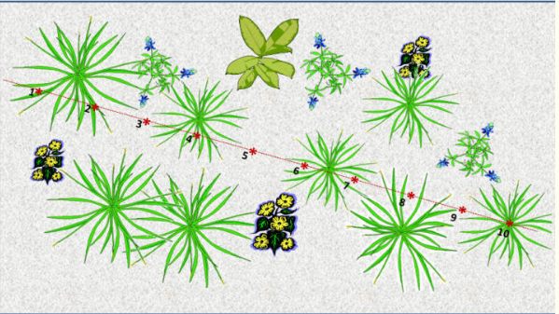
Cover: Line Point Intercept Method
Drawing from Principles of Vegetation Management & Assessment and Ecological Monitoring & Analysis – University of Idaho College of Natural Resources
If the red line is the tape and each red dot is the location of the pin drop the amount of cover is:
Foliar Hit: Points 1, 2, 4 & 10 = 40% foliar cover
Canopy Hit: Points 1, 2, 4, 6, 7, 8 & 10 = 70% canopy cover
Basal Cover: Point 10 = 10% basal cover
Bare ground: Points 3, 5, 6, 7, 8, & 9 = 60% bare ground (if litter cover is present in these areas, the amount of bare ground will be less.

Slide 12
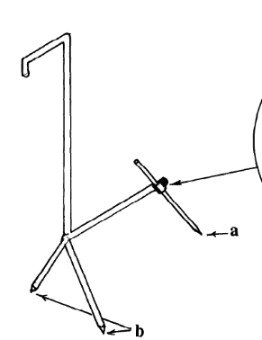
Cover: Step Point & Modified Step Point
The Step Point and Modified Step Point are point methods are conducted similarly to the Line Point Intercept method.
With Step Point, a predetermined number of steps are taken, the pin is lowered, and ”hits” of basal, foliar, litter and canopy cover and bare ground recorded. Modified Step Point employs a three-legged device that brings the “pin” to the ground at an angle.
The transect for these methods can be much longer so the area covered with these methods is much larger. When vegetation is highly variable, these methods are more accurate than LPI. However, there is an opportunity for bias due to point size, step length, and foot placement.
Drawing from Modified Step-point System for Botanical Composition and Basal Cover Estimates

Slide 13
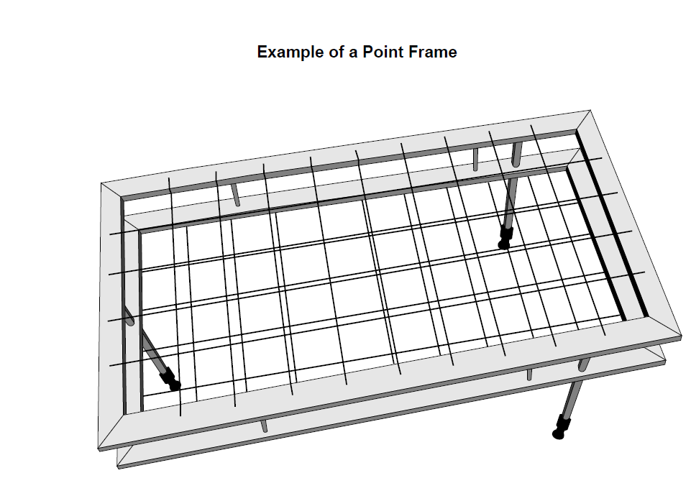
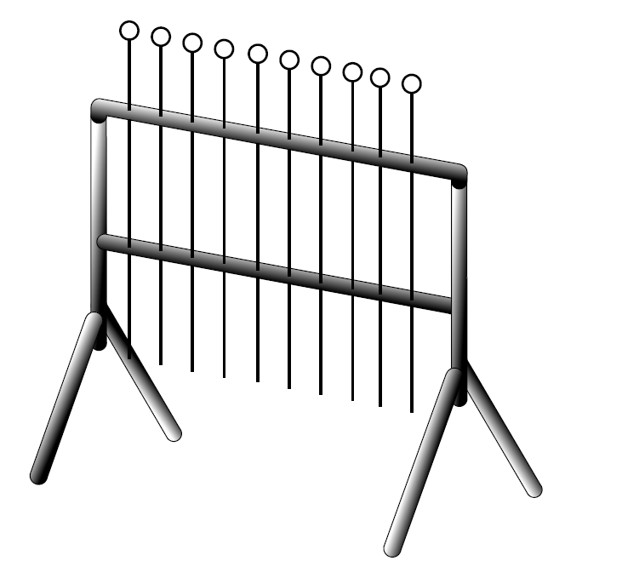
Cover: 10 Pin Frame & Point Frame
The Point Frame and the 10-Pin Frame are similar to the Line Point Intercept and Step Point Method. Both methods allow more data to be collected at each point reducing the time needed to collect an adequate number of points.
Drawings of Point Frame (left) and 10 Pin Frame (right) from “Sampling Vegetation Attributes – Interagency Technical Note”

Slide 14
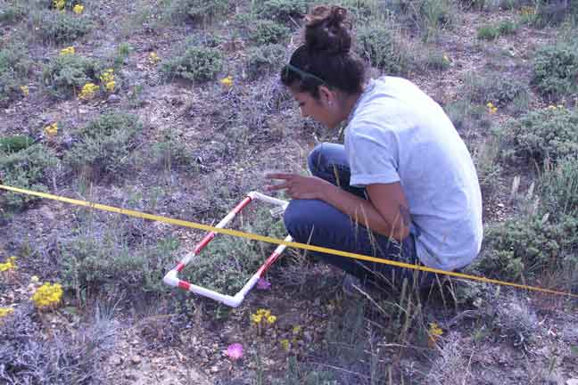
Cover: Daubenmire Frame
Daubenmire frames are used to estimate the species composition and percent cover of the vegetation. A 20X50 centimeter quadrat is placed along a tape on permanent transects. The frame can be used to measure canopy, frequency, and composition by canopy cover.
This method is easy and rapid to use. Look directly down onto the area within the frame and estimate the cover class for each type of cover that you wish to measure. The Daubenmire frame can also be used to collect frequency and composition data.
How to Use a Daubenmire Frame – Texas Parks and Wildlife
https://www.youtube.com/watch?v=sCs1d8GLzKU
How to Make a Daubenmire Frame
http://www.google.com/url?sa=t&rct=j&q=&esrc=s&source=web&cd=4&ved=2ahUKEwiejJvEuarfAhWhmeAKHXP4DFYQFjADegQIBxAC&url=http%3A%2F%2Fwww.utahweed.org%2Fuwsa%2FBioDaubenmire.doc&usg=AOvVaw07tzVRsu5luu490pP5UhYa
Photo from: Using a Daubenmire Frame - Rangeland Health Evaluations-Adventures with Ms. Sutton

Slide 15
Density
Density is the number of individuals of a species in a given unit of area. Density does not vary as much with weather conditions as cover or production. This monitoring method is often used to measure the long-term impact of a change in management.
Since different plant species should be measured with different quadrat sizes, one or just a few plant species are selected to be monitored. Density estimates are made by counting the number of individual plants of the selected species that are located within the plots.
Sampling sod forming grasses for density can be difficult because identifying individual plants isn’t possible. In those cases, upright stems and inflorescences are counted.

Slide 16
Production
Production usually refers to the amount of vegetative biomass that grows on a site. Production of a site is a measure of how well the ecological processes are functioning. When reviewing production data it is important to know the type production measured.
Gross primary production: All organic material produced, above and below ground.
Biomass: The total weight of living organisms in the ecosystem, including plants and animals.
Standing crop: The amount of plant biomass present above ground at any given point in time.
Peak standing crop: The greatest amount of plant biomass above ground present in any given year.
Total forage: The total herbaceous and woody palatable plant biomass that is available to herbivores.
Allocated forage: The forage remaining after the desired amount of residual material is subtracted from the total forage.
Browse: The amount of woody plant biomass accessible to herbivores.
The most common types of production measured on rangeland are standing crop and peak standing crop.

Slide 17
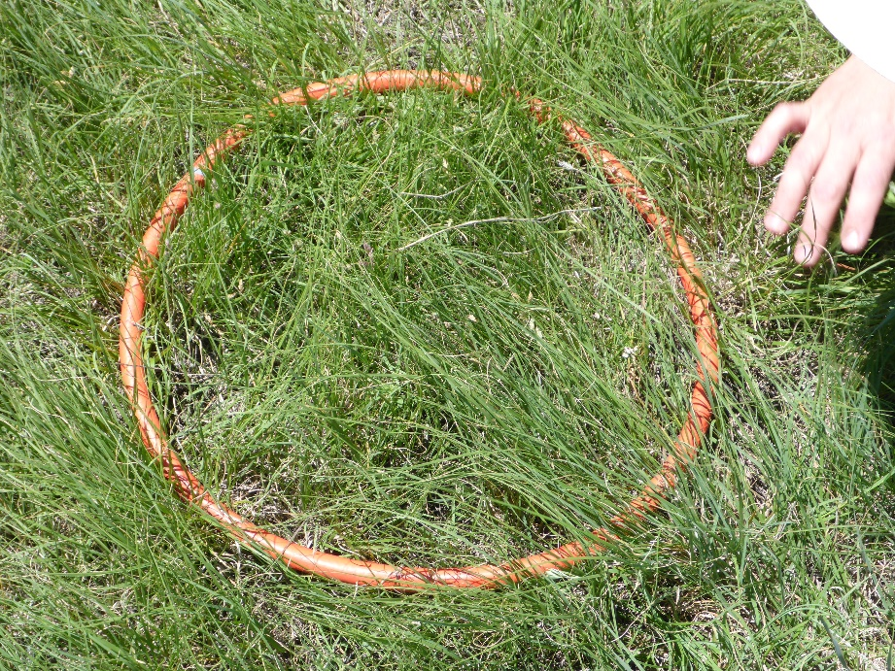
Production: Harvest Method
The harvest method is used to determine the amount of current-year, above-ground vegetation production on a defined area. Peak standing crop, standing crop, and species composition by weight are monitored by this method.
With the harvest method, all above ground vegetation (grasses, grass-likes, and forbs) and current year shrub growth is clipped from a number of plots. This means that the herbaceous plants are clipped to ground level. The vegetation is clipped by species, bagged and allowed to air dry. Once the plant material is dry, the bags containing the vegetation are weighed in grams, the weight of the bag subtracted, and the weight of the vegetation recorded.
The size and number of plots that should be clipped depends upon the density and variability of vegetation. The denser the vegetation, the smaller plot size. In Nebraska, a 1.92 square foot plot is the most common plot size. With this plot size, the production in pounds per acre is determined by multiplying the weight of the vegetation in grams by 50.
Photo: 1.92 ft² clipping frame. The vegetation will be clipped to ground level, sorted by species (either before or after clipping), dried and weighed to determine production and species composition.

Slide 18
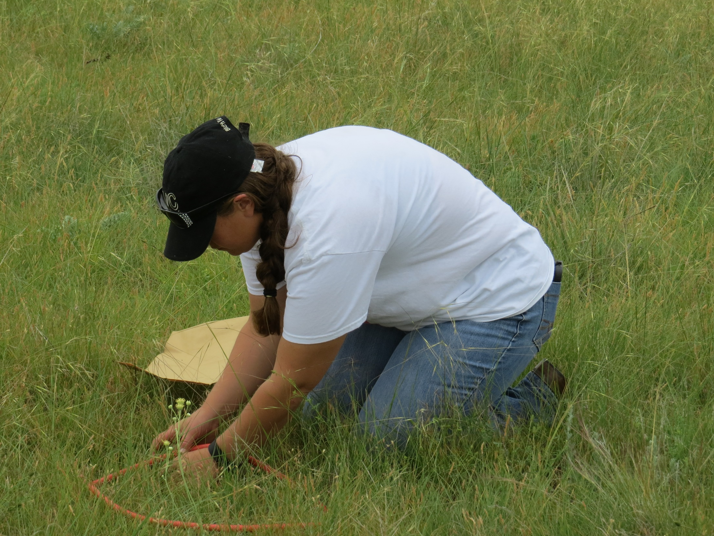
Production: Double Sampling Method
The double sampling method is similar to the harvest method. The difference is that with double sampling some plots are clipped and the production in other plots is estimated by using weight units.
A weight unit is a plant or several plants of a given species. The weight unit will be different for each sampling location. For example, a weight unit for big bluestem might be 3 tillers. A weight unit for little bluestem might be a clump 2” in diameter. A weight unit for blue grama might be a group of plants in an area the size of your palm. These weight units are weighed in grams.
Several plots will be clipped by species and bagged for weighing after drying. Production by species will be estimated in the remaining plots using the weight units. If 10 plots are being evaluated, at least 2 plots should be weighed.
Example: The weight unit of little bluestem is a 2” diameter clump that weighs 25 grams, Plot 2 contains 5 clumps of little bluestem, two that are 2” in diameter, 1 that is 1” in diameter, and 2 that are 4” in diameter. The estimated weight for little bluestem in that plot will be:
  Two 2” clumps @ 25 grams each = 50 grams
  One 1” clump @ 12.5 grams = 12.5 grams
  Two 4” clumps @ 50 grams each = 100 grams
  Total estimated weight = 162.5 grams (or 8125 pounds per acre wet weight)
After samples from the clipped plots have dried, the estimated weights will be adjusted for dry weight. In this example, if the little bluestem was 50% dry weight, the estimated pounds of little bluestem per acre would be 4062.5.
This process would continue for each plant species found in the plots.

Slide 19
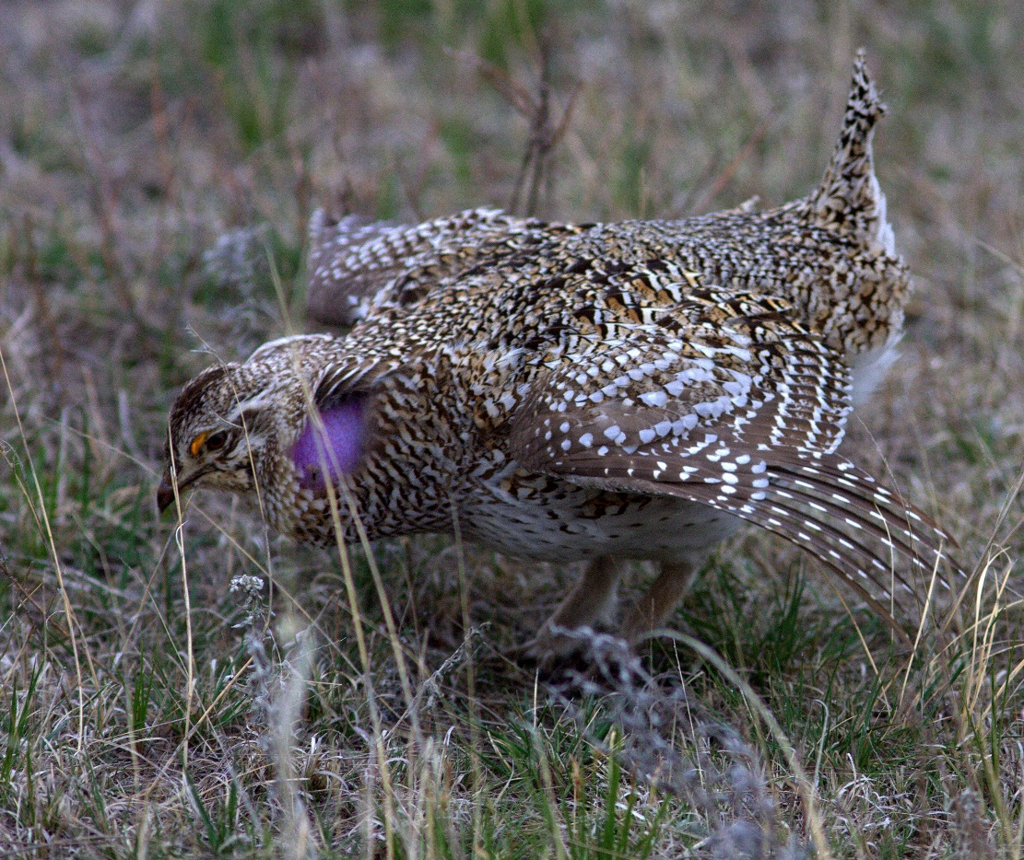
Structure
Structure is how vegetation is arranged in a three-dimensional space. It looks at height and density of the vegetation at different grass heights.
Structure is used to describe the suitability of sites for wildlife cover. The methods used to measure structure can be done quickly and a large area can be measured in a short period of time.
Structure estimates use visual obstruction techniques that have little bias. The two methods to measure structure are the Robel pole and the Cover Board.
Photo: Structure is an important element of wildlife habitat for prairie grouse. Photo by: Robert Broweleit.

Slide 20
Structure: Robel Pole
The Robel pole was developed by wildlife biologist, Robert Robel to measure hiding cover for greater prairie chicken. The amount of pole height obscured by vegetation was correlated to nesting success.
The observer views the pole from a distance of 4 meters with their eyes at 1 meter height. The last band visible on the pole before being covered by vegetation is the reading.
A common method for completing this method is to collect data at twenty sample points a minimum of 10 paces apart. This is completed along 4 transects. At each sample point, readings are taken at the four cardinal directions. This results in 320 observations. For management purposes, the average of the observations will be used for each key area.
Measuring Biomass with the Robel Pole : https://www.youtube.com/watch?v=X0ppFrhEwCg
Photo: Reading a Robel pole in short-grass prairie. Photo: USDA-ARS

Slide 21
Structure: Cover Board
The cover board method uses a profile or density board to estimate the vertical area of the board covered by vegetation from a specific distance. The size of the board is modified to meet the purpose of the study. The board is somewhat narrow with bands of alternating color along the height of the board.
The cover board is located 15 feet from the observation point. The cover in each segment of the cover board is recorded. The cover can be for all vegetation or selected species. The board is used to evaluate thermal cover, hiding cover, and nesting cover.
A density board is similar to a cover board. The density board is 6’ tall painted an alternating black and white with each band numbered from 1 at the bottom to 6 at the top. The observer is 66 feet away in a random direction, All numbers that are visible are added for a density reading.,

Slide 22
Composition
Composition is the proportion of a plant species in relation to the total of the given area. The individual value for an attribute – weight, density, number, or percent cover – is compared to the total for the entire population.
The primary method to determine composition is dry weight rank. While completing other methods, the data needed to determine composition can also be collected. Those methods are Daubenmire frame (% cover by species), line point intercept, and point intercept (% by number), harvest and double sampling (% by weight).
On rangelands, composition is usually determined for percent of each species by air dry weight as compared to the total air dry weight. Dry weight rank is the best method to determine composition.

Slide 23
Composition – Dry Weight Rank
With dry weight rank, quadrats are observed and the top three species which contribute the most weight in the quadrat are ranked. A large number of plots can be sampled quickly since the relative production is estimated.
Twenty plots per sampling point or key area are observed. All plants found in each quadrat are listed, and the top 3 in terms of production are ranked, with the species with the highest weight ranked 1, second highest ranked 2 and third highest ranked 3. No other species present in the plot are ranked.
After all 20 plots are ranked, the total number of 1s, 2s, and 3s for each species is tallied. The results are given a weighting. The total number of 1s is multiplied by 7, the total number of 2s is multiplied by 2 and the total number of 3s is multiplied by 1. These 3 weighted numbers are added for each species.
When 20 plots are sampled, the weighted total for each species is divided by 20. The resulting number is the % species composition.
See slide 24 for an example dry weight rank calculation.

Slide 24
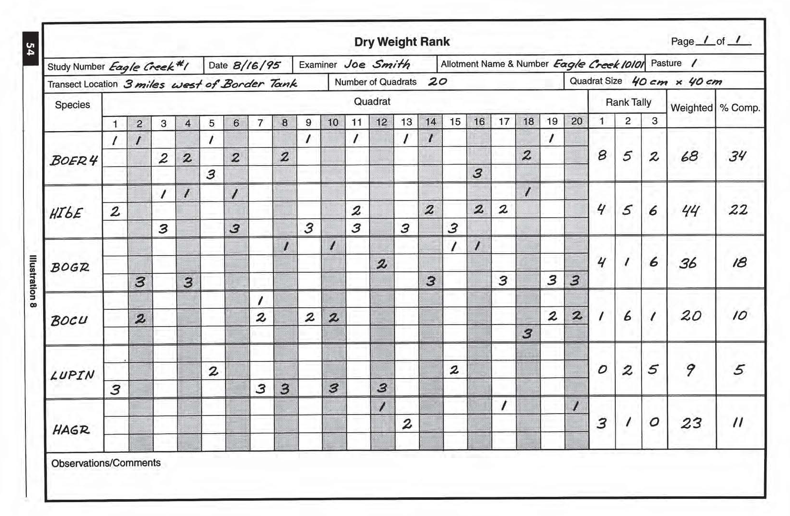
Composition – Dry Weight Rank
Plant symbol is used rather than plant name in this example.

Slide 25
Determining Similarity Index
Similarity index is a comparison of the composition of the current plant community to the composition of the reference plant community or other desired plant community. Similarity index is expressed as a percentage of the reference plant community for the ecological site being evaluated.
To calculate similarity index the weight of each species present on the site is determined in air dry pounds per acre. When production has been measured by harvest or double sampling methods, this data is already available. This weight of current production for each species is compared to the weight for each species listed in the ecological site description (ESD).
The allowable amount for each species is either what was measured (if less than listed in the ESD) or the amount from the ESD (if the clipped weight is more than the listed in the ESD). These individual allowable values are added for total allowable production per acre and then divided by the representative production listed in the ESD. The result is the Similarity Index.
Similarity Index is quick and easy to calculate and gives a good, single number index that reflects how well the management strategy is doing.
Similarity index determinations are sometimes determined by estimating the percentage of each species on the site and comparing it to the percentage found in the reference plant community. The results obtained by using this method will be slightly different from the similarity index using weights.
See Slide 26 for an example similarity index calculation.

Slide 26
Determining Similarity Index by Weight
Plant Species | Allowable Production per Acre in Reference Plant Community (from ESD) | Annual Production per acre on Site | Allowable Pounds Per Acre
Big Bluestem | 95 | 50 | 50
Little Bluestem | 315 | 400 | 315
Sideoats Grama | 250 | 200 | 200
Plains Muhly | 45 | 70 | 45
Western Wheatgrass | 120 | 250 | 120
Blue Grama | 200 | 150 | 150
Threadleaf Sedge | 15 | 100 | 15
Perennial Forbs | 165 | 250 | 165
Other plants not found on this site but in reference community** | 445 | 0 | 0
Allowable amounts for each species is the lesser of the weight listed in the ESD or that clipped on-site.
Total representative annual production from the ESD is 1650. Allowable Production is 1060.
Similarity Index is 64%.
**When calculating similarity index you do not need to calculate or list production other plants not found on-site. This was added to illustrate the process. The 1650# is listed in the ESD as the representative value for production on the site.

Slide 27
Determining Similarity Index by Percentage
Plant Species | Allowable % production by species in Reference Community (from ESD) | % production by species on site (from Dry Weight Rank or other estimate) | Allowable Percentage
Big Bluestem | 25 | 30 | 25
Little Bluestem | 20 | 15 | 15
Sideoats Grama | 20 | 30 | 20
Plains Muhly | 5 | 2 | 2
Western Wheatgrass | 10 | 5 | 5
Blue Grama | 25 | 5 | 5
Threadleaf Sedge | 5 | 10 | 5
Perennial Forbs | 5 | 3 | 3
TOTAL |  | 100 | 80
The allowable percentage for a given species is the lower of the allowable or actual.
Similarity Index is 64%.

Slide 28
Activities and References
Activities
References
Use the monitoring tools --Daubenmire frame, line point intercept, 10-pin frame, modified step point -- to measure % ground cover, % litter cover and % bare ground.
Use the Robel pole to measure structure of wildlife habitat.
Complete a plant census of an grassland area.
Sampling Vegetation Attributes
Interagency Technical Reference, CES, USDA, BLM
Monitoring Manual for Grassland, Shrubland, and Savanna Ecosystems Volume 1: Quick Start
Monitoring Manual for Grassland, Shrubland, and Savanna Ecosystems Volume II

Slide 29
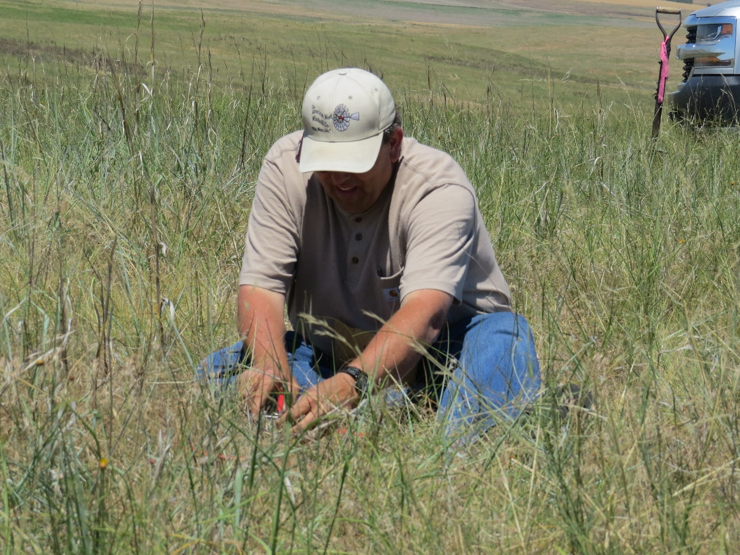
End of Lesson Twenty

