Slide 1

Policy & Land Use
Envirothon Nebraska
Kevin Schwartman, P.G.
Water Planner/Geologist
Nebraska Department of Natural Resources
Contact information:
Office Phone: 402-471-3958
Email: kevin.schwartman@nebraska.gov
Notes:
Introduction.

Slide 2
The Policy & Land Use Test
Divided into four separate areas:
Nebraska Government/Legislation
Current Issues in Nebraska
Nebraska Geography/Land Use
Nebraska Environmental History/Historical Figures
Notes:
Policy test is divided into four areas.

Slide 3
The Policy & Land Use Test
Objectives of the Policy & Land Use Test
Objective 1:
Understand the role that local, state and federal agencies have in:
Implementing and creating Policy on:
Understand and development of conservation practices
Research
Collection and storage of natural resources data
Providing education and technical support
Developing and enforcing regulations
Notes:
Objective 1

Slide 4
The Policy & Land Use Test
Objectives of the Policy & Land Use Test
Objective 2:
Describe Nebraska geography and land use
Policies on land ownership and water rights
Crop types and irrigation use
Agrichemical use
Its effects on crop production and the environment
Environmental problems and opportunities in Nebraska
Place and names of major rivers, lakes, geographic regions
Describe the function of specific rivers and lakes
Along with their historical significance
Know the history of natural resources use in Nebraska
Notes:
Objective 2

Slide 5
The Policy & Land Use Test
Objectives of the Policy & Land Use Test
Objective 3:
Show up-to-date knowledge on the following:
Current land and water use laws and their effects
Historical significance of natural resources law
May include current bills
Historical figures in conservation and natural resources
Plants and animals protected by The Endangered Species Act
Current policies in regulation and regulatory issues
Water rights issues
Protection of wetlands
Issues related to multi-state compacts
Notes:
Objective 3

Slide 6
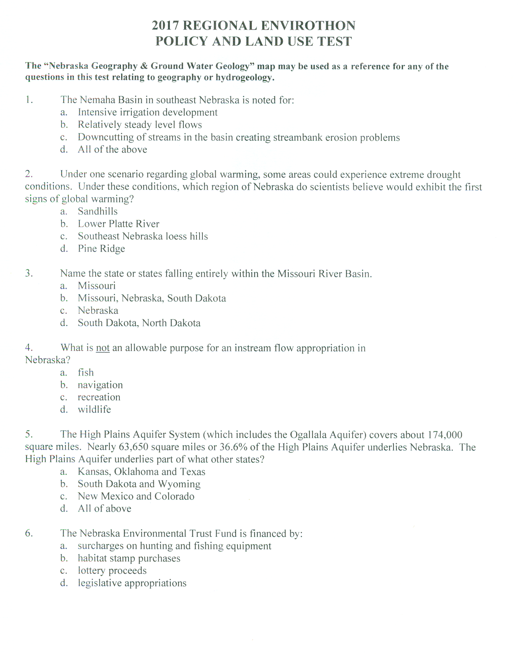
The Policy & Land Use Test
Notes:
Policy and Land Use test, close up view, margins are bigger in the actual test.

Slide 7
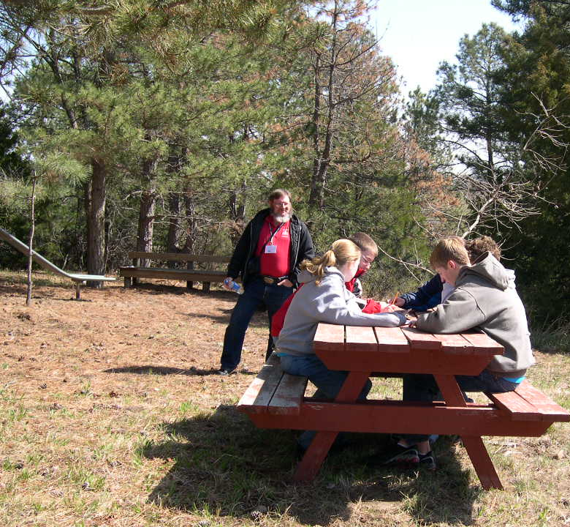
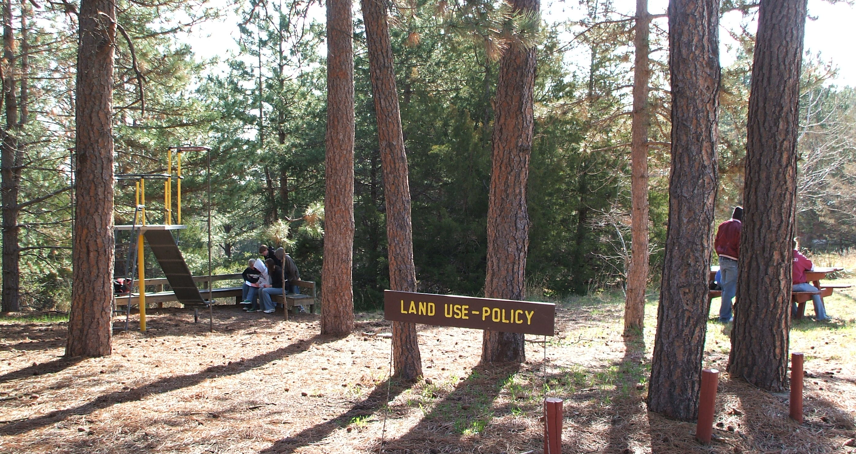
The Policy & Land Use Test questions
Regional and the State Tests are multiple choice
The regional test is 25 questions
The state test is 50 questions
Halsey National Forest, State Envirothon Competition, 2008
Notes:
Test questions. No pre-test instruction, hand samples, or demonstrations. Just need places for the competitors to sit with a clipboard away from the other team.

Slide 8
The Policy & Land Use Test
Last three questions are each associated with maps
No Prior knowledge needed to answer these questions
Designed to test map reading skills
Ability to follow directions
Map #1: Restrictions of Surface Water Appropriations in Nebraska
Notes:
With no instruction, hand samples or demonstrations, I did add map questions a few years ago.

Slide 9
The Policy & Land Use Test
Map #2: Hydrologically Connected Surface and Ground Water for Fully and Overappropriated Designations
Map #3: Fully and Overappropriated Surface Water in Nebraska
Notes:
Map questions.

Slide 10
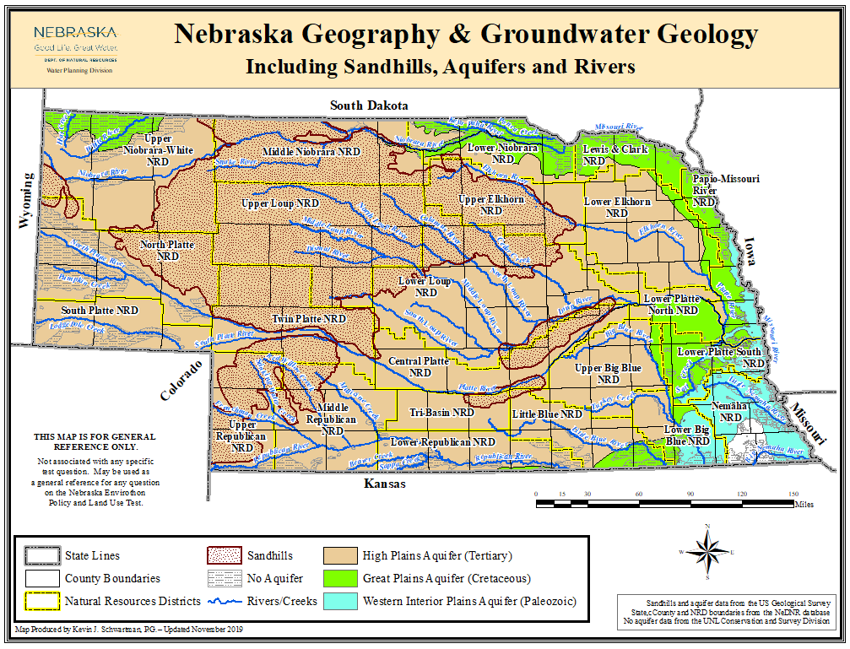
The Policy & Land Use Test
No questions are associated with this fourth map
An additional resource for geographic questions
Notes:
No questions, just an additional resource.

Slide 11
The Policy & Land Use Test
Questions
database
Notes:
Question database, keeps a record of when each question was asked.

Slide 12
The Policy & Land Use Test
Questions database
Questions are cycled
About every two to three years
Longer if possible
One question is almost never used two years in a row
Outdated and/or inaccurate questions are updated
Removed
Replaced with a similar questions whenever possible
New questions are added annually
At least 5 per year
Try to base newer questions (mostly) on common sense
So not to require a lot of specific knowledge of any subject
Notes:
Question cycling. Used to use regional questions in the state test, but it was decided that different questions should be used instead.

Slide 13
Useful Study Exercises
Exercise 1
Contact a representative from your local NRD:
Discuss policies and their effects
On natural resources management and usage
Discuss local environmental problems
Policies used to control and/or correct these problems
Check out each of the Natural Resource District webpages
Discuss The role of the local, state, and federal government
In regard to protecting natural resources
How their rolls may differ
Notes:
Exercise 1

Slide 14
Useful Study Exercises
Exercise 2
Read and clip out newspaper and magazine articles
Keep a scrapbook to use as a study resource
On land use and policy issues
Useful articles can often be found in newspapers such as:
The Omaha World Herald
The Lincoln Journal-Star
Other local newspapers
Magazines such as:
Nebraska Farmer
Nebraskaland
Notes:
Exercise 2

Slide 15
Useful Study Exercises
Also check out newsletters published by:
Various government agencies
Describing their programs
Land use issues
Current projects
Policies
Natural resource legislation
Become familiar with the roles of various government agencies
Most have websites
An excellent source of information
What role they have
What services they provide
Most agencies also have brochures and publications
Describing their functions
Notes:
Exercise 3

Slide 16
Useful Study Exercises
Look at Federal Agency Websites:
Bureau of Land Management (BLM)
http://www.blm.gov
BLM Facts page
http://www.blm.gov/nhp/facts/index.htm
Bureau of Reclamation (BOR)
http://www.usbr.gov
BOR Projects & Facilities page
https://www.usbr.gov/projects/facilities.php?state=Nebraska
Click Nebraska on the map for information on state projects
Environmental Protection Agency (EPA)
http://www.epa.gov
Notes:
Agency sites, Federal.

Slide 17
Useful Study Exercises
Federal Agencies:
Nebraska Natural Resources Conservation Service (NRCS)
http://www.ne.nrcs.usda.gov
United States Army Corps of Engineers (COE)
http://www.usace.army.mil
United States Geological Survey (USGS)
http://www.usgs.gov
Most have information on current/historical activity in Nebraska
Notes:
Agency sites, Federal

Slide 18
Useful Study Exercises
Look at Nebraska State Agency Websites:
Nebraska Department of Agriculture
http://www.agr.state.ne.us
Nebraska Department of Environment and Energy (NDEE)
http://www.deq.state.ne.us
Health and Human Services System (HHS)
Public Health tab for Division of Public Health
http://dhhs.ne.gov/publichealth/Pages/public_health_index.aspx
Nebraska Game and Parks Commission (NGPC)
http://outdoornebraska.gov/
Notes:
Agency sites, State.

Slide 19
Useful Study Exercises
State of Nebraska Agencies:
NE Natural Resources Commission/Water Task Force
https://nrc.nebraska.gov/water-sustainability-fund-0
University of Nebraska:
Conservation & Survey Division (CSD)
http://snr.unl.edu/csd
Check out Survey Areas > Soil Survey
        > Water Resources Survey
Nebraska Water Center
https://watercenter.unl.edu
National Association of Resource Districts
http://www.nrdnet.org
Notes:
Agency sites, State.

Slide 20
Useful Study Exercises
State of Nebraska Agencies:
Nebraska Department of Natural Resources (NeDNR)
https://dnr.nebraska.gov
Check out the “Statutes, Rules & Regulatory History” page
On the NeDNR main page > click on Services
Under “Surface Water”
Click on “Statutes, Rules & Regulatory History” link
Note the rights and responsibilities of water users
Direct Link:
https://dnr.nebraska.gov/surface-water/statutes-rules-regulatory-history
Notes:
Example of what to look for. Useful list, but research non limited to these presented.

Slide 21

Questions?
Chimney Rock, Summer of 1987
Contact information:
Office Phone: 402-471-3958
Email: kevin.schwartman@nebraska.gov

