Slide 1

Policy & Land Use
Envirothon Nebraska
Kevin Schwartman, P.G.
Water Planner/Geologist
Nebraska Department of Natural Resources
Contact information:
Office Phone: 402-471-3958
Email: kevin.schwartman@nebraska.gov

Slide 2
The Policy & Land Use Test questions
Divided into four separate areas:
Nebraska Government/Legislation
Current Issues in Nebraska
Nebraska Geography/Land Use
Nebraska History

Slide 3
The Policy & Land Use Test questions
Objective 1 of the Policy & Land Use Test:
Understand the role that local, state and federal agencies have in:
Implementing and creating Policy on:
Understand and development of conservation practices
Research
Collection and storage of natural resources data
Providing education and technical support
Developing and enforcing regulations

Slide 4
The Policy & Land Use Test questions
Objective 2 of the Policy & Land Use Test:
Describe Nebraska geography and land use
Policies on land ownership and water rights
Crop types and irrigation use
Agrichemical use
Its effects on crop production and the environment
Environmental problems and opportunities in Nebraska
Place and names of major rivers, lakes, geographic regions
Describe the function of specific rivers and lakes
Along with their historical significance
Know the history of natural resources use in Nebraska

Slide 5
The Policy & Land Use Test questions
Objective 3 of the Policy & Land Use Test:
Show up-to-date knowledge on the following:
Current land and water use laws and their effects
Historical significance of natural resources law
May include current bills
Historical figures in conservation and natural resources
Plants and animals protected by The Endangered Species Act
Current policies in regulation and regulatory issues
Water rights issues
Protection of wetlands
Issues related to multi-state compacts

Slide 7
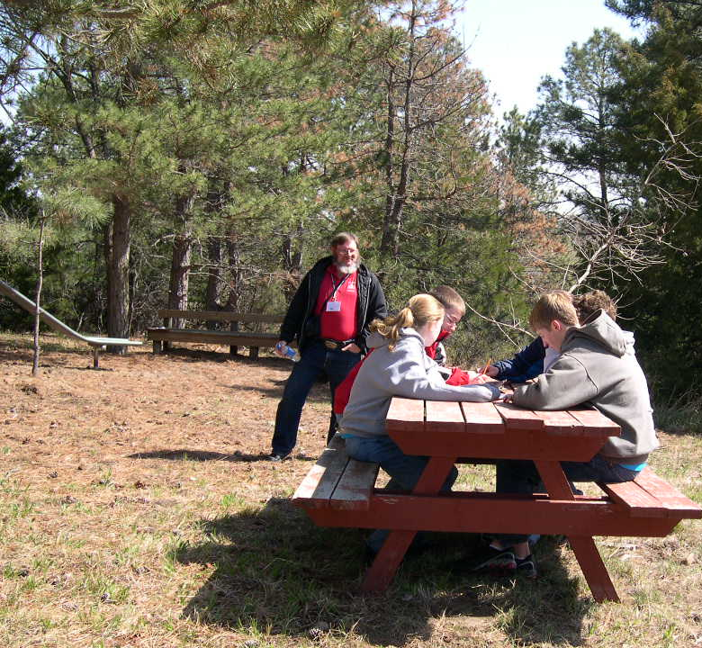
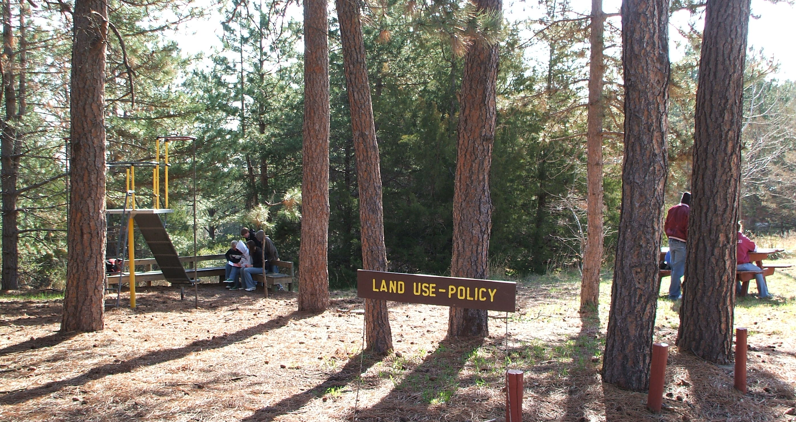
The Policy & Land Use Test questions
Regional and the State Tests are multiple choice
The regional test is 25 questions
The state test is 50 questions
State test includes the questions from the regional test
Halsey National Forest, State Envirothon Competition, 2008

Slide 8
The Policy & Land Use Test questions
Last three questions are each associated with a map
No Prior knowledge needed to answer these questions
Designed to test map reading skills
Ability to follow directions
Please refer to “Map #1: Restrictions on Surface Water Appropriations in Nebraska” map for the following question. Pay attention to the colors and patterns of each of the restricted areas and how they relate to each of the Natural Resources Districts (NRDs) or counties. A map with this information is located on the Nebraska Department of Natural Resources website, but no prior knowledge of the restricted areas is necessary to answer these questions; this will test your map reading skills. (Hint: Note that parts of the stays and moratoriums do overlap.)
00. According to the map, which of the following NRDs are located in the No New Surface Water Appropriations (Moratoriums) areas as of September 09, 2011?
Nemaha, Lower Big Blue, Upper Big Blue, Little Blue, Lewis & Clark, Papio-Missouri River, and part of the Lower Niobrara
North Platte, South Platte, Twin Platte, Central Platte, Upper Republican, Middle Republican, Lower Republican, part of the Upper Niobrara-White
Upper Loup, Lower Loup, Upper Elkhorn, Lower Elkhorn, Lower Platte North and Lower Platte South
Upper Niobrara-White, North Platte, Twin Platte, Central Platte, part of the Tri-Basin, Middle Niobrara and part of the Lower Niobrara
Map #1: Restrictions of Surface Water Appropriations in Nebraska

Slide 9
The Policy & Land Use Test questions
Map #2: Hydrologically Connected Surface and Ground Water for Fully and Overappropriated Designations
Map #3: Fully and Overappropriated Surface Water in Nebraska

Slide 10
The Policy & Land Use Test questions
General Geography & Ground Water Geology Map
No questions are associated with this fourth map
An additional resource for geographic questions

Slide 11
The Policy & Land Use Test questions
Questions database

Slide 12
The Policy & Land Use Test questions
Questions database
Questions are cycled
About every two to three years
Longer if possible
One question is almost never used two years in a row
Outdated and/or inaccurate questions are updated
Removed and replaced
New questions are added periodically
Try to base new questions on common sense
When possible
Avoid requiring prior knowledge of subject

Slide 13
Useful Study Exercises
(Updated from the Policy Study Guide):
Exercise 1
Contact a representative from your local NRD:
Discuss policies and their effects
On natural resources management and usage
Discuss local environmental problems
Policies used to control and/or correct these problems
Discuss The role of the local, state, and federal government
In regard to protecting natural resources
How they may differ

Slide 14
Useful Study Exercises
(Updated from the Policy Study Guide):
Exercise 2
On the Nebraska Department of Natural Resources website:
Check out the “Statutes, Rules & Regulatory History” page
On the NeDNR main page > click on Services
Under “Surface Water”
Click on “Statutes, Rules & Regulatory History” link
Note the rights and responsibilities of water users
Direct Link:
https://dnr.nebraska.gov/surface-water/statutes-rules-regulatory-history

Slide 15
Useful Study Exercises
(Updated from the Policy Study Guide):
Exercise 3
Read and clip out newspaper and magazine articles
Keep a scrapbook to use as a study resource
On land use and policy issues
Useful articles can often be found in newspapers such as:
The Omaha World Herald
The Lincoln Journal-Star
Other local newspapers
Magazines such as:
Nebraska Farmer
Nebraskaland

Slide 16
Useful Study Exercises
(Updated from the Policy Study Guide):
Also check out newsletters published by:
Various government agencies
Describing their programs
Current projects, policies
Land use issues
Along with natural resource legislation
Become familiar with the roles of various government agencies
Most have websites
An excellent source of information about
What role they have
What services they provide
Most agencies also have brochures and publications
Describing their functions

Slide 17
Useful Study Exercises
(Updated from the Policy Study Guide):
Federal Agencies include:
Bureau of Land Management (BLM)
http://www.blm.gov
BLM Facts page http://www.blm.gov/nhp/facts/index.htm
Bureau of Reclamation (BOR)
http://www.usbr.gov
BOR Projects & Facilities page
https://www.usbr.gov/projects/facilities.php?state=Nebraska
Click Nebraska on the map for information on state projects
Environmental Protection Agency (EPA)
http://www.epa.gov

Slide 18
Useful Study Exercises
(Updated from the Policy Study Guide):
Federal Agencies include:
Nebraska Natural Resources Conservation Service (NRCS)
http://www.ne.nrcs.usda.gov
United States Army Corps of Engineers (COE)
http://www.usace.army.mil
United States Geological Survey (USGS)
http://www.usgs.gov
Most have information on current/historical activity in Nebraska

Slide 19
Useful Study Exercises
(Updated from the Policy Study Guide):
State of Nebraska Agencies include:
Nebraska Department of Agriculture
http://www.agr.state.ne.us
Nebraska Department of Environmental Quality (NDEQ)
http://www.deq.state.ne.us
Health and Human Services System (HHS)
Public Health tab for Division of Public Health
http://dhhs.ne.gov/publichealth/Pages/public_health_index.aspx
Nebraska Department of Natural Resources (NeDNR)
https://dnr.nebraska.gov
Nebraska Game and Parks Commission (NGPC)
http://outdoornebraska.gov/

Slide 20
Useful Study Exercises
(Updated from the Policy Study Guide):
State of Nebraska Agencies include:
Nebraska Natural Resources Commission/Water Task Force
https://nrc.nebraska.gov/water-sustainability-fund-0
University of Nebraska:
Conservation & Survey Division (CSD)
http://snr.unl.edu/csd
Nebraska Water Center
https://watercenter.unl.edu
National Association of Resource Districts
http://www.nrdnet.org
Also check out each of the Natural Resource District webpages

Slide 21

Questions?
Chimney Rock, Summer of 1987
Contact information:
Office Phone: 402-471-3958
Email: kevin.schwartman@nebraska.gov

