Slide 1
Lesson Sixteen:
Range Management and Conservation Practices on Rangeland

Slide 2
What is Range Management?
Range management has been defined in several ways:
The care of native grazing lands.
The wise use of native grazing lands for sustainability to benefit current societies and future generations.
The manipulation of rangeland components to obtain the optimum combination of goods and services and sustainability.
The management of rangeland to ensure a sustained yield of rangeland products while protecting and improving the basic range resources of soil, water, and plant and animal life.
The common threads throughout all definitions of range management are managing native grazing lands, producing goods and services and sustainability.

Slide 3
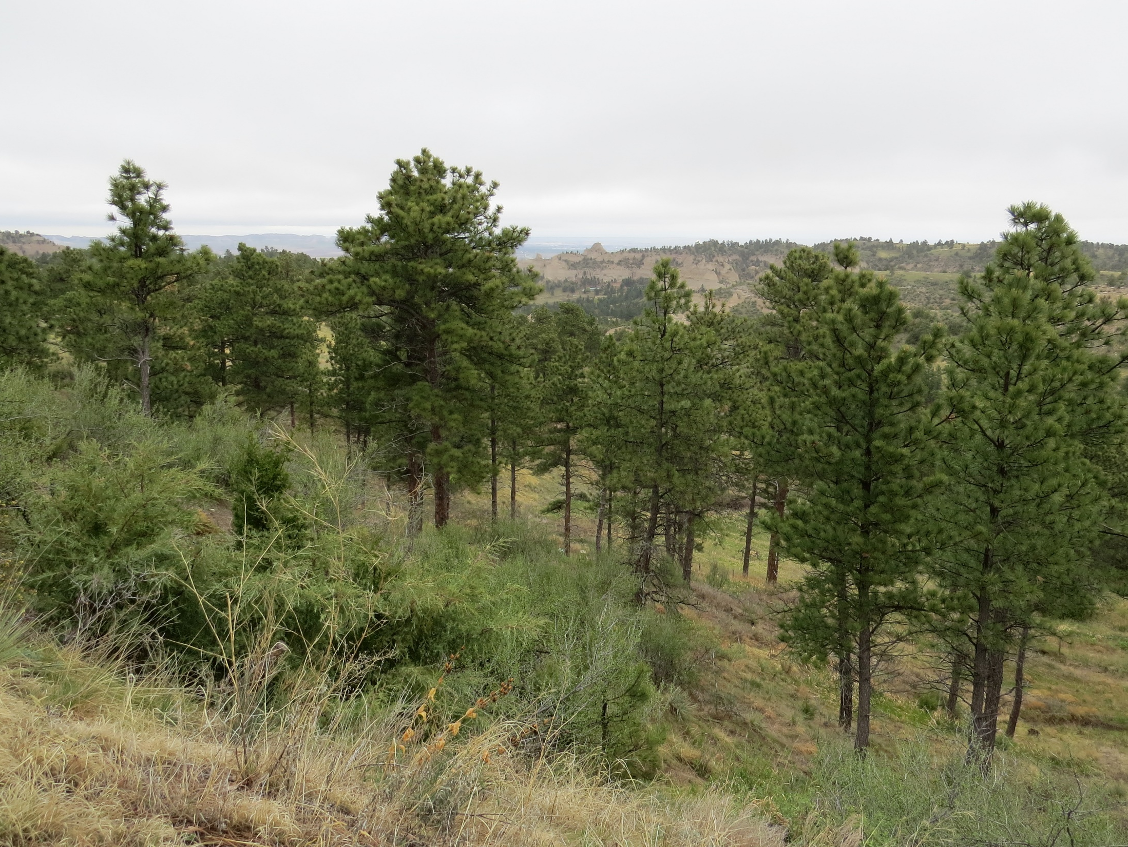
Basic Range Management Concepts
Rangelands are renewable resources. They can produce a sustained yield if managed using ecological principles rather than intensive, agronomic principles.
Sustainable management of rangeland maintains soil and water quality, soil and water health, and basic biogeochemical cycles.
Rangelands produce a variety of products and managing for multiple use is important.
Many important public concerns on rangeland occur across multiple ownerships (wildfire, water quality, invasive weeds).
Rangelands change through succession and disturbance. Managers apply, control or respond to disturbance based on knowledge of ecological principles.
The only constant on rangeland is change.
If you do nothing (no management, grazing, fire, etc.) the land will not return to a pristine, pre-settlement state.

Slide 4
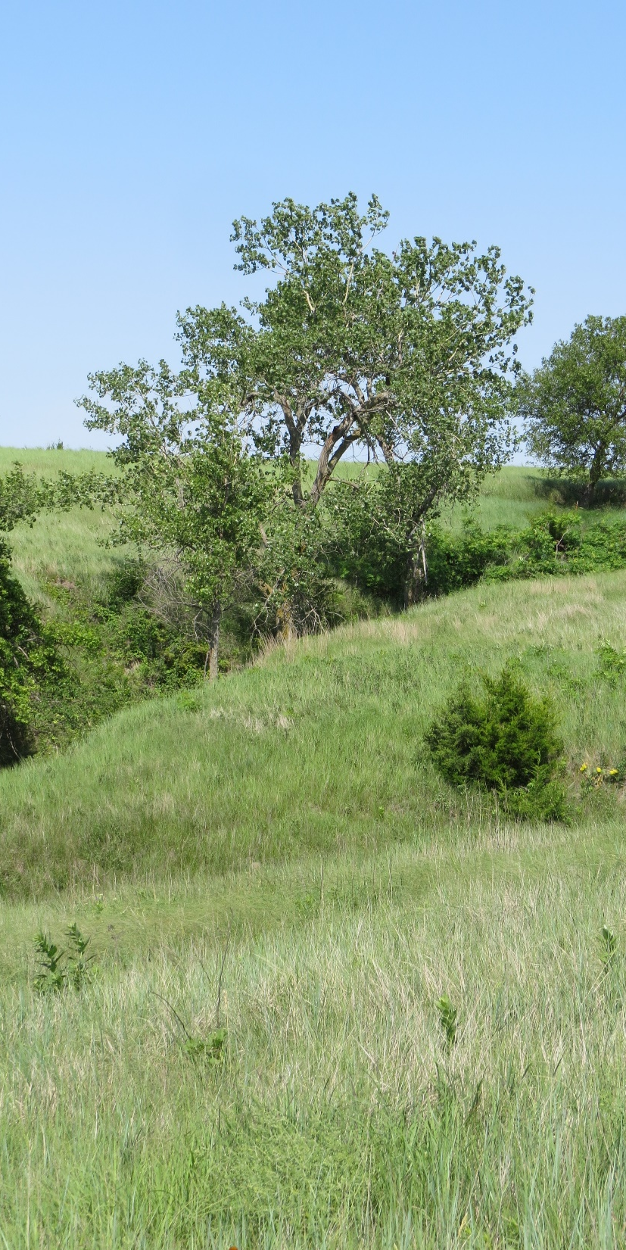
What Are the Five Principles of Range Management?
Range management is based on the following grazing principles:
Graze with the appropriate kind and class of animal.
Graze with the appropriate stocking rate
Graze during the appropriate season or time.
Graze for the appropriate degree of use.
Graze to achieve the appropriate distribution.

Slide 5
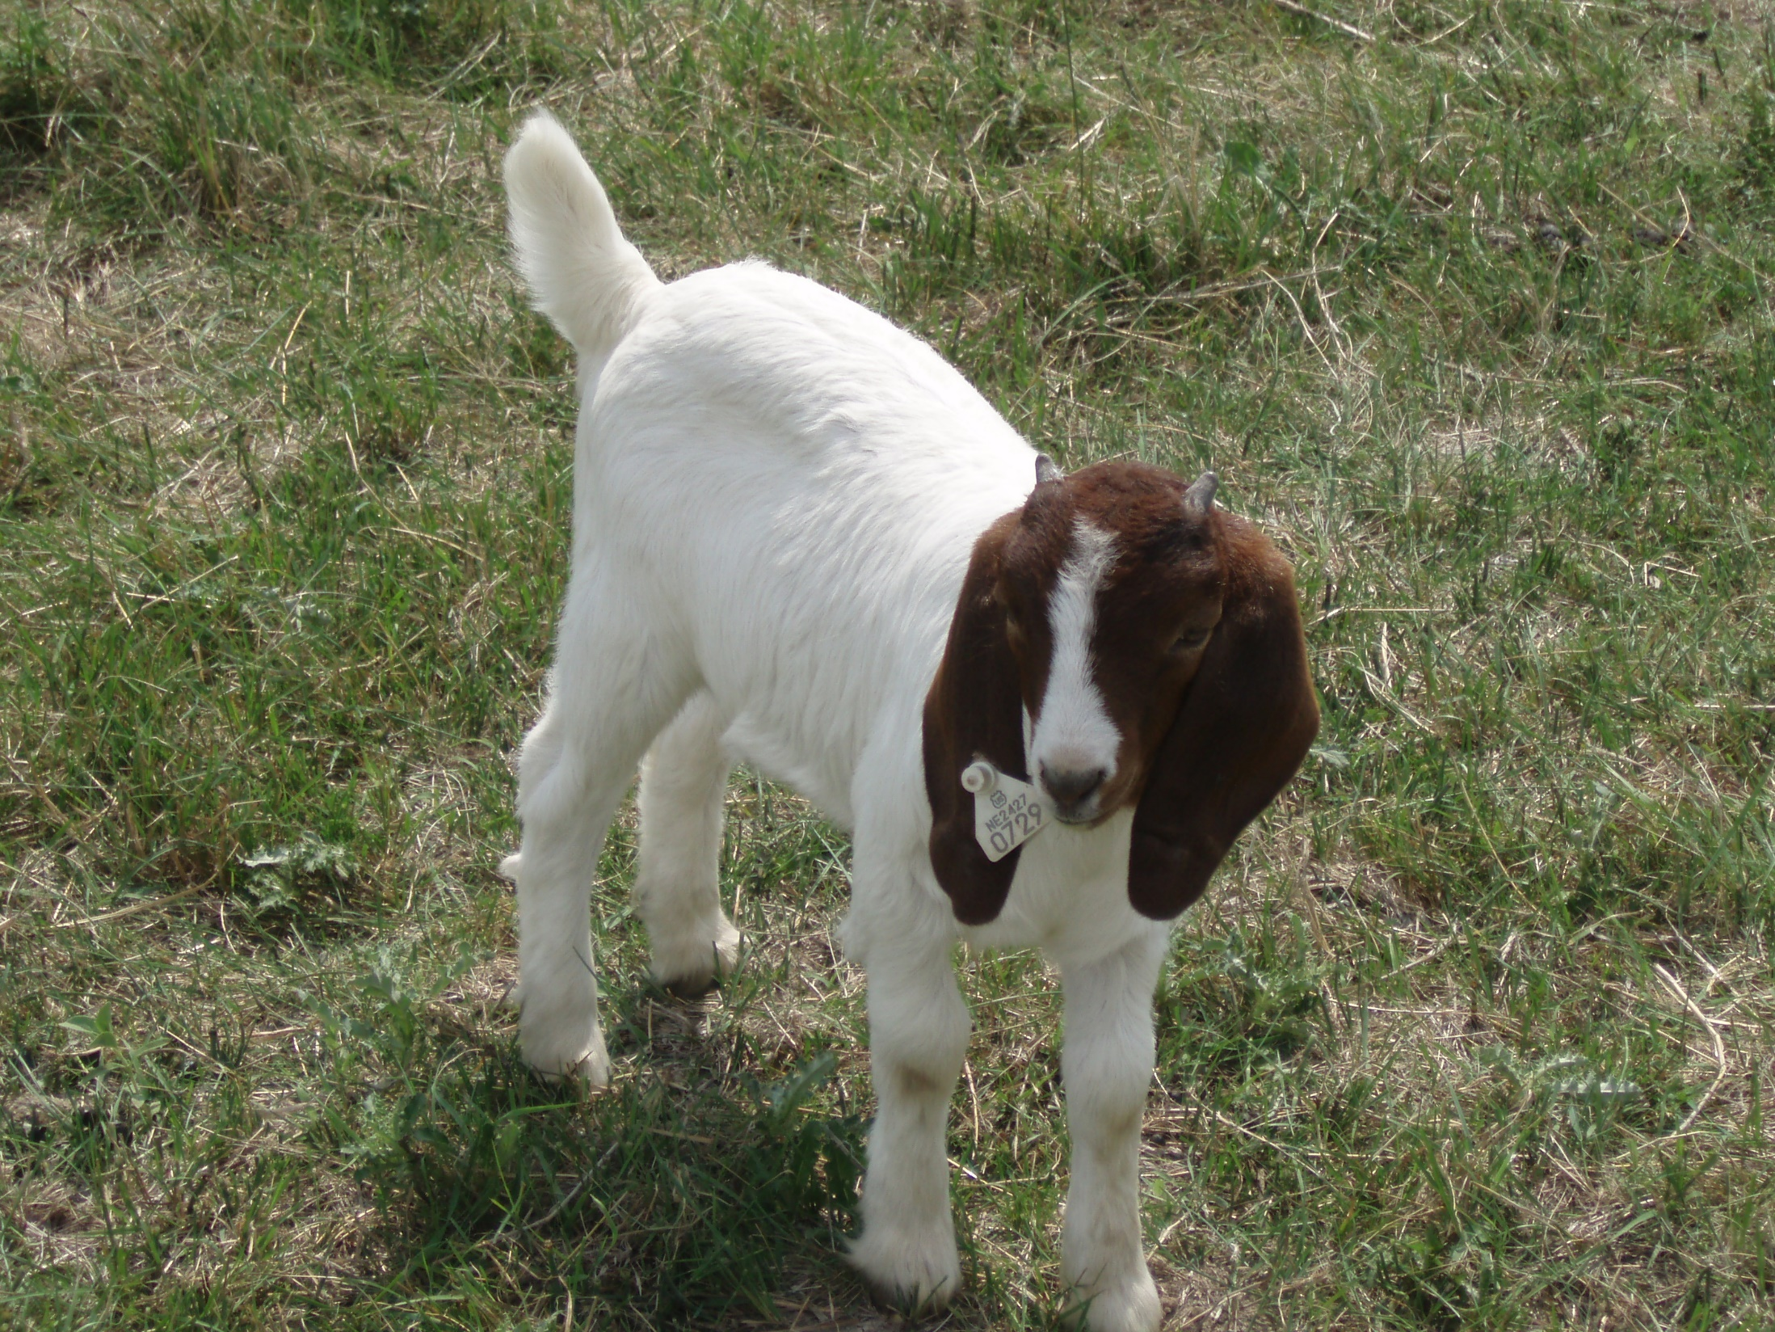
Graze with the appropriate kind and class of animal.
Kind of animal (species)
Cattle, sheep, goats, horses, wildlife
Match the species with the predominant vegetation type. If the site is dominated by browse, think about goats.
Class of animal (age, sex, physiological status)
Mature or young, nursing or dry
If forage is low quality, older, dry (non-lactating) animals may do better than other classes of animals.
Adaptation to climate and forage quality
Breed of animal, genetic potential for growth
Some breeds of cattle are more adapted to hot, humid areas while others are more adapted to colder climates.

Slide 6
2. Graze with the appropriate stocking rate.
Balance forage supply with forage demand.
The number of animals and their forage demand should match forage production.
Use the “Take half and leave half” principle to maintain healthy plants.
See lesson 15 for more information about animal units, available forage and forage balance.

Slide 7
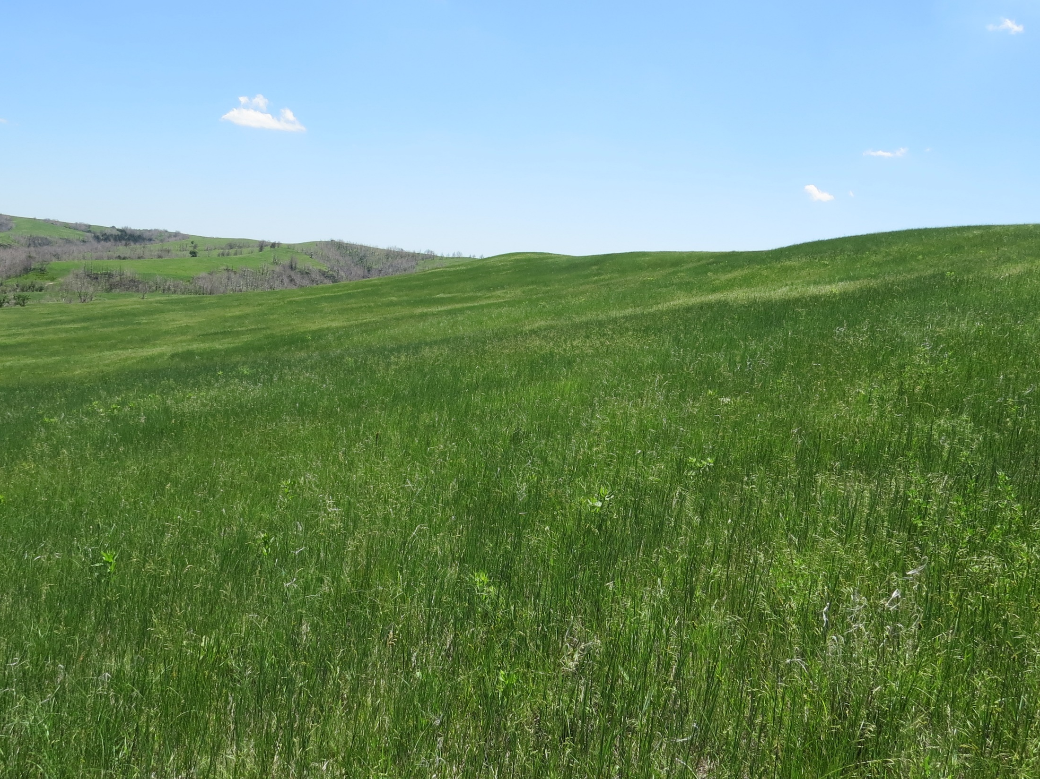
3. Graze During the Appropriate Season and/or Time: Season
Grazing can be year-long (the pasture is grazed for the entire year). Plants are grazed multiple times and are not given enough time to recover before being grazed again.
Grazing can be seasonal (pasture is grazed only during the growing season or only during the dormant season each year).
When pastures are grazed during one season one year and the other season the next year, plants have time to recover every other year.
Grazing can be in a rotational sequence using a grazing system. The plants have time to recover after grazing.
The rotation includes multiple pastures, with a grazed period followed by an ungrazed period.
See Lesson 19 for examples.

Slide 8
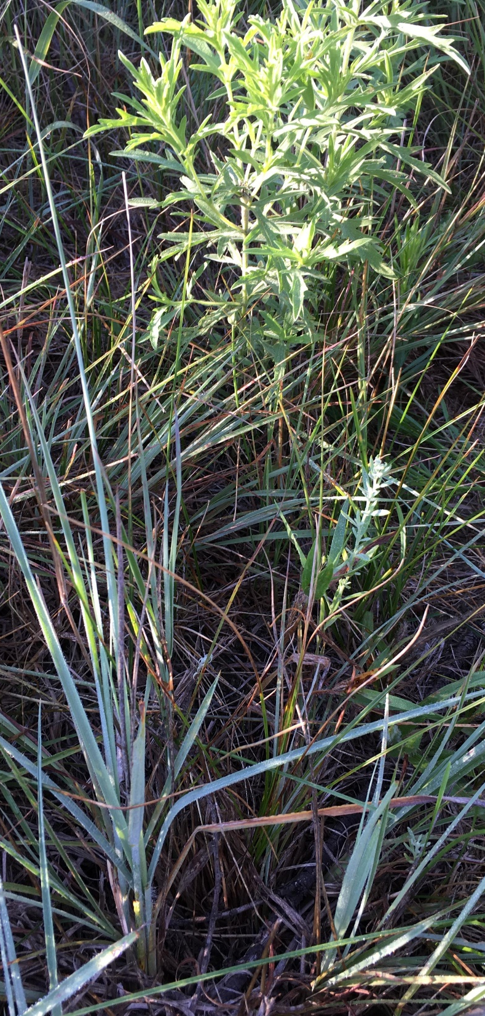
3. Graze During the Appropriate Season and/or Time: Time
Season of use – Dormant season impacts the plants less than grazing during the growing season.
Phenological State – Grazing spring growth may be less harmful than other stages in the plants’ life cycle.
Some plants, such as prairie sandreed, can be damaged when grazed during their rapid growth period because buds that produce next year’s tillers are formed at that time.
Some plants, such as big bluestem, can be damaged when grazed short in late summer through killing frost.
Opportunity for regrowth – Grazing time should allow the plant to produce new leaves and develop strong root systems before it enters dormancy.
Photo: Young sand bluestem tillers.

Slide 9
4. Graze for the Appropriate Amount of Time
The appropriate length of grazing time for a given amount of land depends upon a number of factors including:
Type, class and size of animals
Productivity of site – forage production
Percentage of the individual plant grazed or grazing height – “take half, leave half”
Plant recovery – the more leaf area that is grazed, the longer the recovery time.
Weather Conditions – drought, extreme cold temperatures in the spring, and excessive high temperatures during the grazing season reduce production reducing the appropriate grazing time.
Photo: Heavily grazed big bluestem in mid-June. If the pasture is in a rotation that includes deferment, these plants will have time to recover and will not be damaged. If the grazing period is extended and the plants re-grow and are re-grazed, damage to the plants will occur.

Slide 10
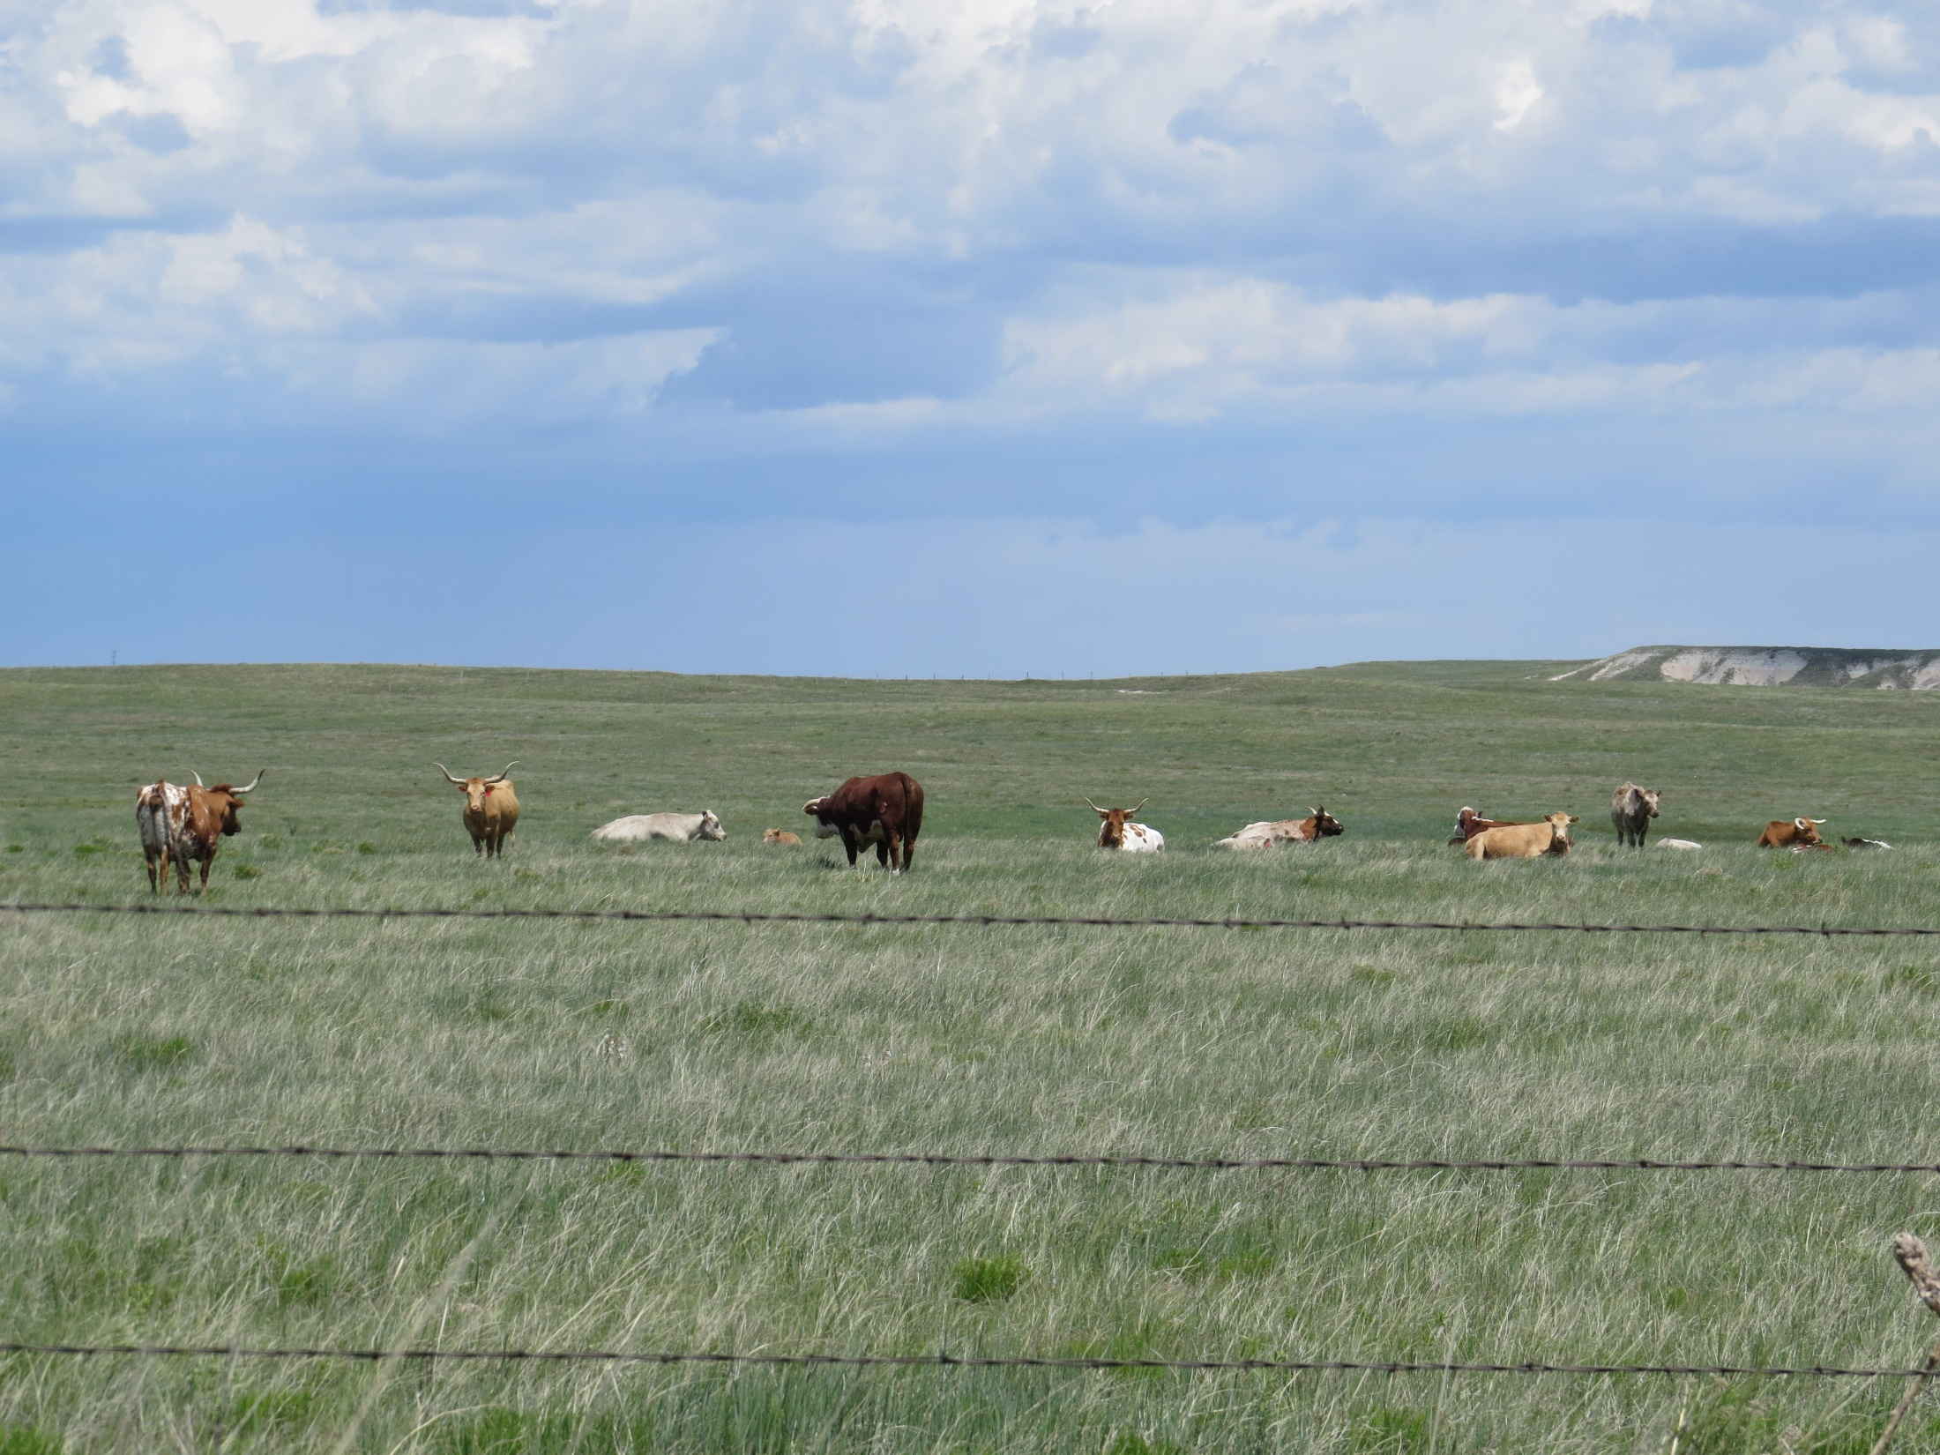
5. Graze to Achieve Appropriate Grazing Distribution
Grazing distribution is the pattern of where animals prefer to graze. Grazing animals tend to graze in a patchy manner. There are several scales to grazing distribution. Grazed patches result from preferred:
Locations on the landscape
Plant communities within the landscape
Patches within the plant communities.
Areas within the patches (called feeding stations).
Plant species
Individual plants within the species

Slide 11
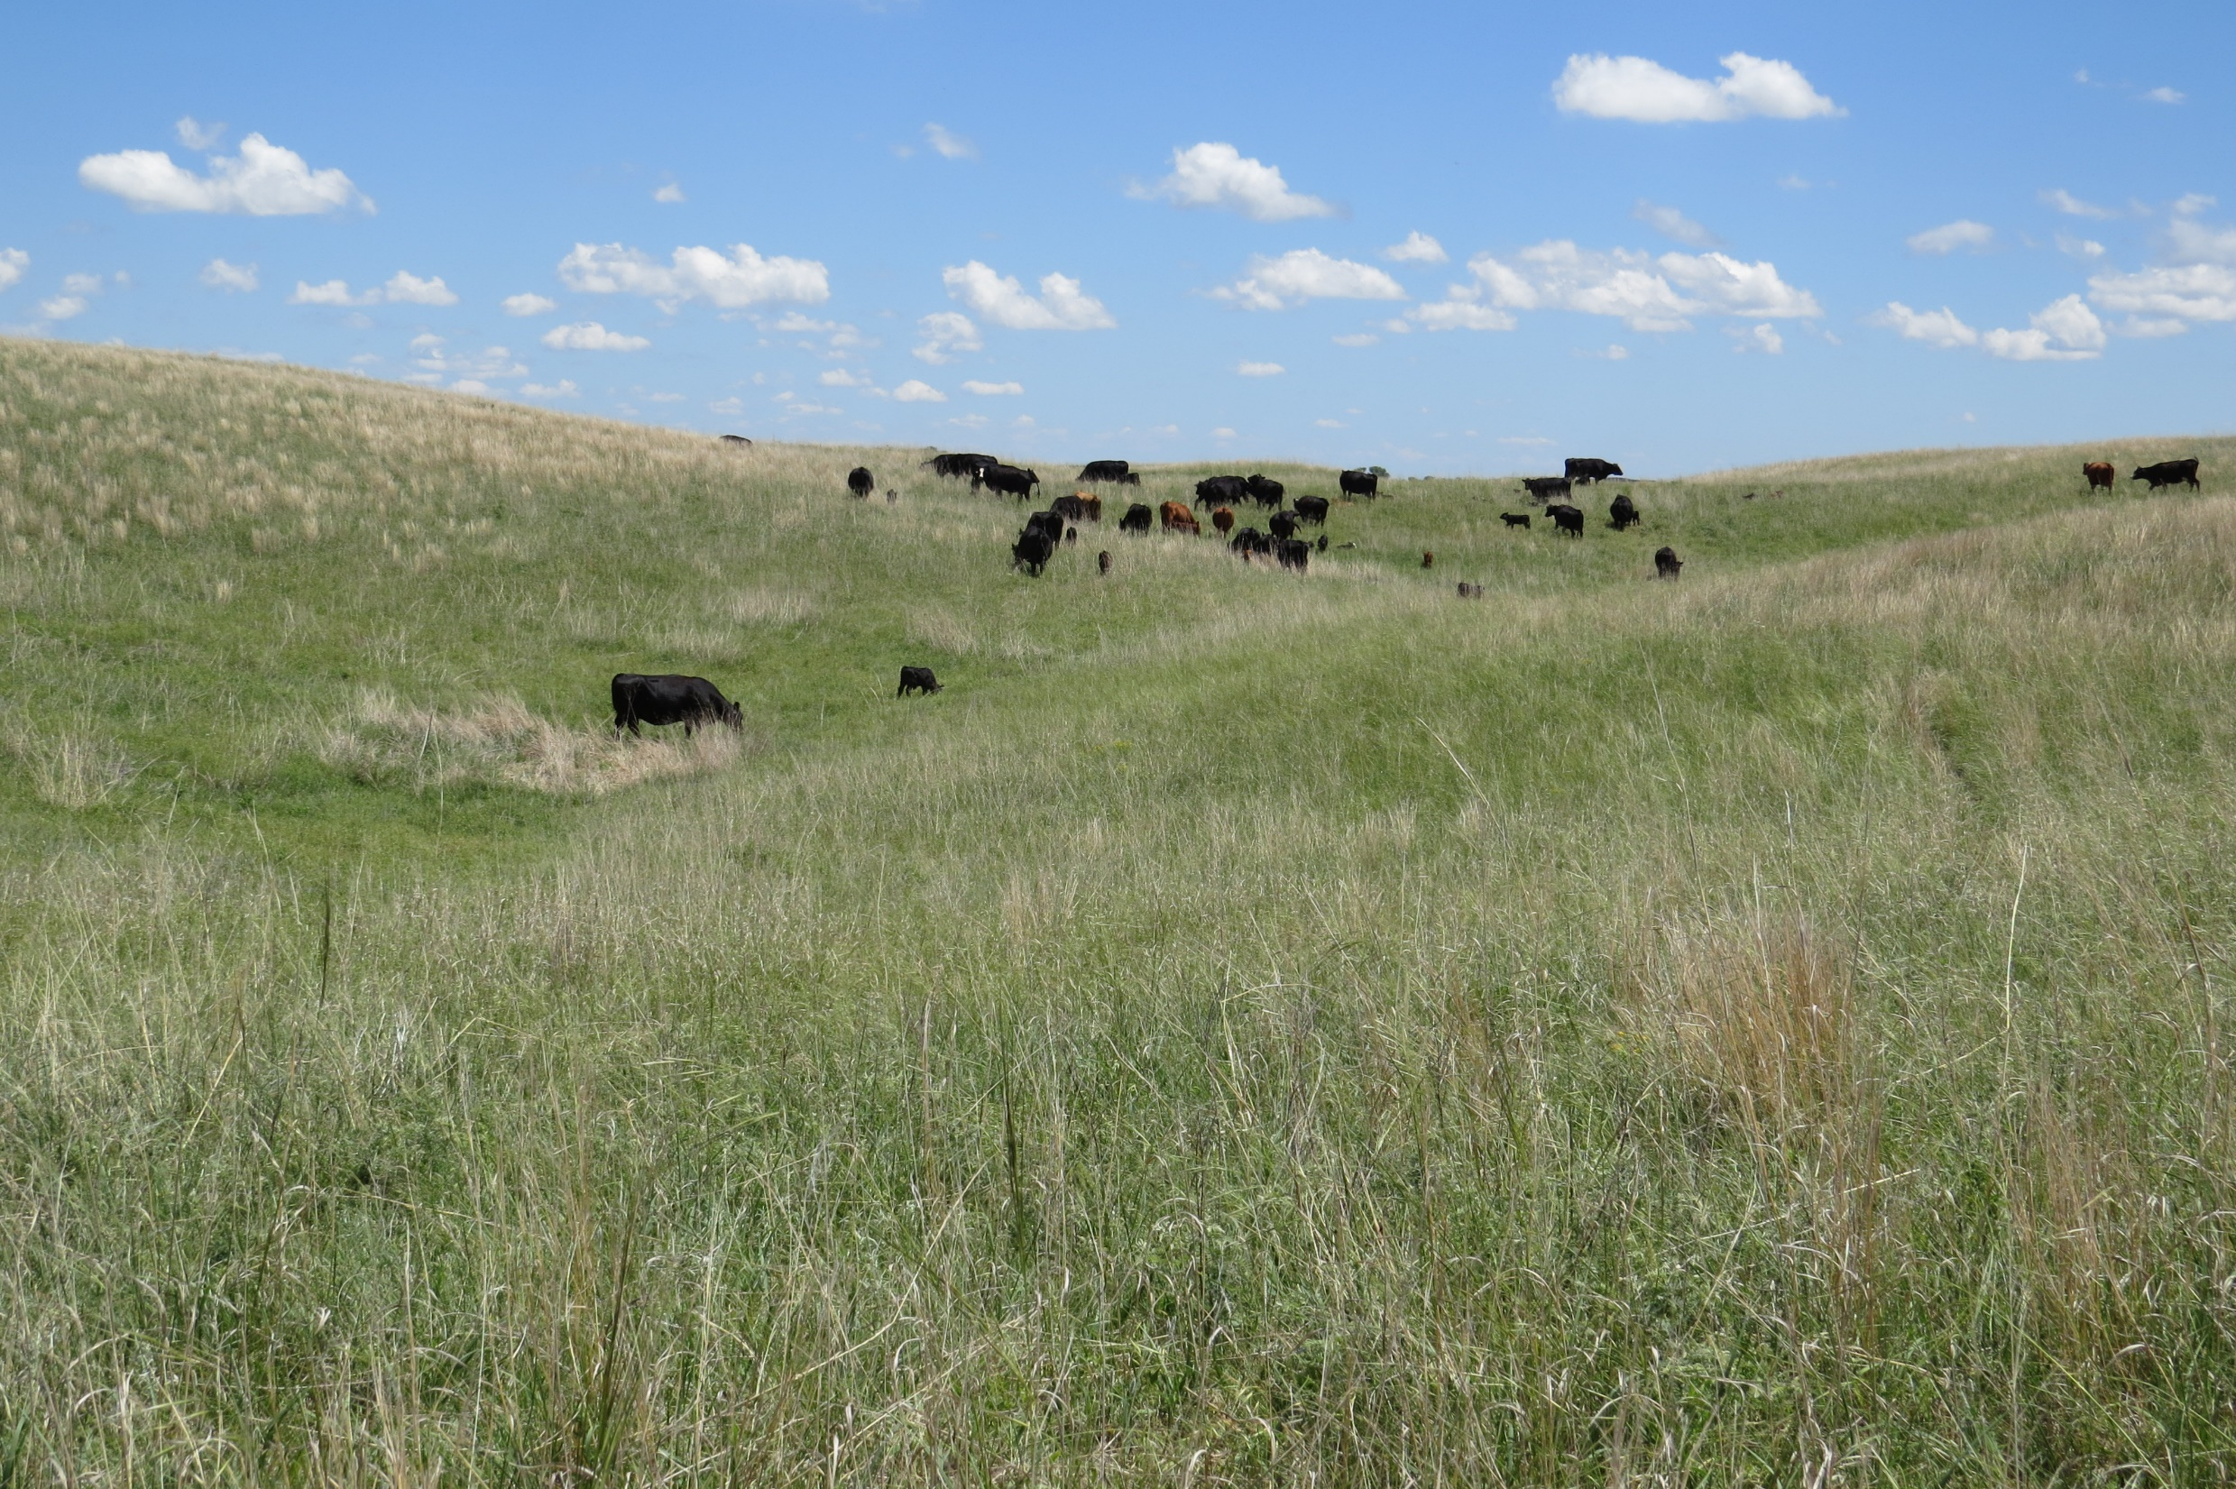
5. Graze to Achieve Appropriate Grazing Distribution
Factors that impact grazing distribution include:
Distance from Water – Areas closest to water are more heavily grazed.
Vegetation Type – Type, species, and age of plants; presence and/or absence of highly palatable species will affect distribution.
Topography - Level areas are grazed more readily than steep areas. Livestock prefer areas with less than 10% slope.
Ecological Sites – Different ecological sites produce different types and associations of plants, some of which are preferred over others.
Shade – Trees attract livestock during hot, sunny days.
Weather – Prevailing wind direction and other factors affect grazing distribution. In the heat of the summer, cattle graze where wind provides relief. In winter cattle graze in locations that provide protection from the winds and snow.
Animal Pests – When pests like flies are a problem, animals tend to select uplands and open areas with more wind.
Management Practices - Location of supplements and oilers, rubbing posts, etc.

Slide 12
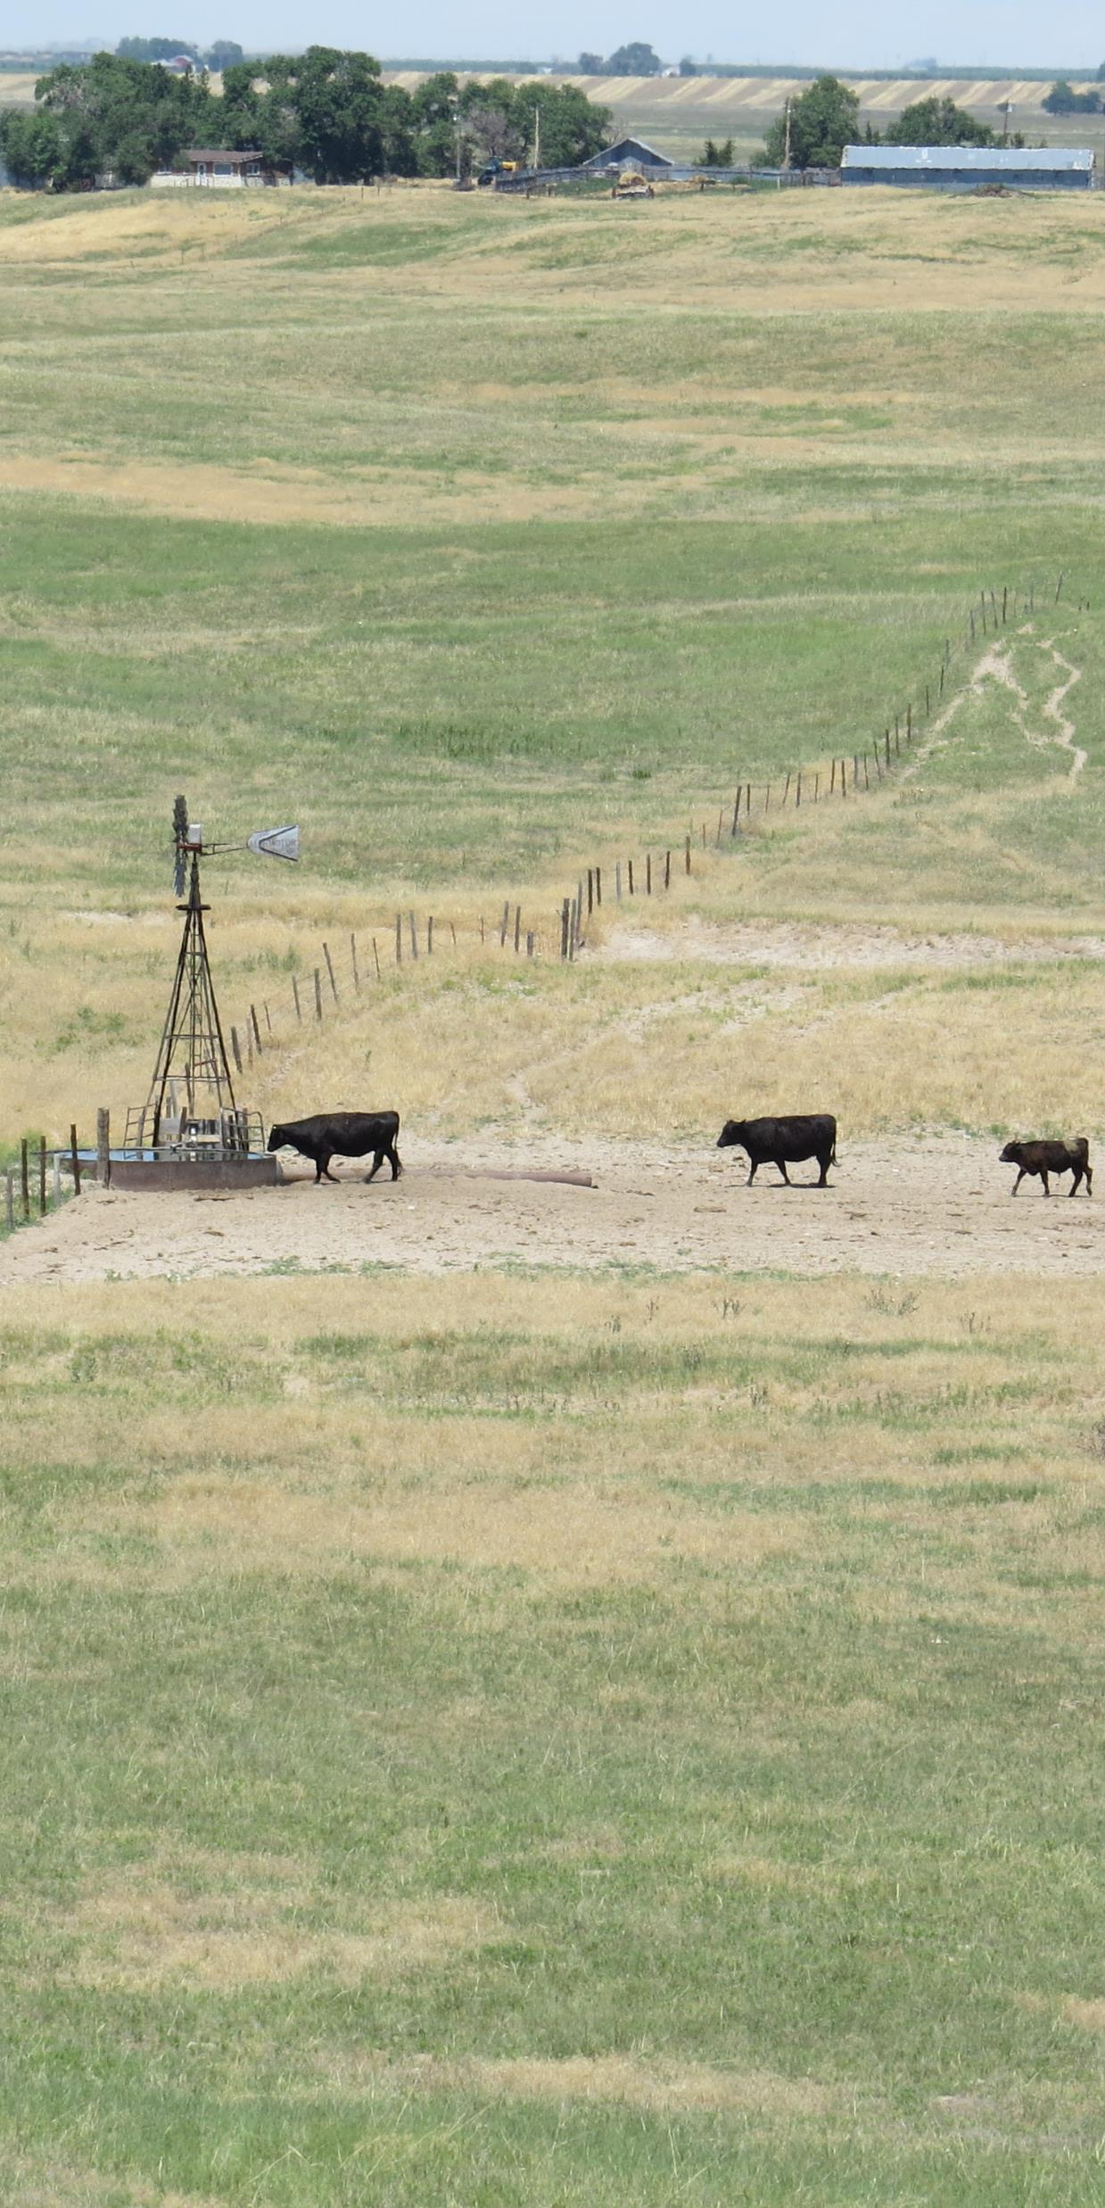
Conservation Practices on Rangelands
Conservation practices on rangelands relate to the implementation of prescribed grazing. Prescribed grazing is sometimes called proper grazing use or grazing management.
Prescribed grazing: Managing the interactions between plants, soils, topography, and grazing animals to achieve the landowner’s economic and ecologic objectives for the land in a sustainable manner.
Facilitating Practices: Conservation practices needed to implement a good prescribed grazing plan. Facilitating practices include cross-fences and water developments. Prescribed burns can be a facilitating practice when used to improve grazing distribution and/or to influence the plant community.
Accelerating Practices: Conservation practices needed to address resource problems on the land that can not be fixed by grazing management alone. Accelerating practices include brush management, weed control, and range seedings.

Slide 13
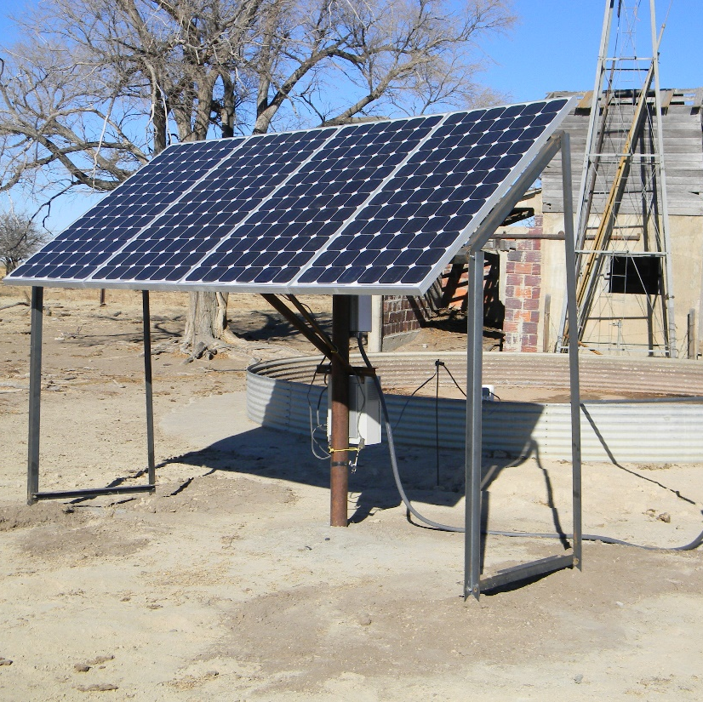
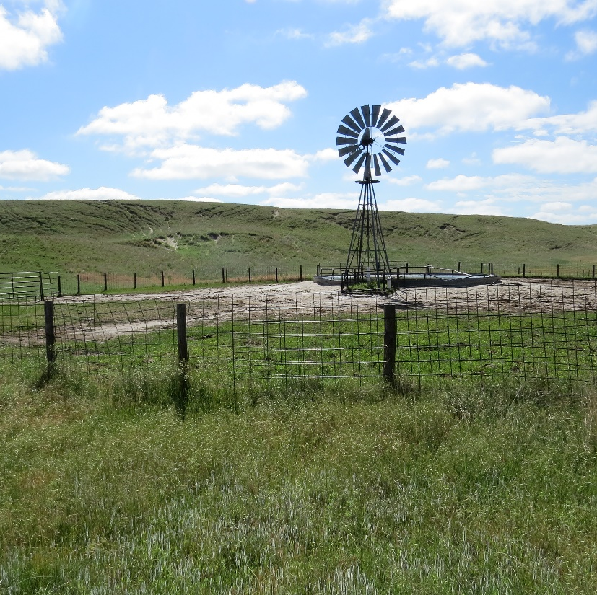
Water Developments on Rangelands: Wells
Livestock wells are a common conservation practice in Nebraska. Wells are installed primarily for livestock water but are located to facilitate better livestock distribution.
Wells are drilled to provide water directly to a tank or trough or to deliver water through a livestock pipeline to multiple tanks.
Most of Nebraska has access to the High Plains Aquifer, which includes the Ogallala Aquifer and the alluvial aquifers near streams located within the Ogallala Aquifer. In these areas, individual wells and wells feeding pipelines are common. In some parts of the state, ground water is deeper and harder to access.
Livestock wells may have a pumping plant powered by wind, electricity or solar energy. Solar wells can be permanent fixtures or they can be designed as portable systems that can be moved from pasture to pasture with the livestock.
Windmills and solar wells are more economical in areas where powerlines are not nearby. Running new powerlines for electric wells can be quite costly.
Photos: Top: Solar panel system for solar powered livestock well. Bottom: Wind mill for livestock water.

Slide 14
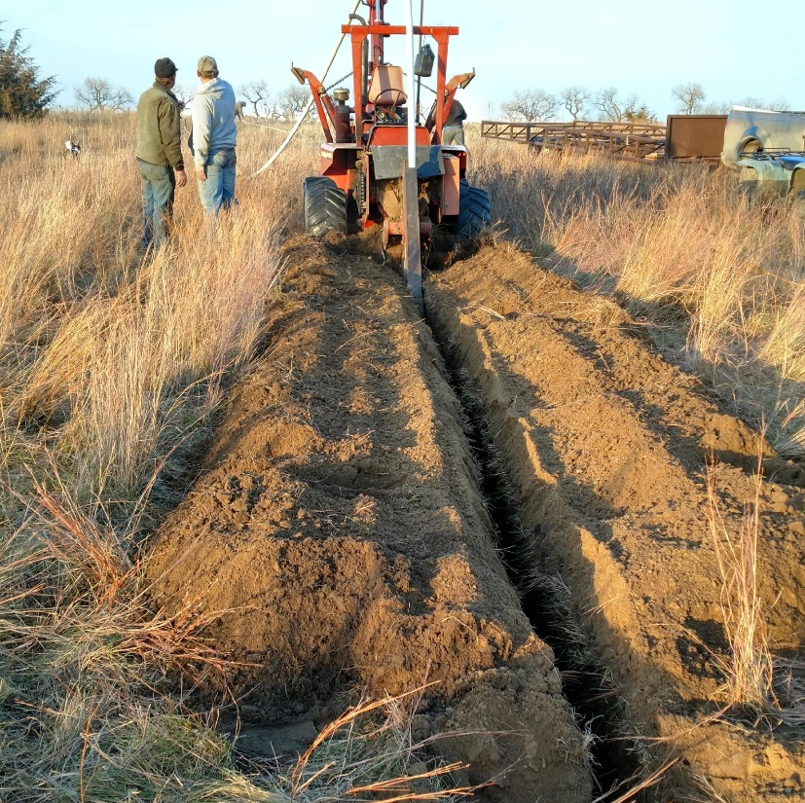
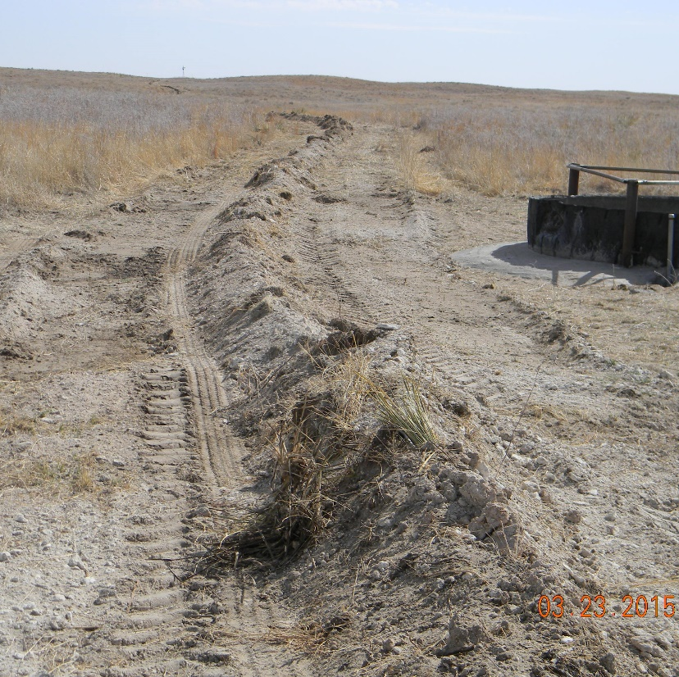
Water Developments on Rangelands: Livestock Pipelines
Livestock pipelines are an alternative to multiple wells in a pasture or set of pastures. It is often less costly to install one well and several hundred or thousands of feet of pipeline than to drill multiple livestock wells.
The size of pipe used in livestock pipelines in Nebraska is determined by the amount of water to be delivered, the difference in elevation (uphill and downhill) along the pipeline route and the length of pipeline.
In Nebraska most on-ranch pipelines are either polyvinyl chloride (PVC) or polyethylene (PE). With PVC pipe, a trench is dug, the sections of pipe glued together and placed in the trench, and the trench covered. The disturbed soil will settle and grass re-establishes in 1-2 years. With PE pipelines, the pipe is more pliable and is on a large roll. The pipeline is knifed into the soil as a longer continuous pipe.
In areas with limited water, large community pipelines on rural water systems are used to supply water. Rural water systems in Sioux and Knox counties are over 100 miles long and supply more than 50,000 acres.
Photos: Top: Livestock pipeline being installed on a sandy site in Holt County, photo by: Myra Richardson Bottom: Livestock pipeline immediately after construction on a sands site in Dundy County

Slide 15
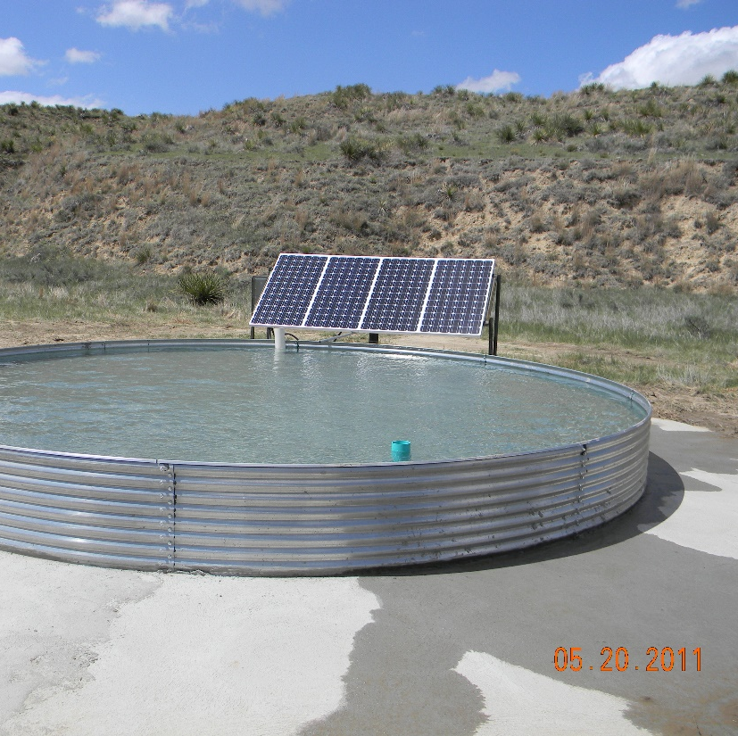
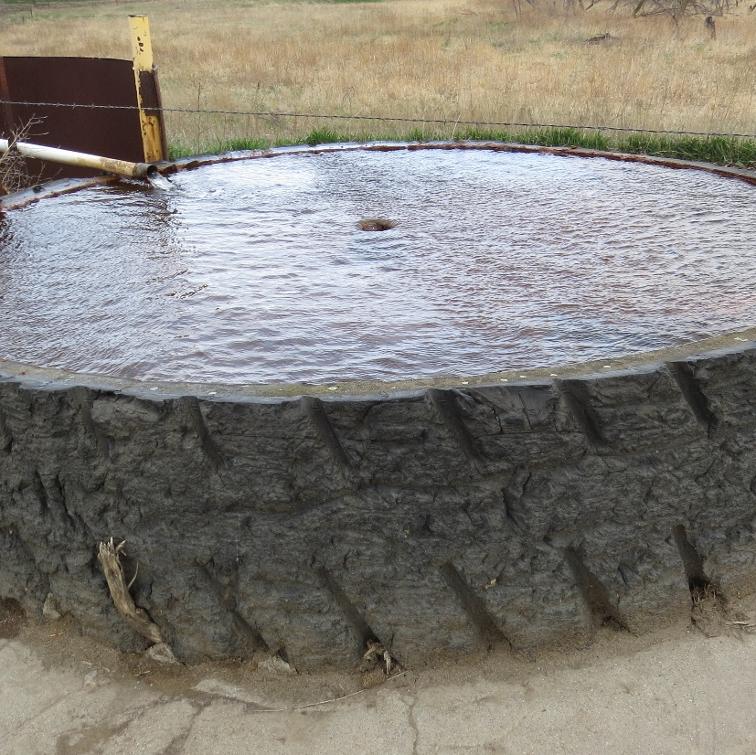
Water Developments on Rangelands: Tanks
There are a number of options for types of tanks. Factors to consider when selecting a tank type include the amount of water needed, the durability needed, availability in the area, and ease of installation.
“Bottomless” tanks consist of a galvanized steel rim (which does not have a bottom) that is installed on a concrete pad, with a layer of bentonite clay, or a thick, flexible membrane. These tanks can be quite large and a typical size is 30’diameter. These tanks are a good way to supply a large volume of water to a pasture at a single watering point.
Steel bottom tanks are manufactured entirely of galvanized steel. These tanks are smaller (usually 11’ diameter or smaller) than the typical bottomless tank. Several steel bottom tanks in various locations throughout a pasture on a pipeline system is a good way to achieve even grazing distribution.
Rubber Tire Tanks are tanks that are made from recycled mining equipment tires. The typical size for this type of tank is 9’ diameter. These tanks are very durable, long lasting tanks. Some rubber tire tanks are placed on a concrete pad and some have a steel plate installed in the bottom of the tank.
Polyethylene Tanks and Fiberglass tanks are similar in size and function to steel bottom tanks and are used less frequently on Nebraska rangelands.
Photos: Top: Bottomless tank with solar well Bottom: Rubber tire tank supplied by spring development.

Slide 16
Water Developments on Rangelands: Ponds and Dugouts
Ponds and dugouts are constructed to capture runoff water from the surrounding watershed. In some areas ponds are the most common livestock water source.
Ponds are large structures that have a dam and spillway to safely release excess storm water. Dugouts are dug into the ground on level bottomlands and do not have a dam, but a small berm.
When water levels in ponds and dugouts are low, the water quality for drinking can be quite low. During droughts, these water developments may not provide adequate water for the livestock and wildlife.
Photo: Pond in Cheyenne County, Kristin Dickinson, NRCS

Slide 17
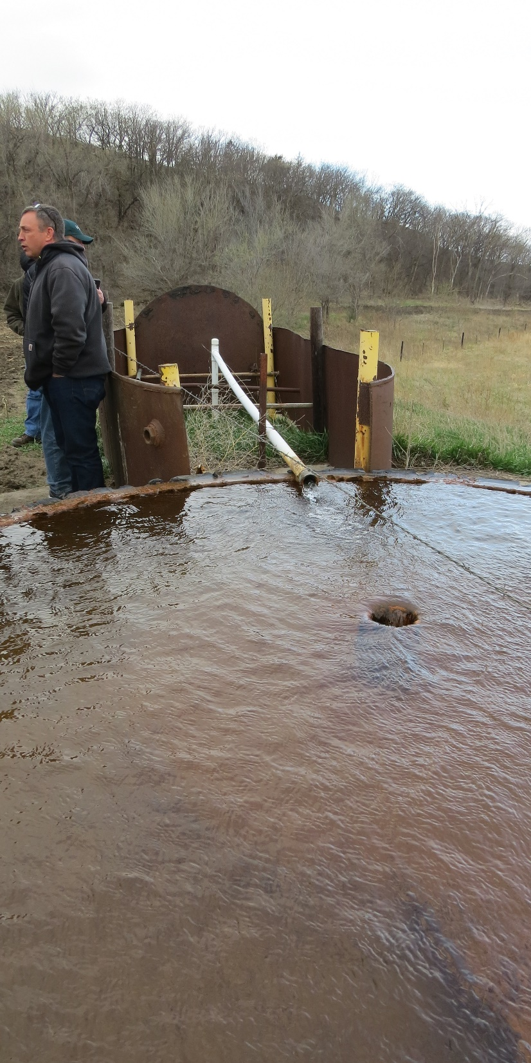
Water Developments on Rangelands: Spring Developments
Springs are areas where water is seeping or flowing from small openings in the ground or from joints or fissures in the rock. Some areas have abundant springs, which can be important water sources.
When the water is slowly seeping to the surface these areas can be excavated, a spring box inserted, and collection pipes used to harvest the water and direct it to a tank.
In Nebraska, there are a few areas where spring development is feasible, but this is a relatively uncommon practice across the state.
Photo: Spring development in Knox County, NE

Slide 18
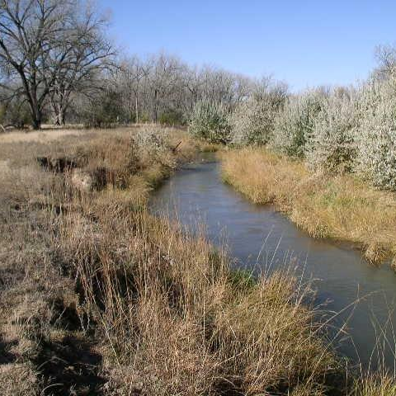
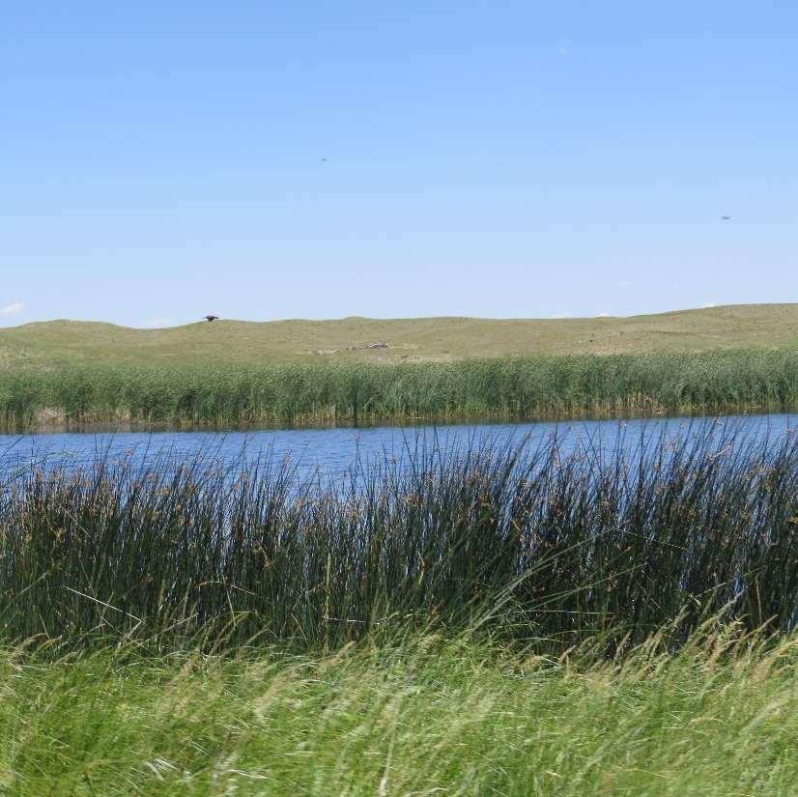
Water on Rangelands: Natural Water Sources
Lakes, streams and rivers are also common water sources in Nebraska.
When natural sources are used as primary water sources, care should be taken to prevent harm to the riparian areas, shorelines and water quality. These areas can be protected by:
Including other water sources within the pasture.
Fencing the majority of the stream or lake to limit area of access along the riparian area or shoreline.
Use a grazing strategy that limits the amount of time in the pasture(s) by implementing a rotational grazing system.
Top Photo: Frenchman Creek in Dundy County, NE
Bottom Photo: Sandhills Lake in Grant County, NE

Slide 19
Water Development Considerations – Volume
Water developments should be designed to supply the daily water requirements for livestock and/or wildlife that will drink the water. It is recommended that 2-3 days storage be available with electric wells or reliable springs and 3-7 days with solar and wind sources. According to the Natural Resources Conservation Service (NRCS) technical guidance the minimum daily water requirements for livestock and wildlife are:
Animal Type | Daily Requirements
Cow & Calf | 15-20 gallon
Dairy Cow | 25-30 gallon
Horse | 15-20 gallon
Sheep or Goats | 1.5-3 gallon
Bison | 20-25 gallon
Deer or Pronghorn | 1-2 gallon
Elk | 5-8 gallon

Slide 20
Water Development Considerations – Spacing or Travel Distance (Livestock)
Water developments should be spaced to promote even grazing distribution and to protect sensitive areas. NRCS recommendations for spacing for livestock are based on type of topography and the type of grazing system. NRCS’ suggested maximum travel distances for livestock are:
Cattle:
Type of Topography | Conventional Grazing Maximum Travel Distance | Intensive Grazing Maximum Travel Distance
Steep | 1 /2 Mile | 1 /8 Mile (660 feet)
Rolling | 3 / 4 Mile | 1/6 Mile (880 feet)
Level | 1 mile | 1 /4 Mile (1320 feet)

Slide 21
Water Development Considerations – Spacing or Travel Distance (Wildlife)
NRCS recommendations of optimum and maximum water spacing for selected wildlife species:
Type of Wildlife | Optimum Spacing | Maximum Spacing
Deer and Bighorn Sheep | 1 / 2 mile | 1 mile
Pronghorn and Elk | 1 mile | 2 miles
Wild Turkey and Pheasant | 1 / 2 mile | 1 mile
Prairie Grouse | 1 mile | 2 miles
Bobwhite Quail | 1 / 4 mile | 1 / 2 mile
Songbirds | 1 / 4 mile | 1 / 2 mile

Slide 22
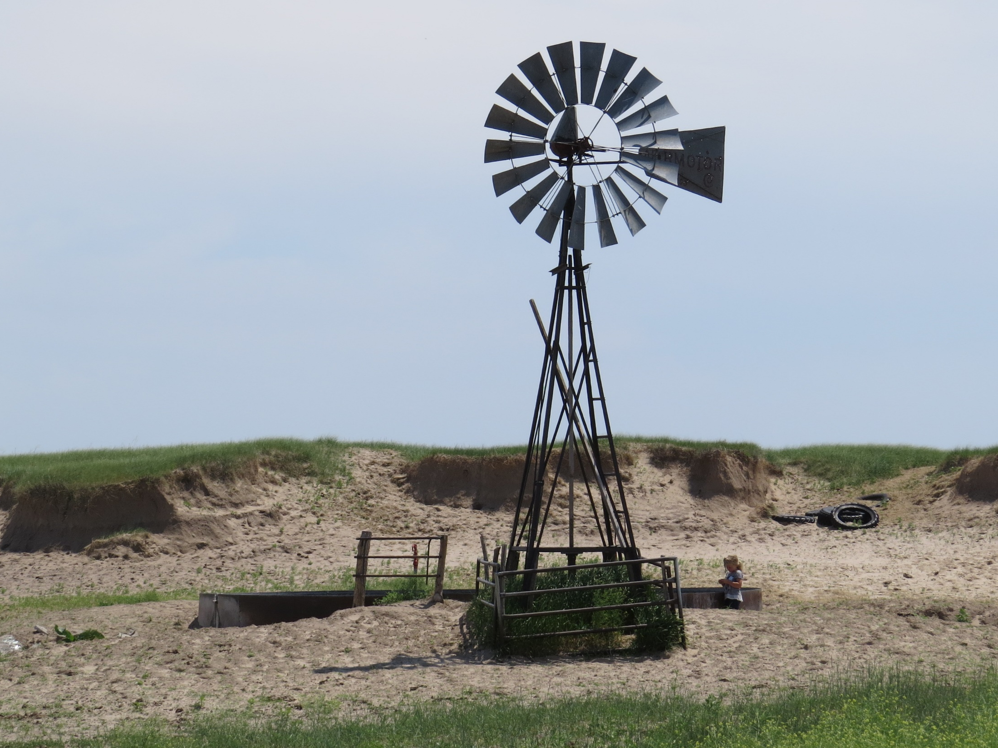
Water Development Considerations – Location
When installing water developments, the physical location of the development should be considered. A water location that is the appropriate distance from other water locations or in a location that will improve grazing distribution can still be in an improper location.
A tank in a location surrounded by steep hills will result in trailing and erosion. A tank located near a blowout area can cause the blowout to enlarge due to increased animal activity. When locating a tank, topography near the tank and animal travel patterns are important considerations.

Slide 23
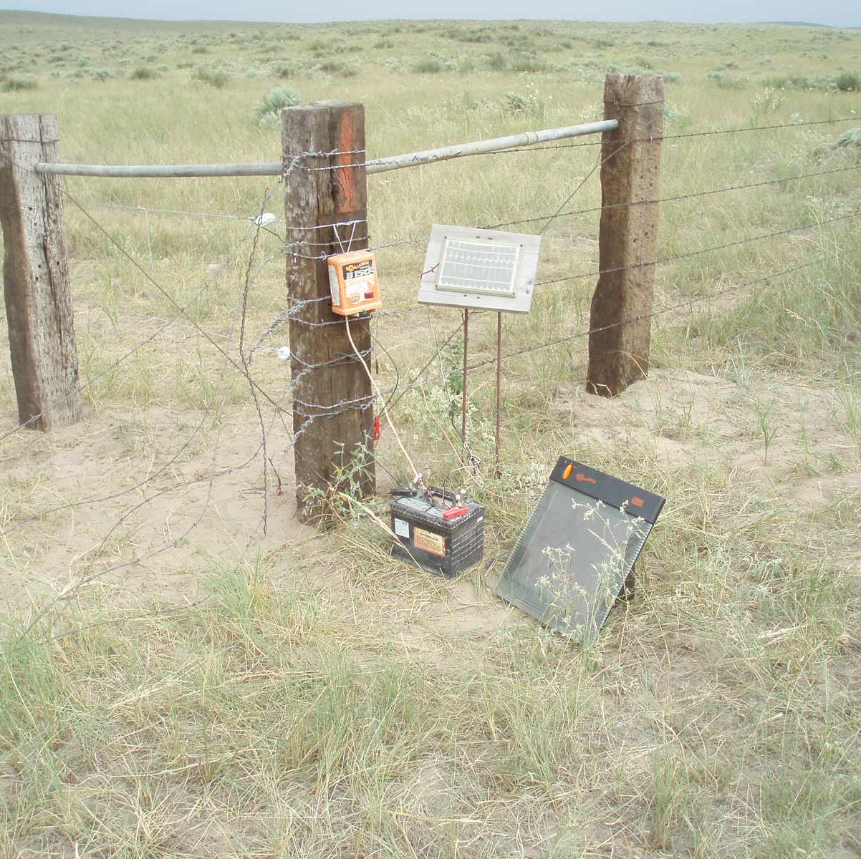
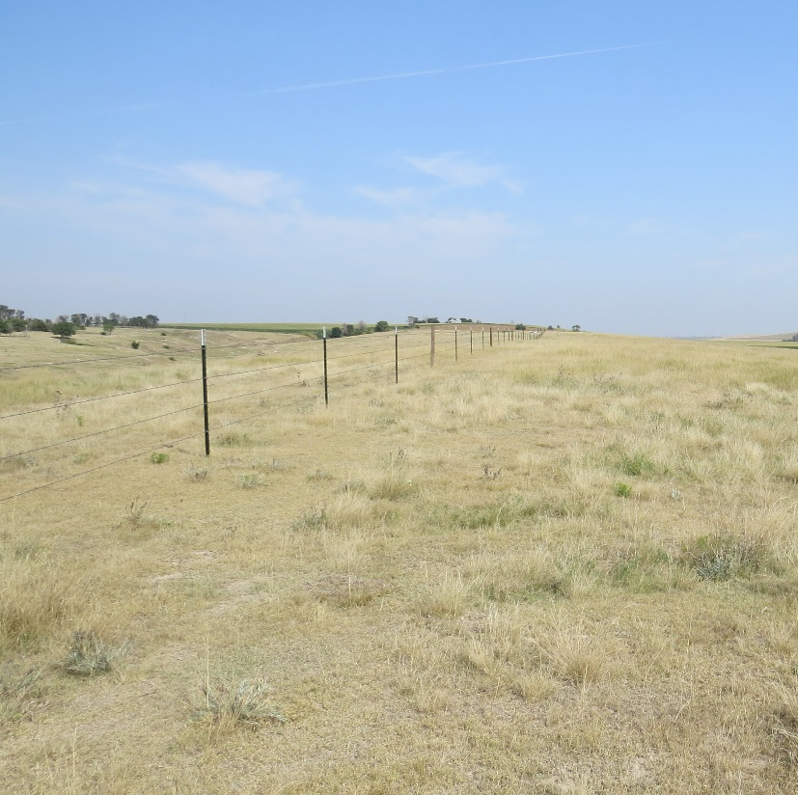
Interior Fencing
A fence installed within the interior of a grazing unit is known as a cross-fence. Cross-fencing is usually installed to implement a planned grazing system and/or to improve grazing distribution. Interior fences are also installed to separate different livestock herds (livestock management), or to restrict access to a sensitive area such as a riparian area or an erosive area.
Cross-fencing may be temporary or permanent fencing. In Nebraska, most cross-fences are permanent fences with barbed wire and permanent electric fences (power fences) being the most common.
Power fences are different from the temporary electric fence in terms of durability and the energizer. Energizers used in power fences have a higher volt output and produce 35-65 pulses per minute.
Some ranchers utilize temporary electric fencing in grazing systems when experimenting with locations before installing a permanent fence or when changing paddock locations each year.
Photos: Top: Permanent electric fence using high tensile wire
Bottom: Barbed wire fence using metal T-posts.

Slide 24
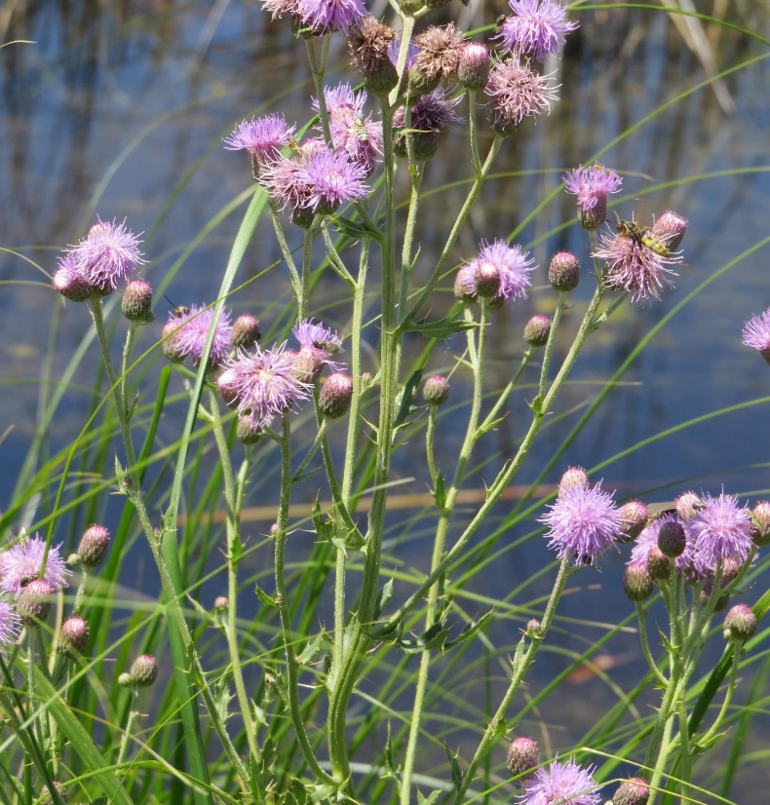
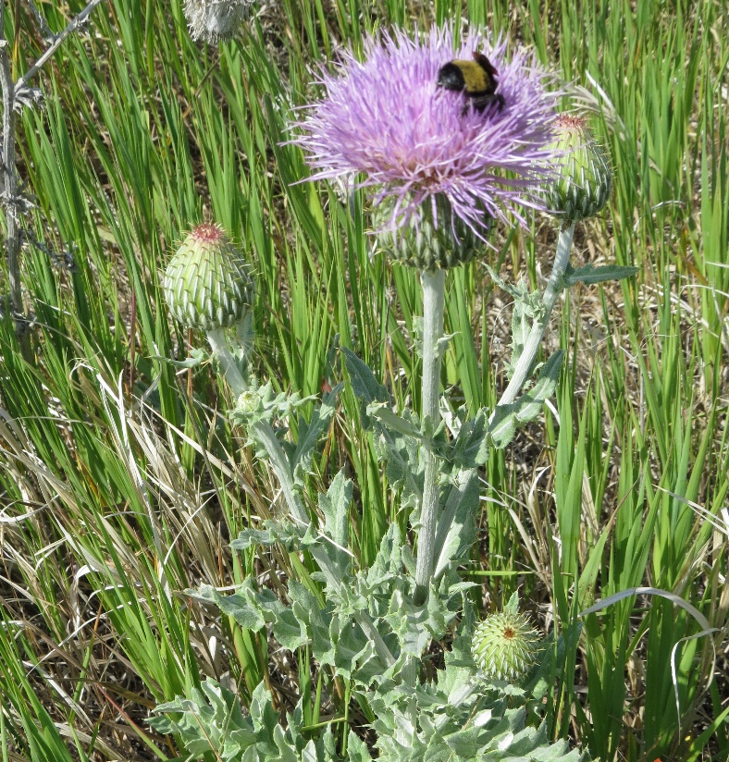
Herbaceous Weed Treatment or Control
Herbaceous weed control is removal of undesirable herbaceous weeds including noxious and invasive plants.
Weed control can be accomplished by mechanical, chemical, and/or biological methods. Mechanical treatment includes mowing, digging or shredding. Many pastures are too steep and/or large or weed infestations too extensive for mechanical treatment to be a viable option.
When using chemicals for weed control, the chemicals selected and time of application should minimize damage to desirable native plants and be applied as part of an integrated pest management plan.
Biological control with host specific insects is somewhat effective for weeds like musk thistle (weevils), and biological control of cheatgrass (bacteria) is being studied and may be a viable option for reducing that weed.
Prescribed burning can also be used for weed control and is discussed in Lesson 18.
A careful evaluation of the pastures should be made to determine if the “weeds” are forbs that have increased due to disturbance and will reduce over time or if they are weeds that will continue to increase and impact the productivity, health and vigor of desirable species.
Photo: Top: Weed control of musk, plumeless and Canada thistle (top photo) are a must, but wavyleaf thistle (bottom photo) is native thistle that does not become a problem with good range management. Wavyleaf provides a valuable source of food for pollinating insects and usually does not need to be controlled.

Slide 25
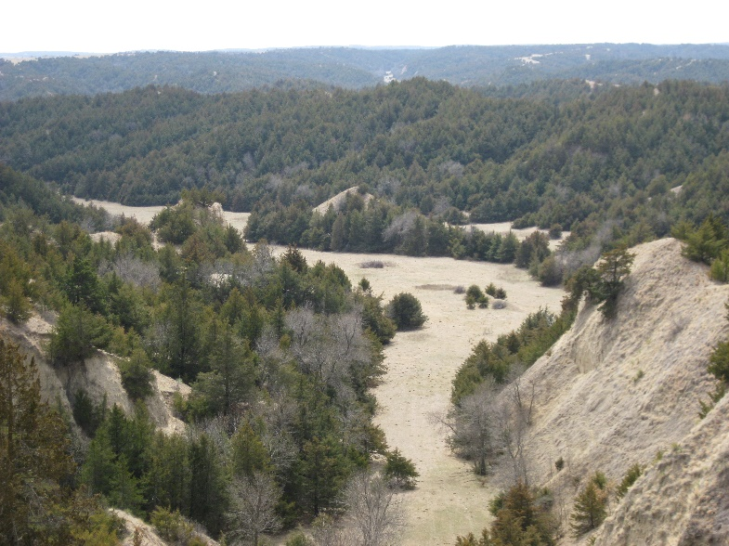
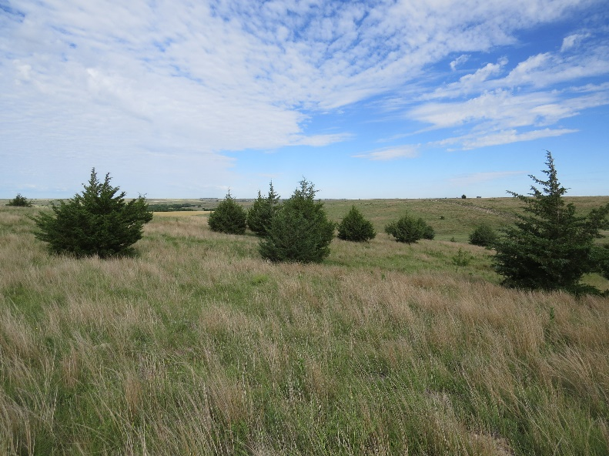
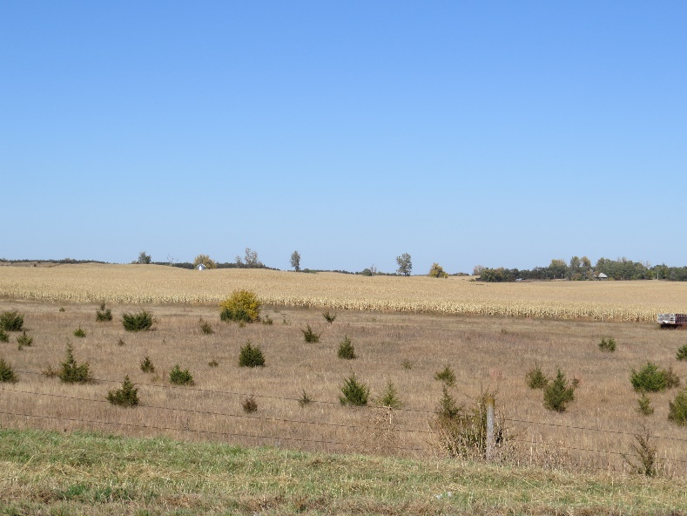
Brush Management
Brush management includes the removal of woody species that have encroached into rangeland ecosystems. Brush management can be accomplished through mechanical removal or chemical removal. In Nebraska, the most common woody species being removed are eastern red cedar, honey locust, Siberian elm, Russian olive, salt cedar, dogwood, and smooth sumac.
Mechanical methods of weed control include manual cutting with a chainsaw, tree shears, and tree mulchers.
Forestry Mulcher: https://www.youtube.com/watch?v=4W6PJHT9nto
Tree Shears:
https://www.youtube.com/watch?v=5FrvDLYdIIk
https://www.youtube.com/watch?v=stBDME5O3yc
Turbo Saws:
https://www.youtube.com/watch?v=SbD1f47MC4c
Mechanical removal alone is very effective for control of eastern red cedar; when all branches are removed the tree will not regrow or re-sprout. If the tree or shrub is a re-sprouting species, chemical stump treatment should immediately follow mechanical removal.
Brush management is most cost-effective when the trees are small and infrequent. The more and larger the trees, the higher the cost for removal.
Bottom photo (Antelope County): Small, abundant trees could easily be controlled with a tree mower or a prescribed burn (which is not brush management). Middle photo (Red Willow County): Larger, scattered trees are still at a size and abundance that removal is economical. Top Photo (Lincoln County): The number of trees has nearly eliminated forage production and trees are so extensive that removal of trees will exceed the value of the land.

Slide 26
Additional Practices on Grazing Lands
As mentioned earlier in this lesson, prescribed grazing is the keystone range management practice and will be covered in lesson 19.
Range seedings and prescribed burning are common accelerating practices and will be covered in lessons 17 and 18.

Slide 27
Activities and Review
Observe a rangeland unit. Does it appear to be overgrazed or does it have distribution problems?
What would you recommend to a rancher to address any natural resource issues that you have found on the land?
https://globalrangelands.org/topics/uses-range-and-pasture-lands/introduction-grazing-management
Kansas State University: Grazing Distribution Publication

Slide 28
End of Lesson sixteen

