Slide 1
Lesson Eighteen:
Prescribed Burning

Slide 2
What is a Prescribed Burn?
A prescribed burn is a controlled fire (sometimes called a planned or controlled burn) applied to a predetermined area under a specific set of environmental conditions to achieve one or more of the following objectives:
Controlling undesirable woody and/or herbaceous vegetation.
Restoring and maintaining ecological sites and function.
Preparing sites for harvesting, planting or seeding.
Controlling plant disease.
Reducing wildfire hazards.
Improving wildlife habitat.
Improving plant production (quantity and/or quality).
Enhancing seed and seedling production.
Improving distribution of grazing and browsing animals.
Photo: Igniting a prescribed fire on CRP in Chase County, NE.

Slide 3
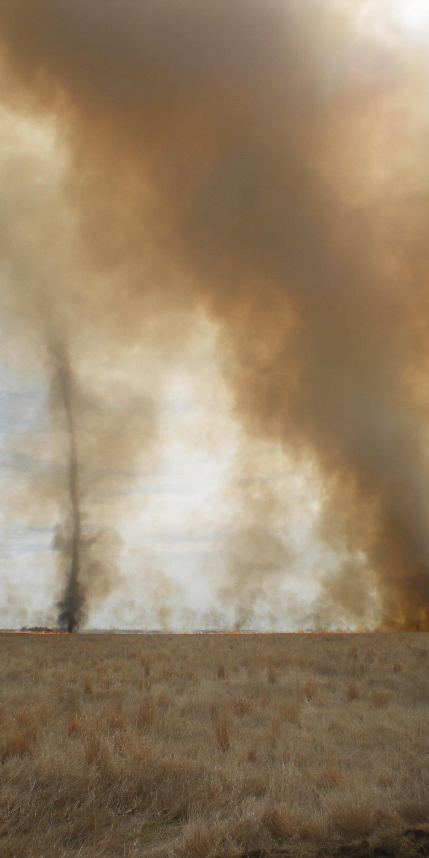
What is a Prescribed Burn Prescription and Plan?
A prescribed burn is conducted according to a prescription that is site specific and prepared in advance according to a written plan. A prescribed burn plan includes:
Description of the objectives for the burn
Description of the fuels present in the burn area
Delineation of the burn unit and its boundaries
Description of the precise weather conditions required for the prescribed burn to be safe and meet objectives.
Listing of individuals to be notified prior to the burn
Locations and types of firebreaks and/or fuel breaks
Equipment and personnel needed to conduct the burn.
Other pertinent items for a safe, effective burn.
Photo: Fire tornado during prescribed fire on CRP in Chase County, NE.

Slide 4
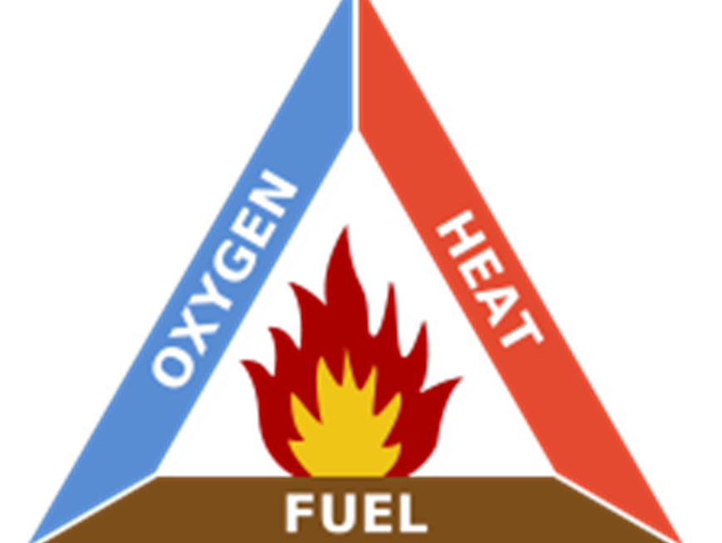
Fire Behavior
Developing a prescribed burn plan requires an understanding of fire behavior. Fire behavior is the interaction and response of fire to the physical and atmospheric environment.
Fire will behave differently in terms of direction, speed and intensity depending upon the type and distribution of fuels, weather conditions, and lay of the land or terrain.
Variation in fire behavior is dependent on variations in the fire triangle. The fire triangle consists of oxygen, heat, and fuel. All three elements are required for a fire to ignite and continue.

Slide 5
Fire Behavior and Fuel
Fuels are the main source of energy for a fire and anything that can burn can be a fuel. Fuel characteristics impact fire behavior.
Size: Larger, denser fuels require more energy (heat) to ignite, but once ignited will burn longer than small, less dense fuels. Put another way, fuels with a high surface area to volume ratio ignite and burn faster than low surface area fuels.
Condition: Living, growing plant material has higher moisture content than either dead or dormant plant material. Live material is more difficult to ignite than dead plant material.
Chemical Composition: Plants containing a relatively high amount of waxes, oils, and resins (for example, eastern red cedar, pines) will burn more intensely and throw off more burning embers than plants with a low amounts (hardwood trees and most grasses).
Moisture Content: Fuels that have a high level of moisture do not burn as well as drier fuels. For example, green growing grasses require more energy to burn than dormant grasses.
Continuity : Fuels that are evenly spread across the landscape burn more consistently than patchy fuel.
Amount: The required amount of fuel depends upon the objectives of the burn. Resting pastures for a full growing season may be necessary to produce enough fuel to meet the objectives.
Photo: Prescribed burn in smooth brome pasture. The grass is green enough that the fire is moving quite slowly.

Slide 6
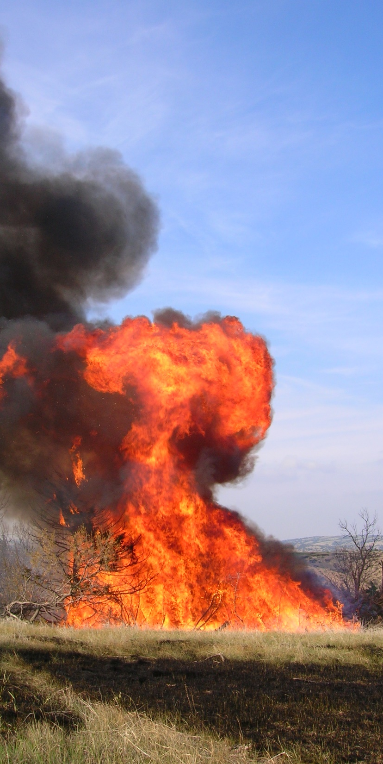
Fire Behavior and Topography
Topography is the lay of the land. Topography has a large impact on fire behavior. The effect of topography, especially slope and aspect, on fire behavior is the easiest factor to predict.
Slope: The degree of incline of a hill. Fire will travel uphill faster than downhill. Flames preheat upslope fuels so less energy is needed to ignite the fuel than downslope fuels. When slopes are steep, the intensity of the fire can be so large that trees are ignited.
Aspect: Aspect is the direction the slope is facing. South and southwest aspects are warmer, drier, and have lower fuel loads as compared to north and northeast aspects. North facing slopes tend to have higher fuel loads and more trees than South facing slopes.
Special topographic concerns: Box canyons and saddles constrict airflow creating higher wind speeds and more extreme fire behavior. These areas should be avoided when establishing burn unit boundaries.
Photo: Prescribed burn in Lincoln County. Volatile fuels with an uphill slope created an intense fire.

Slide 7
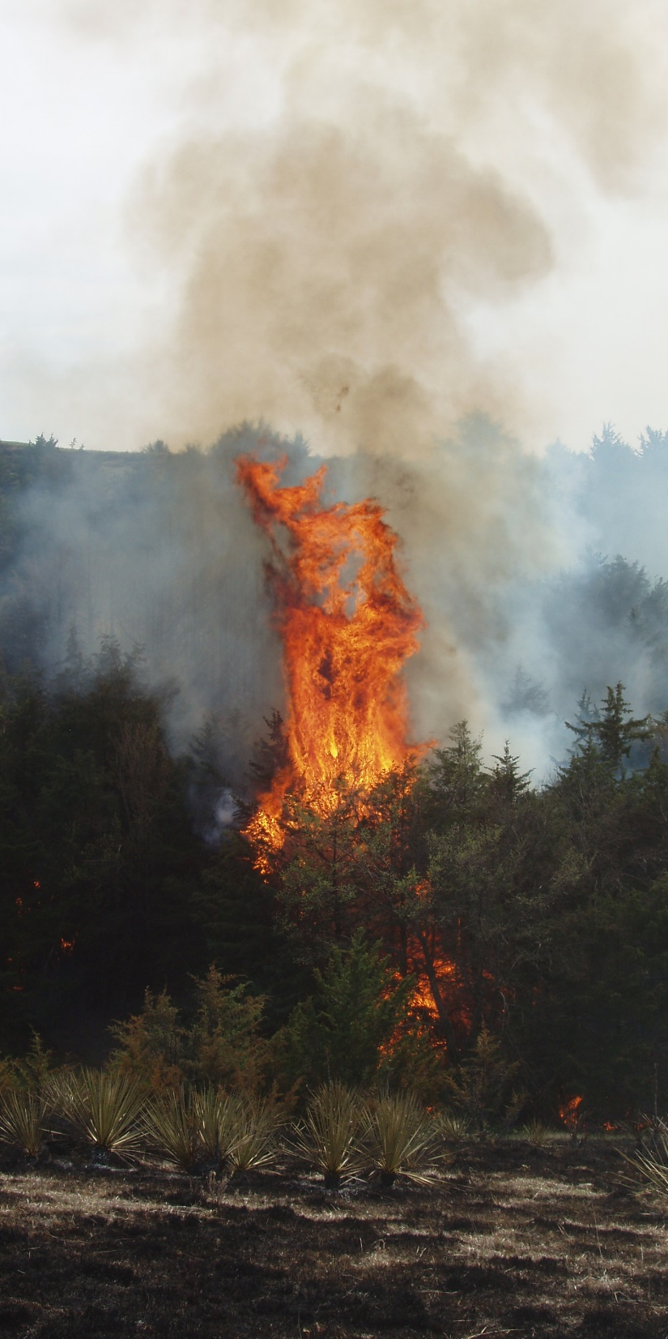
Fire Behavior and Weather
Weather is the atmospheric conditions in a given area. Temperature, wind speed and direction, and moisture must be considered when planning and conducting prescribed burns. Weather influences all three elements of the fire triangle.
Temperature: High temperatures increase evaporation which reduces the amount of moisture in fuel and the amount of energy needed to ignite those fuels.
Relative Humidity: Relative humidity (RH) is the amount of moisture in the air. The lower the RH, the less moisture in the fuels. Low RH can lower fuel moisture within a few hours in small fuels like grasses.
Temperature – RH Relationship: As temperatures increase, RH decreases. Intense fires occur more frequently in mid-afternoon because temperature is at its highest and relative humidity at its lowest.
Wind: Wind is the horizontal movement of air and is the most difficult to predict, most variable, and therefore the most critical element effecting fire behavior. The velocity, direction and gustiness are important wind factors.
Wind:
Increases oxygen supply
Determines fire direction
Influences speed of fire
Increases moisture loss in fuels
Carries sparks and burning embers
Bends vegetation resulting in preheated fuels
Disperses smoke
Photo: Prescribed burn in Lincoln County.

Slide 8
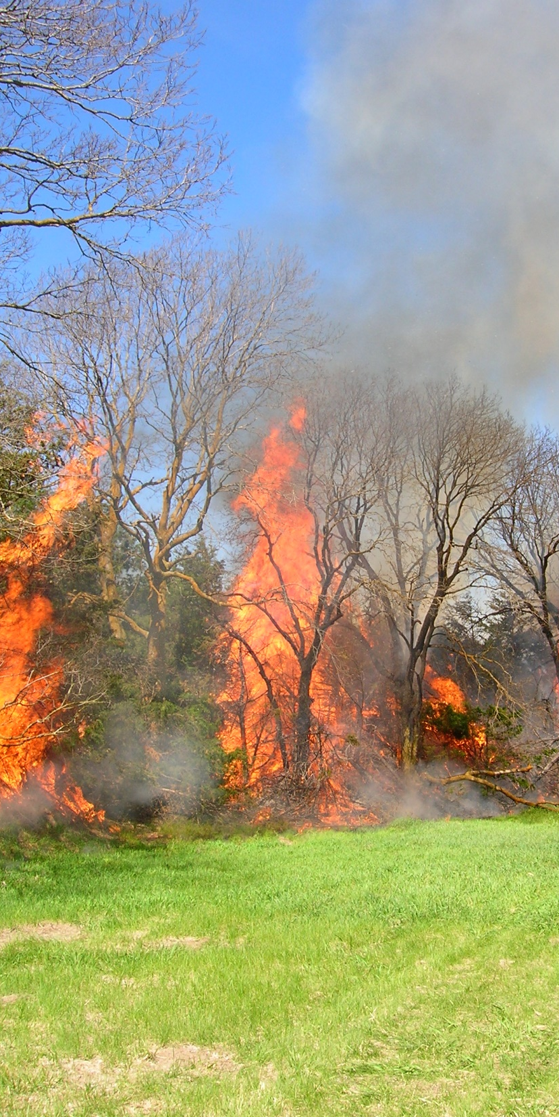
Fire Behavior and Weather - Continued
Precipitation: Precipitation is condensed moisture in the form of rain, snow or fog. Precipitation affects fuel moisture.
Light fuels quickly take in moisture from precipitation and quickly lose the moisture with high temperatures and/or low humidity.
Precipitation events early in the growing season can lead to green, growing vegetation which impacts fuel characteristics.
Atmospheric Stability: Stable atmosphere resists upward motion and limits in-drafts which cause unpredictable and extreme fire behavior. Stable atmosphere is desirable when conducting a prescribed fire.
The Haines Index indicates the dryness and stability of the air on a scale of 2 – 6. A Haines index of 5 or 6 will result in extreme fire behavior.
Photo: Prescribed burn in Lincoln County.

Slide 9
Predicting the Intensity of a Prescribed Fire
Fires will tend to be low intensity when:
Land has little slope.
Slopes have a North aspect.
Fuels are small.
Fuels are live.
Fuel loads are light.
Fuels are patchy.
Fuel moisture is high.
Fires will tend to be high intensity when:
Land is steeply sloping.
Slopes have a South aspect.
Fuels are large.
Fuels are dead.
Fuel loads are heavy.
Fuels are continuous.
Fuel moisture is low
Actual fire behavior will vary depending upon different weather variables.

Slide 10
Pre-burn Preparation - Firebreaks
Firebreaks are features along the burn unit boundaries that make ignition safe. The best firebreaks are created months before the prescribed burn. The burn plan will specify where and what kind of firebreaks are needed. Firebreaks can be permanent or temporary.
Permanent: Natural or man-made boundaries that include rivers and creeks, lakes and ponds, and roads
Temporary: Constructed specifically for conducting the prescribed burn, including:
Bare, mineral soil – Soil that has no vegetation or debris. These firebreaks are created with tillage or other earth movement.
Mowed
Grazed
Crops – Crops that will be green at the time of the burn can be used as firebreaks.
Wet-line – used in combination with another type of firebreak
Black-lines – areas burned before the prescribed burn along the burn unit boundaries
Generally speaking, firebreaks should be 10 times the height of the fuel within the burn unit. All fuel within the firebreak should be removed.
Firebreaks should be installed around items that need protection such as power poles, oil field equipment, buildings and windbreaks.

Slide 11
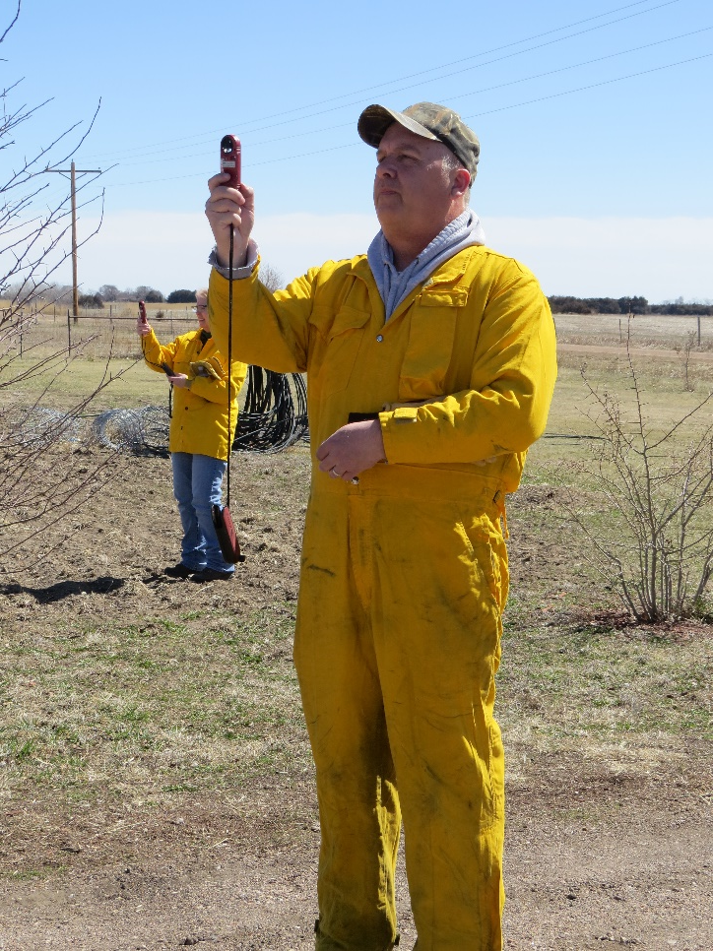
Equipment
The prescribed burn plan will specify the type, size and amount of equipment needed to conduct a prescribed burn. Common equipment used during prescribed burns includes:
Engine or pumper unit: This can be a fire department engine, a pickup with pumper unit (large water tank with equipment to pump out water), or UTVs with pumper unit.
Drip torches to start the fire along the burn unit boundaries,
ATVs equipped with tank and sprayer.
Backpack sprayers
Hand tools such as flappers and rakes
Water tenders which are large water tanks used to refill the pumper units and water tanks.
Radios for all crew members
Weather monitoring device, such as a Kestrel, which electronically monitors temperature, relative humidity, and wind speed and direction.
Fire resistant clothing,preferably Nomex which is a fire-resistant material. If Nomex is not available, clothing should be denim or other 100% cotton material. No synthetic clothing should be worn.
Photo: Burn crew member (wearing Nomex) using Kestrel to determine weather conditions.

Slide 12
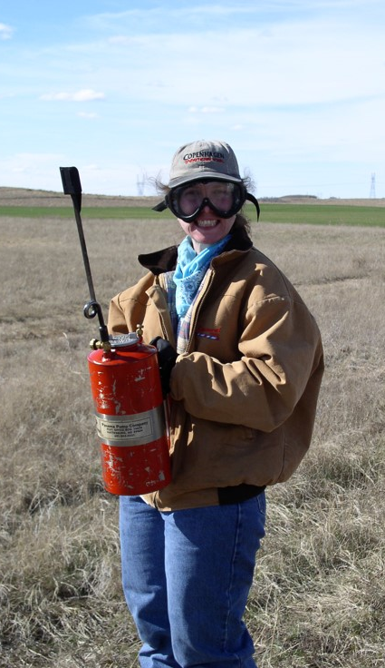
Burn Crew Activities
A safe successful prescribed burn requires a number of people who are assigned to specific jobs. The crew member positions are:
Burn boss – The burn boss is in charge of the prescribed burn. The burn boss needs to be experienced in prescribed burning, familiar with fire behavior, able to communicate effectively, and able to give clear instructions.
Engine driver – The engine driver works with the hose operator and needs to know how to operate the pumper or engine and how to refill the water tank. The engine driver coordinates with the hose operator and ignitor.
Hose operator – The hose operator delivers water to the burn boundary and coordinates with the ignitors and engine driver. Since the engine can be loud, knowledge of hand signals is needed.
Ignitor – The ignitors operate the drip torch. Since the ignition is usually completed on foot, the ignitor must be in good physical shape especially if the burn unit is large.
ATV Patrol – The members of the ATV patrol drive the fire line to make sure that fire does not leave the burn unit boundary.
Hand Crew – The members of the hand crew secure the fire line and keep the fire from crossing the boundary. They follow the ignitor and engine.
Lookout – The lookout watches the burn unit for escapes and hazards to the crew. The lookout also observes the fire behavior and monitors the weather conditions.
Photo: Burn crew member with drip torch.

Slide 13
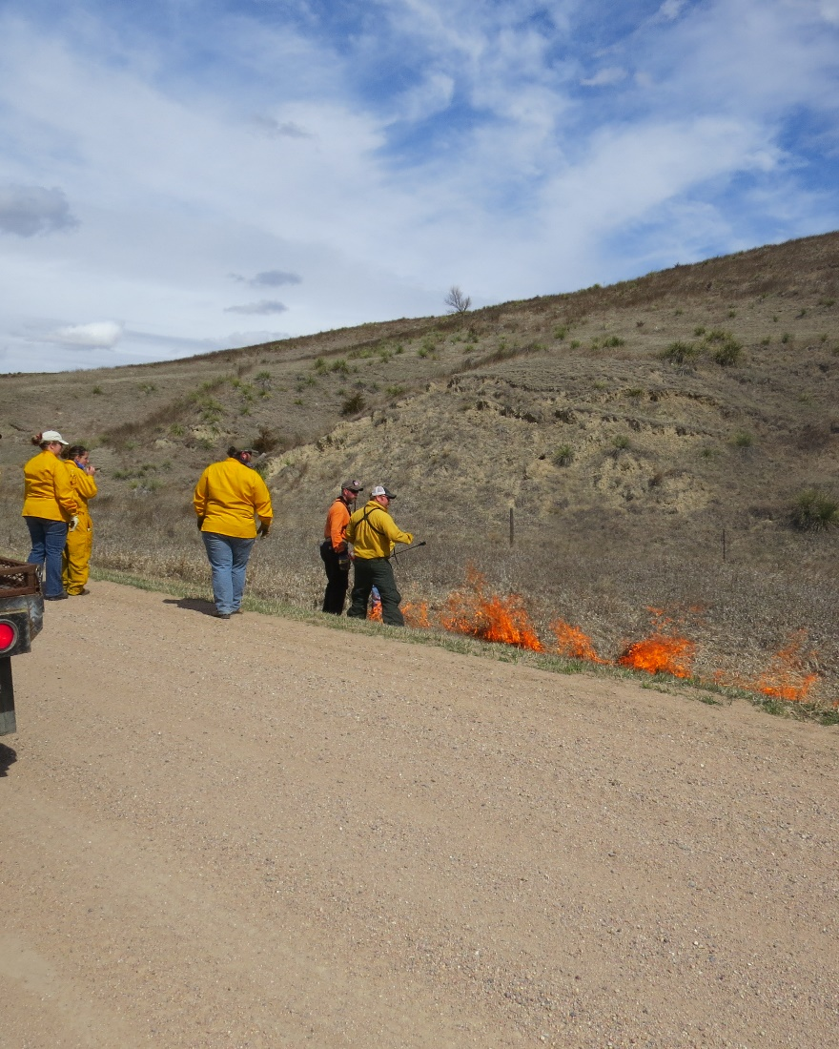
Prescribed Fire Techniques
The prescribed burn plan will describe the prescription for conducting the burn including the safe range of conditions for wind speed and direction, relative humidity, and temperature. It will also identify ignition points, fire spread, and ignition pattern to be implemented.
There are three types of fire spread with prescribed fires in Nebraska. The head fire, backing fire and flanking fire.
The head fire moves with the wind. It moves quickly and exhibits intense fire behavior. The flames bend with the wind and preheat fuels.
A backing fire moves against the wind. It moves slowly and is only intense when there are heavy fuel loads or when moving uphill.
A flanking fire moves perpendicular to the wind. These fires are medium intensity.
Photo: Backing fire along county road during a prescribed burn.

Slide 14
Prescribed Fire Techniques
Ring Fire: In Nebraska, the most common ignition pattern is a ring fire. Backing fire, flanking fire, and head fire are all used in a ring fire. A ring fire uses two ignition teams that begin at the downwind corner of the burn unit and work in opposite directions until they meet at the upwind side of the unit. This technique requires communication so that one team does not get ahead of the other.
https://www.youtube.com/watch?v=S9gYZn1wmMs
https://www.youtube.com/watch?v=lcLnhs4FXvI
Head Fire Strips: Head fire strips are often used with interior ignition. Head fires are lit in strips to speed up the progress of the fire. Several parallel strips are ignited beginning at the down wind side of the burn unit. Each strip is a small head fire that will extinguish when it reaches the burned strip below it.
https://www.youtube.com/watch?v=gPLhXfVqxyk
Flanking Fire Strips: Flanking fire strips are strips of fires similar to head fire strips but the strips are perpendicular to the wind instead of parallel to the wind. This technique is used when fuels within the burn unit are patchy.
https://www.youtube.com/watch?v=9kkxlg065Mo
Interior Ignition using UAVs: The University of Nebraska-Lincoln has developed a system to use drones to complete interior ignition. Watch the following video for footage of the drone lighting interior areas in the Loess Canyons southeast of North Platte.
https://www.youtube.com/watch?v=owiXxnpmMhA

Slide 15
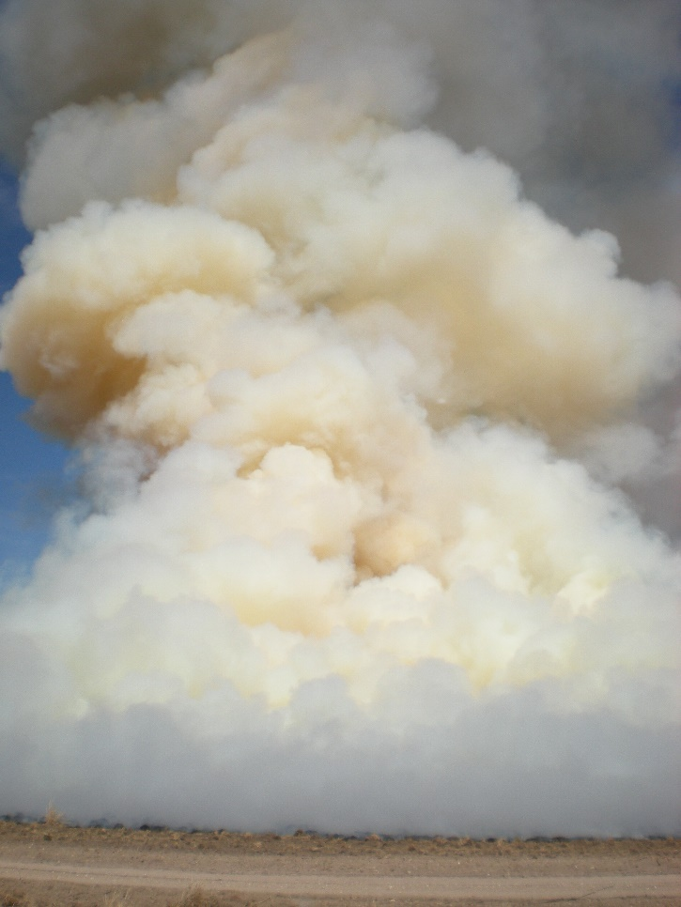
Other Burn Plan Items
Smoke Management: As prescribed burns have become more frequent, smoke management and air quality have become important issues. When smoke decreases air quality in cities and along major highways it can have safety impacts. Prescribed burns need to consider smoke production and dispersal. Smoke can limit visibility and aggravate respiratory health problems. The plan needs to consider downwind features such as heavily traveled roads, cities, homes, feedlots, schools, hospitals, assisted living centers, airports and electric lines.
Contingency Plan: A contingency plan is really a safety plan. This part of the prescribed burn plan outlines what actions will be taken if the burn escapes the burn unit. The lookouts are very important because they are in the position to see escapes first. This part of the plan identifies escape routes which are secure paths for the crew to take to get to safety in case of an emergency. Safety zones are identified in the plans and are locations for the crew members to go to if the fire is heading their way and it can not be stopped.
Mop-up: Many prescribed burns contain dense fuels that can smolder for hours or days after the unit has been burned. The mop-up plan outlines who will monitor the burn unit, for how long and under what conditions flare-ups could occur.
Burn Permit: Nebraska has a permanent burn ban and burning can only occur with permission of the local fire chief in the form of a burn plan. When planning a prescribed burn, it is advisable to visit with the fire chief well in advance so that the chief can review the plan and issue the permit when conditions are favorable for the burn.
Photo: Smoke from prescribed burn as viewed from several miles away.

Slide 16
Activities and Review
Map out a small grassland area near your school on google earth. Identify areas in the area that would need to be protected or that could be hazards if it were burned.
Discuss the benefits to the land from a prescribed burn on the above area.
Prescribed Fire in Nebraska: A Guide for Planning, Preparing and Conducting Your Prescribed Fire (Pheasants Forever publication)
Conducting a Prescribed Burn and Prescribed Burning Checklist – Nebraska Extension Publication – EC121

Slide 17
End of Lesson Eighteen

