Slide 1
Lesson nineteen:
Prescribed Grazing

Slide 2
What is Prescribed Grazing?
Prescribed grazing is a management plan. Prescribed grazing consists of grazing in a way that takes into account production potential, site limitations, plant growth and physiology, and nutritional needs of grazing animals.
With prescribed grazing, the intensity, frequency, timing, and duration of grazing and/or browsing is adjusted to meet the objectives for the plant communities, grazing/browsing animals and other rangeland resources. Animals are managed to allow the grazed plants time to recover and to maintain adequate cover to protect the soils and hydrology of the site.
Recovery time can be provided through deferment and/or rest. Deferment is removing livestock for a portion of the growing season and rest is removal for an entire year or more. Livestock are moved based on how fast plants are growing, how much forage is present, and the target amount of use.
Photo: A patch of heavily used big bluestem in mid-June. Moving livestock to another pasture will allow the plants to recover and stay healthy.

Slide 3
Elements of a Prescribed Grazing Plan
Prescribed grazing is grazing according to a well thought out plan. A prescribed grazing plan consists of the following elements:
Defined Objectives
Resource Inventory
Forage Inventory
Livestock Inventory
Forage-Animal Balance
Grazing Plan
Contingency Plan
Monitoring Plan
Photo: Matching livestock intake to the amount of production and desired degree of use is an important part of a prescribed grazing plan.

Slide 4
Prescribed Grazing Plan: Objectives and Goals
Objectives and goals for a specific grazing unit vary from ranch to ranch. Private landowners may have different types of goals for their land than public land managers.
Some common goals for rangeland are :
Improve the health and vigor of plant communities
Improve forage quantity and/or quality
More even grazing distribution
Improved water quality and quantity
Increased livestock production
Improved Riparian and watershed function
Reduced erosion
Improved wildlife food and cover or patchier distribution
Photo: Big bluestem with high health and vigor.

Slide 5
Prescribed Grazing Plan: Objectives
Objectives and goals should be SMART: specific, measurable, attainable, reasonable, and timely.
Examples of SMART goals:
Improve the production of my rangeland by increasing the amount of big bluestem, Indiangrass, and other grasses that livestock prefer by 500#/acre to 2000 #/ac and reducing the amount of sand and tall dropseed by 2025. This will be accomplished by implementing a rest rotation system, allowing 1 full year of rest for each pasture every 4th year.
Reduce the amount of cheatgrass present on my rangeland by 75% and increase the amount of native cool season grass by 25% and native warm season grasses by 30% over the next 5 years. This will be accomplished by beginning the grazing season 3 weeks earlier and heavily grazing the cheatgrass and then moving to the next pasture.
Increase the amount of forbs by 50% by implementing prescribed burn rotation so 25-35% of each pasture is burned every year.
Photo: Cheatgrass invaded rangeland. A goal to reduce the amount by 75% may not be achievable unless chemical control of the cheatgrass is included in the plan.

Slide 6
Prescribed Grazing Plan: Resource Inventory
A resource inventory is completed in the field and is a description of the natural resources and resource issues present on the landscape. The resource inventory includes:
The ecological sites present and the plant communities in the sites
Areas with erosion (blowouts, gullies, trailing, streambank erosion), water quality issues, invasive plants, and other resource problems.
Opportunities to improve resource conditions
Location and conditions of fences, water developments, and/or windbreaks.
Location of streams, lakes and ponds.
Areas that are overused and underused (uneven grazing distribution)
The resource inventory uses a variety of assessments to evaluate the natural resources on the ranch. The rangeland health assessment (see Lesson 12) is one of the primary resource assessments for rangeland.
Photo: Blowout in sandhills. Areas that are actively eroding should be identified in a resource inventory.

Slide 7
Prescribed Grazing Plan: Forage Inventory
A forage inventory is a listing of the expected forage and species composition in each grazing unit. The forage inventory estimates the number of Animal Unit Months (AUM) or Animal Unit Days (AUD) expected to be produced in each grazing unit. This estimate is usually based on average annual production for each ecological site. See Lesson 17 for definitions of AUMs. An example forage inventory is shown below.
Pasture6 | Acres | Eco-Site | Plant Community | Est. Prod. | AUM / acre | Site Acres | Site AUMs | AUM for pasture
R-1 | 160 | Sands | Sand Blue-Sandreed | 2100 | 0.70 | 60 | 42 | 77
 |  | Sands | Blue Grama-Sagebrush | 1000 | 0.35 | 100 | 35
R-2 | 160 | Sandy | Sandreed – Sand Blue | 1950 | 0.65 | 160 | 104 | 104
R3 | 75 | Sandy Lowland | Big Blue – Indian – Switch | 4500 | 1.48 | 75 | 111 | 111
R4 | 120 | Loamy Upland | Western – Blue Grama | 1800 | 0.60 | 50 | 30 | 69
 |  | Limy Upland | Little Blue – Gramas | 1650 | 0.55 | 70 | 39
Total for Unit |  |  |  |  |  |  |  | 361

Slide 8
Prescribed Grazing Plan: Animal Inventory
The animal inventory includes the number of grazing/browsing animals, their size, physiological status, and the amount of forage needed to support them.
Type of Animal | Number | Average Weight | AU | Time On Unit | AUMs Forage Needed
Cows | 40 | 1250 | 1.25 | 6 | 300
Bulls | 2 | 2000 | 2.0 | 3 | 12
Calves > 3 mo old | 40 |  | 0.25 | 5 | 50
Deer | 25 | 150 | 0.15 | 12 | 45
Total amount of forage needed in Animal Unit Months: |  |  |  |  | 407

Slide 9
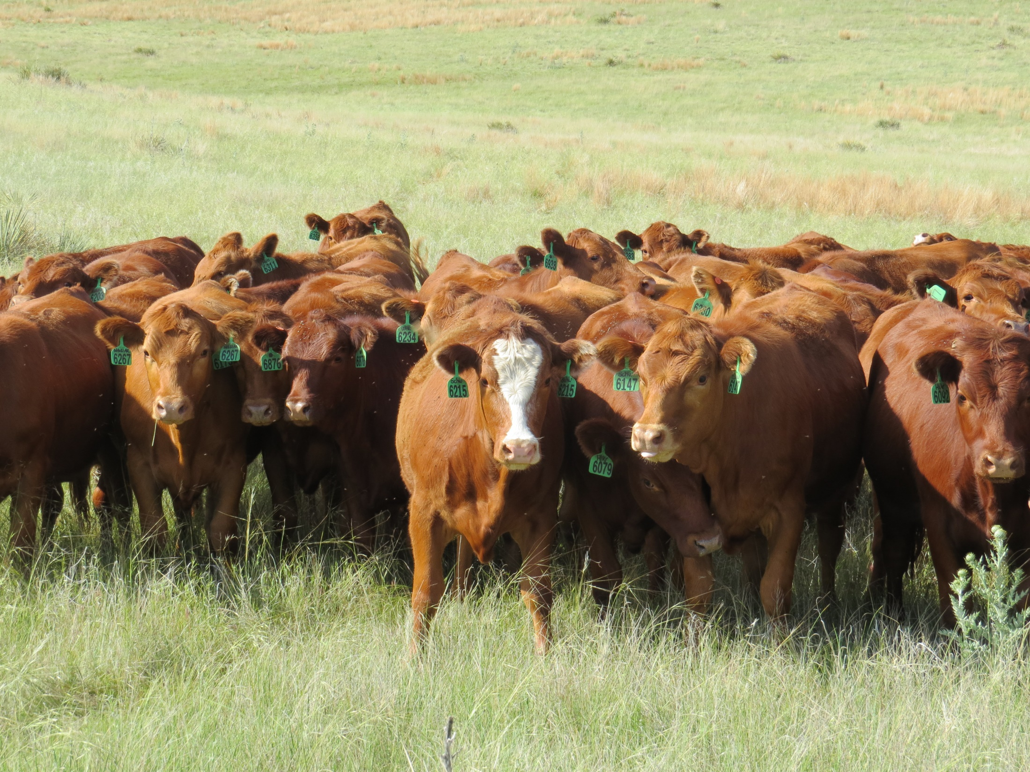
Prescribed Grazing Plan: Forage-Animal Balance
The forage inventory and animal inventory are compared to determine if the number of animals can be supported while staying within the planned degree of use of the plants. In our example, the pastures produced 361 AUM of forage. The animals present on the unit will consume 407 AUM of forage. Our balance is -46. The demand is approximately 13% higher than supply.
To balance the forage and animal demand, the manager has several options: reduce the number of livestock, reduce the time that the livestock are in the pasture, incorporate seeded annual forages for grazing on cropland on the ranch, or provide supplemental forage such as hay.

Slide 10
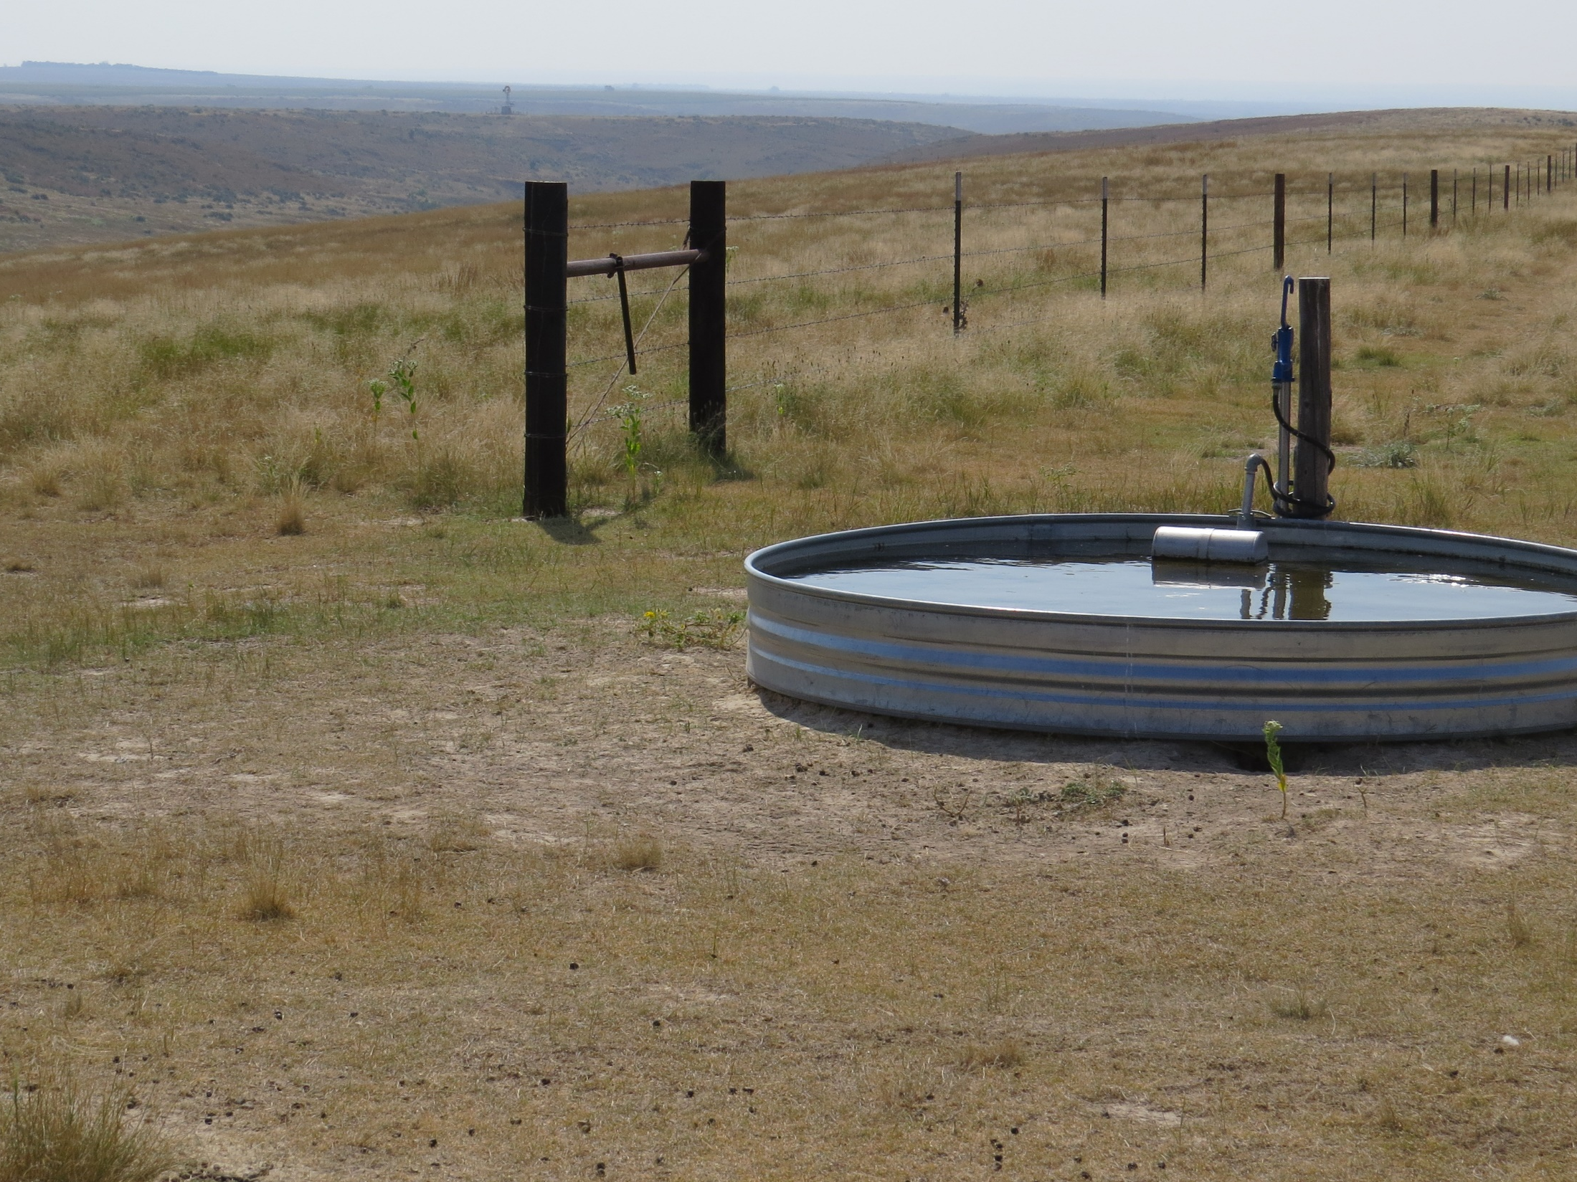
Prescribed Grazing Plan: Grazing Schedule or Grazing System
The grazing schedule is sometimes called a grazing system. The grazing schedule identifies how many pastures are in the grazing system, when each pasture will be grazed and/or browsed, when the pasture will be deferred and/or rested and when any other management activities will occur.
A good grazing system will:
Take into account plant physiology and life history
Be suited to the kinds of plants present in the grazing unit
Be adapted to ecological site and soil conditions
Will improve the health, vigor and production of the favored plants
Will not be detrimental to animal gains
Will be practical to implement in the ranching operation
Will be adaptive or modified throughout the grazing season based on current weather conditions and plant growth.
The actual amount of time in each pasture is not based on the calendar or estimated number of days. Moves are based on plant growth, re-growth and current conditions.

Slide 11
Prescribed Grazing Plan: Time per Pasture
An important part of a grazing system is estimating the amount of forage in each pasture and the number of days that each pasture can support the livestock herd.
For example:
The forage inventory in AUMs for the example grazing unit in slide 7 is 361 AUMs. The number of days per pasture can be determined by calculating the percentage of AUMs of forage available in each pasture and converting that to number of days per pasture. If the grazing season is May 1 – October 31 (6 months or 180 days) the number of days per pasture can be calculated in the following way:
# Days per pasture
Pasture #1 AUM/pasture % of total forage (estimated & rounded)
R1 77 (77/361)*100 = 21% 180*(21/100)=38 days
R2 104 (104/361)*100=29% 180*(29/100)=52 days
R3 111 (111/361)*100=31% 180*(31/100)=56 days
R4 69 (69/361)*100=19% 180*(19/100)=34 days
The number of days per pasture are estimates for planning purposes. Moves should be based on the actual growing conditions.

Slide 12
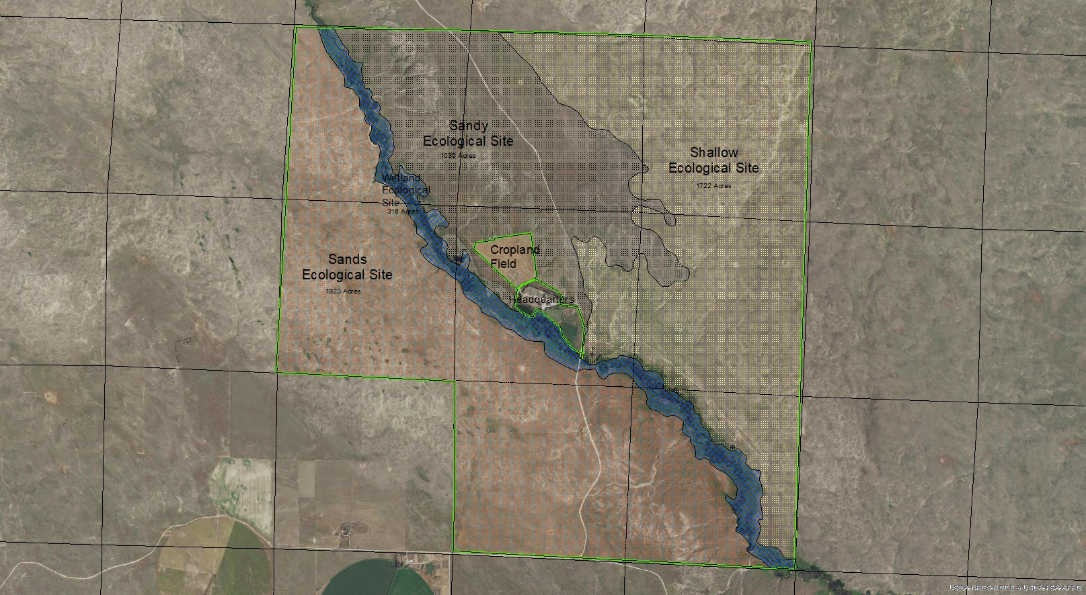
Prescribed Grazing Plan: Grazing Schedule or Grazing System – Example Ranch
This is a map of an example ranch. The ranch includes 4990 acres of rangeland, 45 acres of cropland and 47 acres of headquarters and lots.
A stream flows through the property and the ecological site along the stream is wetland. The other ecological sites on the property are Shallow, Sandy, and Sands.
The stream is currently the only water source and the riparian area has been severely overgrazed.
Grazing distribution is very uneven. The areas with less steep topography and along the stream are areas where the livestock concentrate.
Let’s look at some types of grazing systems that could be implemented on the ranch

Slide 13
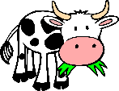
Prescribed Grazing Plan: Continuous Grazing
The current grazing strategy for the ranch is continuous grazing. In continuous grazing, the livestock graze the entire grazing unit all year. With the similar continuous- season long grazing, pastures are grazed from spring until the end of the growing season. The consequences of continuous grazing and/or continuous, season long grazing are:
Preferred plants are grazed multiple times with inadequate time to recover between grazing events.
Preferred plants decline in health, vigor, and productivity. Less preferred plants increase in abundance.
The nutritional quality of grasses selected is relatively high because much of the forage eaten is new re-growth.
If properly stocked, livestock distribution is not uniform; preferred areas are overgrazed and less preferred areas are under or ungrazed.
Patchy grazing provides variable structure for wildlife habitat especially for grassland birds.
Grazing distribution can be improved and grazing pressure removed from riparian areas by installing watering facilities (wells, pipelines, tanks).

Slide 14
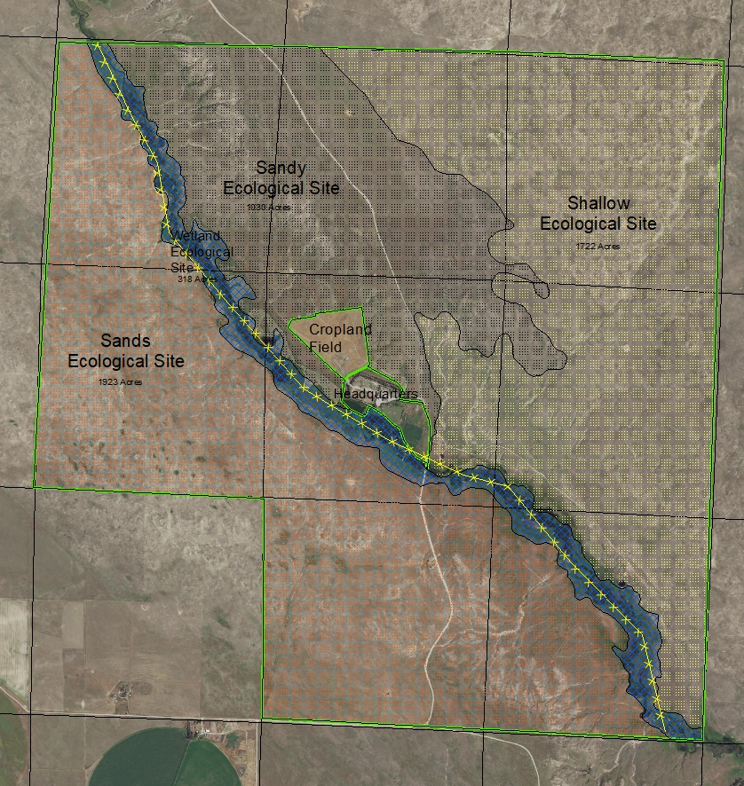
Prescribed Grazing Plan: Seasonal Rotation
In a seasonal rotation, the rangeland is divided into at least two pastures (yellow line represents the cross-fence).
One pasture is grazed during the growing season and the other is grazed during the dormant growing season. The consequences of this type of grazing strategy are similar to continuous grazing except:
The warm season grasses in the winter grazed pasture are more healthy, robust and productive.
Livestock distribution is somewhat more even than with continuous, year round grazing.

Slide 15
Prescribed Grazing Plan: Rest Rotation
In a rest rotation, the grazing unit is usually divided into at least 4 pastures. A different pasture is rested (not grazed for at least 12 months) each year. Stocking rates remain the same as in continuous grazing.
The results from this grazing system are:
Each pasture is rested once every four years giving each pasture a full year of recovery.
The animals are divided into 3 herds instead of one herd allowing different animal management.
Grazing distribution is more uniform.
Rested pasture provides taller, denser cover for wildlife.
When weather conditions are average, the grazed pastures are overgrazed by about 30%.
If livestock numbers are reduced as appropriate for the 3 grazed pastures, then overgrazing does not occur.
Rested
Year 1: Rest Rotation

Slide 16
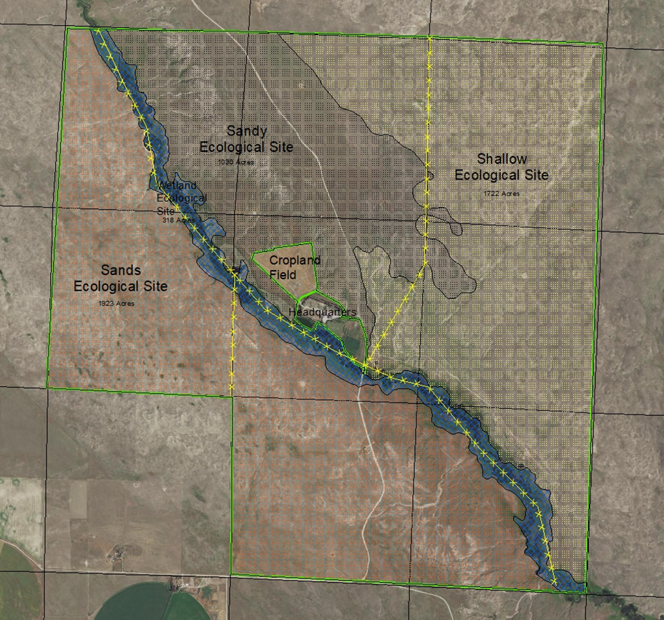
Prescribed Grazing Plan: Rest Rotation
Rested
Year 3 Rest Rotation
Year 2 Rest Rotation
Rested
In year 4, the east pasture will be rested and then the rotation begins again.

Slide 17
Prescribed Grazing Plan: Deferred Rotation
In a deferred rotation, the grazing unit is divided into several pastures. Each pasture is grazed for a portion of the grazing season. The timeframe during the grazing season that each individual pasture is grazed varies from year to year. In areas with higher rainfall, the pastures are grazed two times during the grazing season.
In most situations, additional water will be needed to implement the rotation.
When appropriate stocking rates are implemented, this type of grazing system results in:
Better grazing distribution.
Grazed grasses have more time to recover.
Improved productivity, health, and vigor of plants.
Increased stock density.
More efficient herd management.
Higher costs for water and fencing.
See following slides for an example of deferred rotation plan.

Slide 18
Prescribed Grazing Plan: Deferred Rotation-Year 1
Pasture #2
Pasture #1
Year 1 Rotation:
Pasture 2: May 15 – June 20
Pasture 1: June 21 – July 31
Pasture #4: Aug. 1 – Sept. 30
Pasture #3: Oct. 1 – Oct. 31
Pasture #4
Pasture #3

Slide 19
Prescribed Grazing Plan: Deferred Rotation-Year 2
Pasture #2
Pasture #1
Year 2 Rotation:
Pasture #4: May 15 – July 15
Pasture #3: July 16 – August 15
Pasture #2: August 16 – Sept. 20
Pasture #1: Sept. 20-October 31
Pasture #4
Pasture #3

Slide 20
Prescribed Grazing Plan: Deferred Rotation-Year 3
Pasture #2
Pasture #1
Year 3 Rotation:
Pasture #3: May 15 – June 15
Pasture #4: June 16 – August 15
Pasture #1: August 16 – Sept. 26
Pasture #2: Sept. 27 – Oct. 31
Pasture #4
Pasture #3

Slide 21
Prescribed Grazing Plan: Deferred Rotation-Year 4
Pasture #2
Pasture #1
Year 4 Rotation:
Pasture #1: May 15 – June 25
Pasture #2: June 26 – August 30
Pasture #3: August 31 – Sept. 30
Pasture #4: Oct 1– Oct. 31
Pasture #4
Pasture #3

Slide 22
Prescribed Grazing Plan: Intense Rotation
This rotation is a variation of the deferred rotation and goes by several different names: high intensity-low frequency, short duration grazing, and management intensive grazing. There are more pastures than with a deferred rotation and grazing periods are short. Fencing along ecological site boundaries, rather than along section or quarter section lines, is common. Costs for fencing and water development are high unless portable fencing is used.
The intensity level for this type of system varies significantly from operation to operation. In an intense rotation, the livestock may be moved every two weeks. In a more intense rotation, the moves will be every week and moves in a very intense rotation can be every 1-3 days.
When appropriate stocking rates are implemented, this type of grazing system results in:
Uniform grazing distribution.
Very long deferment period.
Long recovery time for grasses.
Less selectivity by livestock; grasses are grazed that wouldn’t be in other systems.
Increased stock density.
More efficient herd management.
More time spent managing grazing.
Greater potential for overgrazing individual pastures because not moving at the right time by 1-2 days can lead to significant overgrazing.
More flexibility in when each pasture is grazed..
See following slides for an example of intense rotation plan.

Slide 23
Prescribed Grazing Plan: Intense Rotation
In this example, the rotation includes 27 pastures of varying sizes.
If the grazing season is 6 months, the average time in each pasture is 6 ½ days. Each pasture is deferred for approximately 96% of the grazing season.
Cost for water development is significant. To support the number of water locations either numerous wells or a pipeline is necessary.

Slide 24
Prescribed Grazing Plan: Patch-Burn Grazing
With patch-burn grazing, a portion of the unit is burned each year. Livestock are given access to the entire grazing unit. Grasses in the burned areas are more palatable and attract livestock. Livestock spend most of their time (up to 75%) in the most recently burned areas.
A different portion of the pasture is burned each year based on the desired fire return interval. In tall grass prairie, one-third to one-fourth of the pasture is burned each year. In mid- and short-grass prairies, the amount of the pasture burned each year is less and the time between re-burning is longer.
The grassland will have a patchy appearance with a varied habitat structure. Research shows that this type of management improves plant diversity (especially forb diversity), wildlife habitat, and insect (especially pollinating insect) diversity. Animal performance is maintained with this type of strategy.
See Patch-Burn Grazing for Biological Diversity by Chris Helzer, TNC-Nebraska for more information about this type of grazing strategy.
See following slides for an example of patch-burn grazing.

Slide 25
Prescribed Grazing Plan: Patch-Burn Grazing – Year 1

Slide 26
Prescribed Grazing Plan: Patch-Burn Grazing – Year 2
In the 2nd year, livestock spend more time in the areas burned in year 2, less time in the areas burned in year 1 and little time in the unburned areas. In the 3rd year, most time will be in the areas burned in year 3, less in areas burned in year 2, little time in areas burned in year 1 and almost no time in unburned areas.

Slide 27
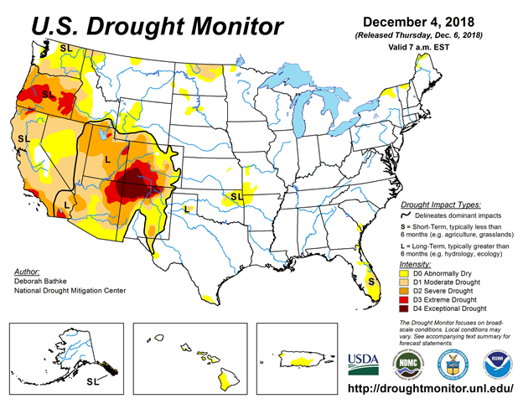
Prescribed Grazing Plan: Contingency Plan
A contingency plan details potential problems that could decrease the amount of forage available in a given year and outlines the actions that will be taken when those problems occur. A good contingency plan is a guide for adjusting the grazing prescription. It ensures that the resource is not degraded and that the actions taken are economically feasible.
Contingency plans are usually focused on actions to take during drought. When forage production is significantly reduced by flooding, hail, wildfire and/or insects, the contingency plan should be implemented. A good contingency plan lists actions that the rancher will take when different levels of forage reduction occur.
The National Drought Mitigation Center has brought together information for ranchers to help them develop an effective contingency plan. The Center’s website has examples of plans from ranchers.

Slide 28
Prescribed Grazing Plan: Monitoring Plan
A monitoring plan is used to determine if objectives and goals are being met and to assess if the grazing prescription is producing the planned results. A monitoring plan uses techniques that measure the trend in the rangeland resource. The rancher makes adjustments to the prescribed grazing plan when progress is not being made.
Monitoring methods may be qualitative or quantitative. Monitoring methods measure the status of resource concerns identified in the grazing plan and the status of the rangeland health indicators.
There are a number of monitoring tools available to measure progress. The key to a good monitoring program is to identify the appropriate method to measure progress toward objectives and progress toward addressing resource concerns.
See Lesson 20 for a discussion of different monitoring methods.
Photo: Monitoring along a transect set up to measure drought recovery. Percent cover from living plants, percent over from litter, and percent bare ground are being measured.

Slide 29
Activities and References
Activities
References
Map out a grassland area near your school or use google maps to map an area. What are potential resource concerns?
What type of grazing system could be used on the property?
What type of water development and fencing would need to be implemented before that grazing system could be implemented?
https://globalrangelands.org/topics/uses-range-and-pasture-lands/grazing-systems
http://fireecology.okstate.edu/patch-burning/what-is-patch-burning
https://drought.unl.edu/ranchplan/BeforeDrought/GrazingStrategy/RotationGrazing.aspx
https://drought.unl.edu/ranchplan/DroughtBasics.aspx
https://drought.unl.edu/archive/Documents/RanchPlan/ranch-plan-handbook-to-print-9.14.pdf

Slide 30
End of Lesson nineteen

